Slide 1
Scratch Yellow Pages
Presented at OAME Conference
May 2021
Notes:
Elizabeth Pearsall pearsallelizabeth7@gmail.com

Slide 2
Notes:
Image https://en.scratch-wiki.info/wiki/File:Logo.png#filelinks https://en.scratch-wiki.info/wiki/Scratch_Media

Slide 3
What is Scratch?
“Scratch is a free tool for exploring computational creativity by programming interactive media (like stories, games, animations, and simulations) and sharing those creations with others online, used by millions of people all around the world.”
http://scratch.mit.edu
Notes:
Source: https://www.facebook.com/groups/TeachingwithScratch/about

Slide 4
In this slide deck you will find information on how to learn to code with Scratch and how to use it with your students.
There are links to various Scratch MIT and Harvard Education websites; suggests of books to use to learn to code; YouTube channels to watch videos to learn to code; Facebook and Twitter accounts to reach out to others about Scratch coding; and ways to virtually reach out to other teachers and their students through Scratch.
You can move back and forth through the deck with links in the Table of Contents and in Subsection Title Cards. Screenshots are not active, Links are.

Slide 5
Table of Contents
How to Get Started: Multilingual Scratch (Slide 8)
How to Get Started: Scratch Accounts (Slide 15)
How to Get Started: Make a Project (Slide 39)
The Role of a Classroom Teacher for Coding (Slide 72)
Educators connecting with the World & Scratch: GU, LCL, CCC (Slide 83)
Students connecting with the World & Scratch: Scratch Pals, Scratch Camp (Slide 88)

Slide 6
TofC - continued
Scratch Through the Year (Slide 98)
Finding Help: People! (Slide 115)
Finding Help: Lesson Plans (Slide 126)
Finding Help: Videos (Slide 137)
Finding Help: Scratch Wiki & Books (Slide 143)
Finding Help: Blogs & Twitter (Slide 161)

Slide 8
How to Get Started: Multilingual Scratch
TofC Back

Slide 9
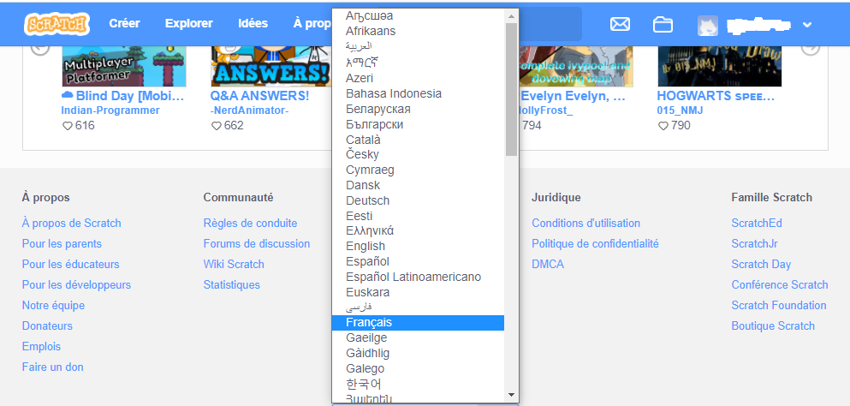
Scroll down any Scratch website pages and click on the English button for a dropdown menu and select the language you want to use.
Here is one way...
Notes:
https://en.scratch-wiki.info/wiki/Scratch_in_Many_Languages

Slide 10
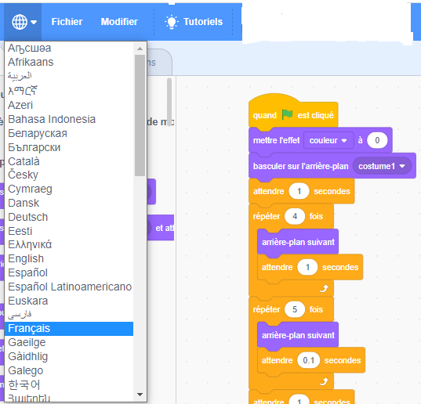
From See Inside screen, pick a language and the blocks will appear in that language.

Slide 11
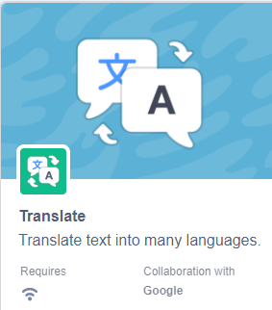
Scratch has the ability to add blocks for Google Translate to include in your projects. With the SEE INSIDE screen, Click on the Block Extension button and then in the CHOOSE AN EXTENSION screen click on Translate
Notes:
Information from Scratch Wiki regarding language
https://en.scratch-wiki.info/wiki/Scratch_in_Many_Languages

Slide 12
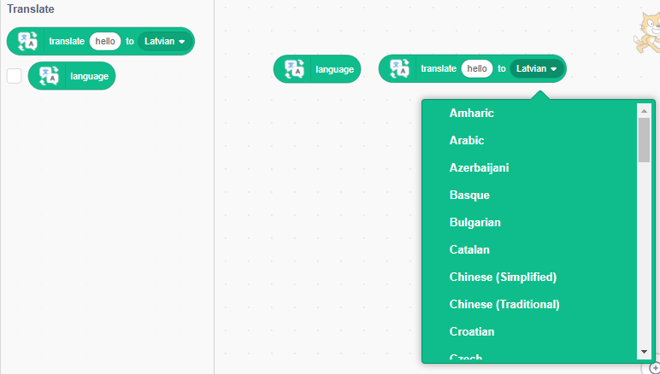

Slide 13
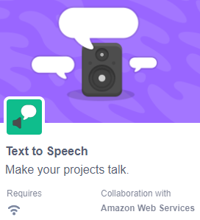
Add Text to Speech blocks and Sprites will translate and say the text you want.

Slide 15
How to Get Started:
Scratch Accounts
TofC Back

Slide 16
Here are some questions you might have about Scratch:
Can I meet all the coding expectations from the Math 2020 curriculum with Scratch?
Yes, most definitely.
Which grade should students start using Scratch?
Probably Grade 4 would be an ideal time. Before then, ScratchJr is great.

Slide 17
Once a student codes something, is it saved so they can see it again?
It is best if each student has an account, either as part of a Teacher account or their own account.
What are the things I should take into consideration to decide between my students having their own account or having them in a class in my teacher account?
First of all, you need to follow your school board and school protocols.
...

Slide 18
Second, consider the age of your students and their ability to handle emails, follow instructions to create their own account, and remembering a password. All these elements go into having their own account. Also, they need to understand how to keep their personal information safe, especially on the internet.
If your students make their own accounts, you should consider keeping a record of their Account Username and Password in case they forget either one!

Slide 19
So what are the advantages of having a Teacher Account?
As a teacher you have an easy access to your student accounts from your teacher account; you can reset their passwords; you can create Studios for students to add projects, and you are alerted to actions contrary to Scratch Community Guidelines.
See for further information
https://scratch.mit.edu/privacy_policy

Slide 20
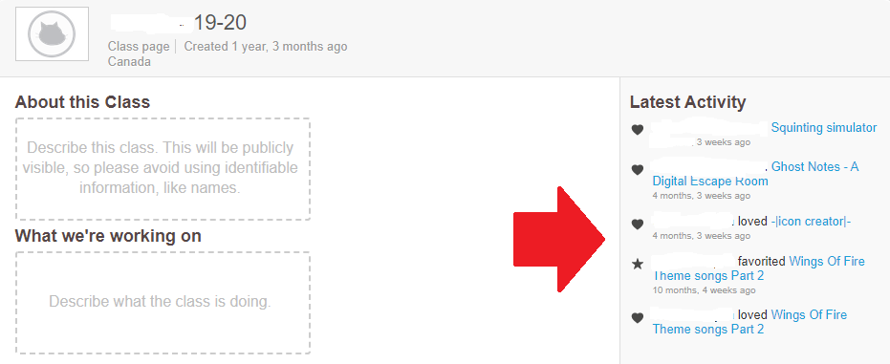
See what other projects your students are viewing and their projects they are sharing

Slide 21
Create a Studio for students to add their project and then it is easy access for you and their classmates to see the work.

Slide 22
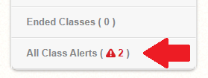
Get Alerts from Scratch for inappropriate actions.

Slide 23
Links to all your Students’ accounts in one place.

Slide 24
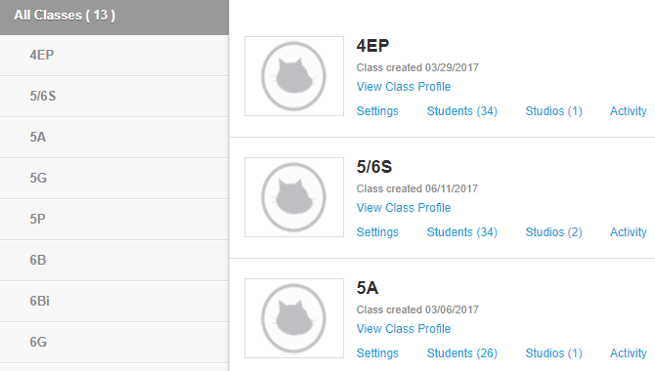
A Teacher Account can have multiple classes

Slide 25
How do I get a Teacher Account?
Here are the links:
https://scratch.mit.edu/educators/
https://scratch.mit.edu/educators/#teacher-accounts
Information regarding Accounts:
https://scratch.mit.edu/educators/faq
https://scratch.mit.edu/educators/faq#student-accounts
https://scratch.mit.edu/educators/faq#community
SetUp Guide:
https://resources.scratch.mit.edu/www/guides/en/scratch-teacher-accounts-guide.pdf
Notes:
https://scratch.mit.edu/educators/faq https://scratch.mit.edu/educators/faq#student-accounts https://scratch.mit.edu/educators/faq#community https://scratch.mit.edu/educators/#teacher-accounts https://scratch.mit.edu/educators/ https://resources.scratch.mit.edu/www/guides/en/scratch-teacher-accounts-guide.pdf

Slide 26
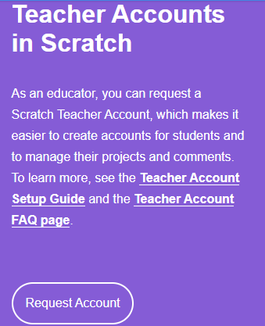
Notes:
Screenshot from https://scratch.mit.edu/educators/

Slide 27
If you have students who would be uncomfortable working on the Internet, can they still code with Scratch?
Yes, Scratch offers a Downloadable version.
https://scratch.mit.edu/download
Notes:
https://scratch.mit.edu/download

Slide 28
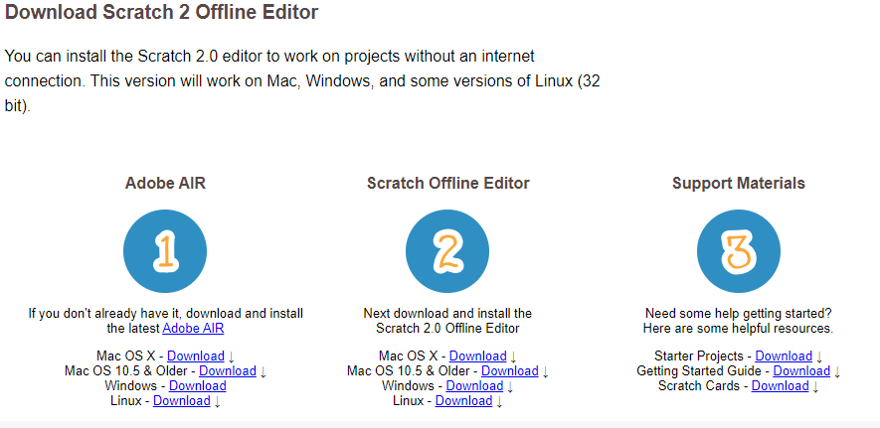
https://download.scratch.mit.edu/scratch2download/
Notes:
https://download.scratch.mit.edu/scratch2download/

Slide 29
If you or your students are hesitant about signing up you can still try it out, however you will not be able to save it in a Scratch Account.
Click on Start Creating and you will be directed to the Scratch interface. Watch a short introductory tutorial and away you go!
Notes:
https://scratch.mit.edu/projects/editor/?tutorial=getStarted

Slide 30
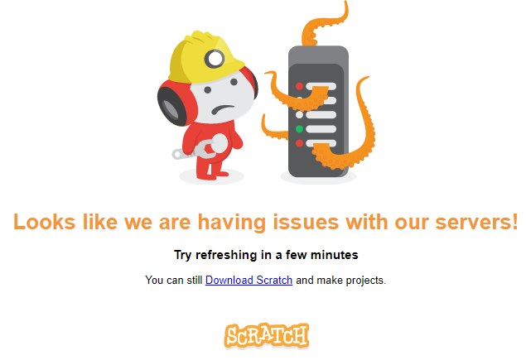
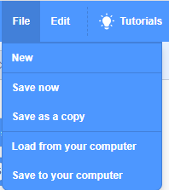
Sometimes Scratch servers are offline due to heavy use. If that happens, you and your students can download the offline version and continue to work. The files can be saved to your computer and uploaded to the online version later.

Slide 31
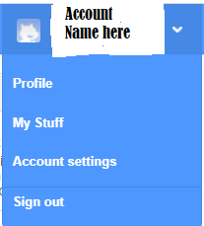
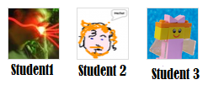
If you have your students make their own accounts you can still view their SHARED projects. You can FOLLOW each of your students. Go to your Account Name and click on Profile.

Slide 32
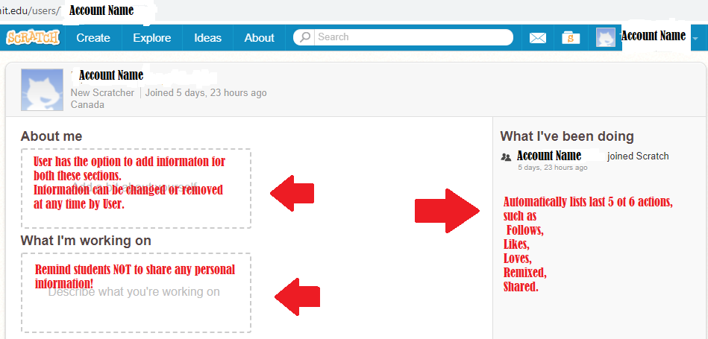
Top of User Profile screen, next slide bottom of Profile

Slide 33
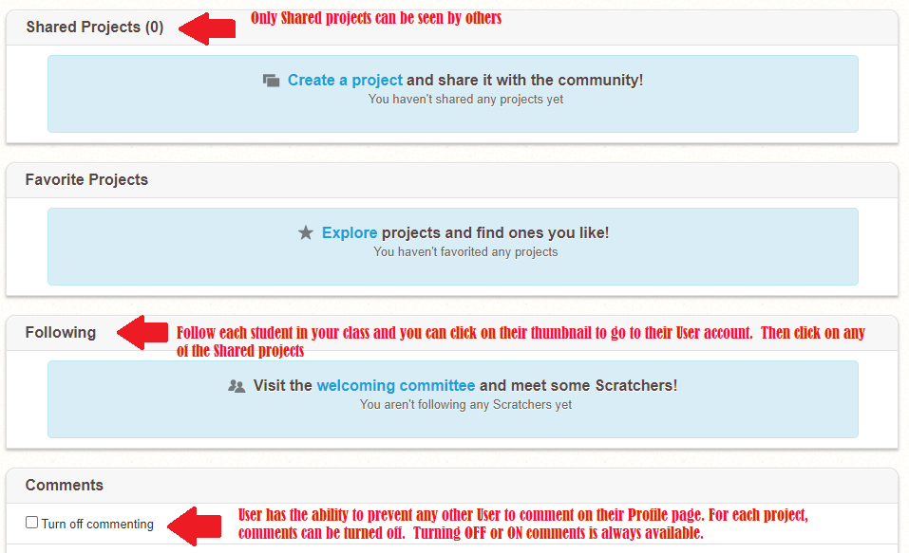

Slide 34
You can add your students to this section.
Type in their user name in the Search window.
Or add the user name to these address
https://scratch.mit.edu/users/STUDENT USER NAME

Slide 35
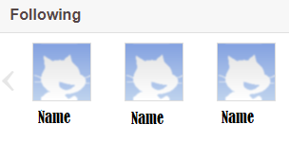
Once at their page, click on ...
You will then be able to click on a student’s thumbnail and go to their account.

Slide 36
As you and your students learn to navigate in Scratch you will notice 3 types of accounts by their addresses.
Each User has an account with a ‘name’ they have created.
Once a User Account has been created, that ‘name’ is no longer available.
https://scratch.mit.edu/users/ACCOUNTNAME/
Each project has a number. Now they are in the 500 millions
https://scratch.mit.edu/projects/531…/
Studios with groups of projects has fewer digits
https://scratch.mit.edu/studios/276.../

Slide 37
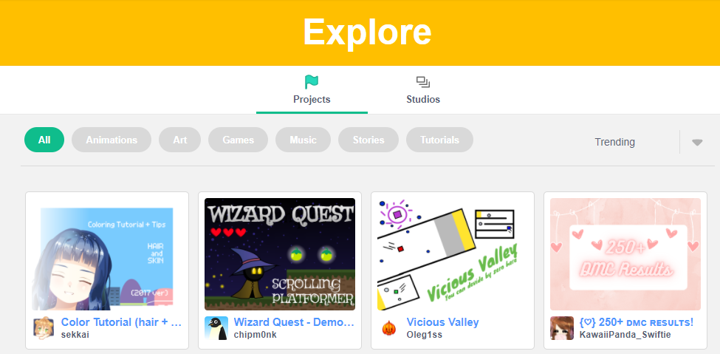
Your students might find it overwhelming to Explore Scratch projects.
There are literally millions of projects and the level of coding in them ranges from basic to complex.
I suggest you direct them to the places you want them to see at the beginning. As you will see in the next set of slides, visiting Tutorials and Starter Projects is the best place to begin.
https://scratch.mit.edu/explore/projects/all/
Notes:
https://scratch.mit.edu/explore/projects/all/

Slide 39
How to Get Started: Make a Project
TofC Back

Slide 40
In this sections are 3 of the resources included within https://scratch.mit.edu that are just a click away with you are creating a project. Tutorials, Cards & Guides, and Starter projects Working through them yourself will give you a solid understanding of Scratch basics.
Start with Tutorials and then move to Starter projects.
There is overlap and review of concepts within them.
Tutorials show the steps and the user creates the project. Starter projects have the coding blocks already. This gives you a chance to see coding and begin to understand how to ‘read’ the stack and predict how the actions unfold.

Slide 41
Starter projects involve REMIXING which is a foundational principle of Scratch - We learn from each other.
A remixed project is not cheating but a way of learning.
A remixed project will acknowledge the original creator, which follows the Creative Commons.
“The Creative Commons Attribution-ShareAlike 2.0 license is the license under which Scratch projects are all published. In other words, this means that anyone can remix and edit anybody else's published projects without penalty. By publishing a Scratch project on the Scratch website, the user automatically agrees to the terms of the Creative Commons License”
Notes:
https://en.scratch-wiki.info/wiki/Creative_Commons_License

Slide 42
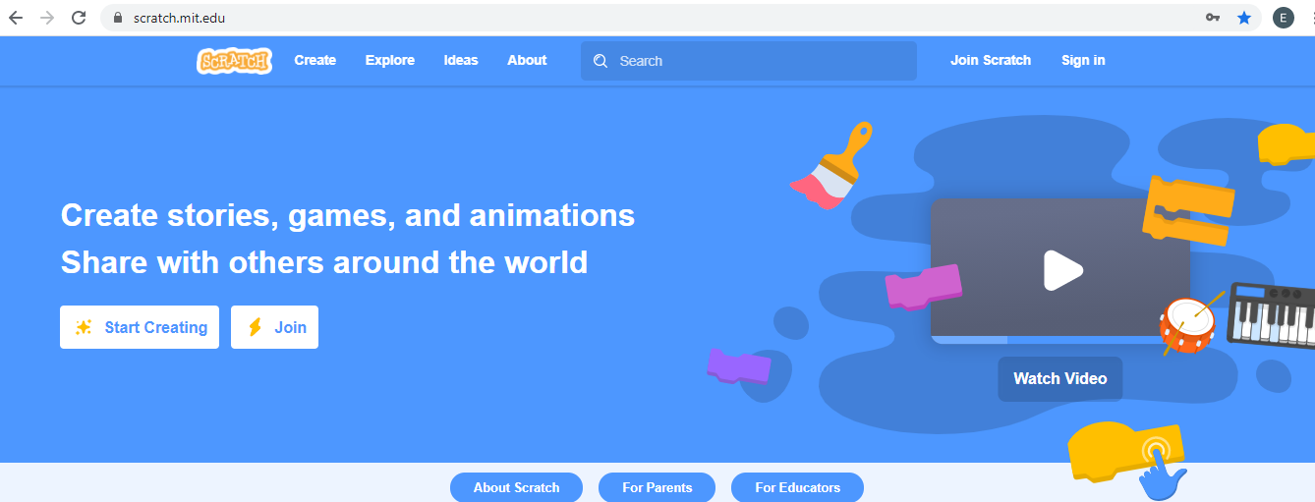
If you don’t have an account, this is the home page.

Slide 43
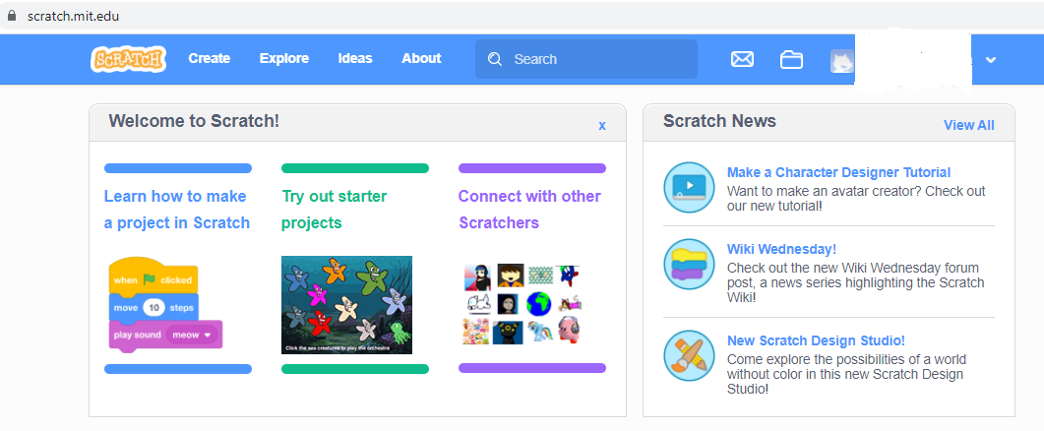
If you do have an account and have signed in for the 1st time this is what you will see. Try out the links in Welcome to Scratch section.

Slide 44
There are two screens for each project. One is called the Project Page view and it is like the cover of the book. It shows a bit of the project.
It has Instructions, “Tell people how to use your project (such as which keys to press).”
It has Notes and Credits, “How did you make this project? Did you use idesa, scripts or artwork from other people? Thank them here.”

Slide 45
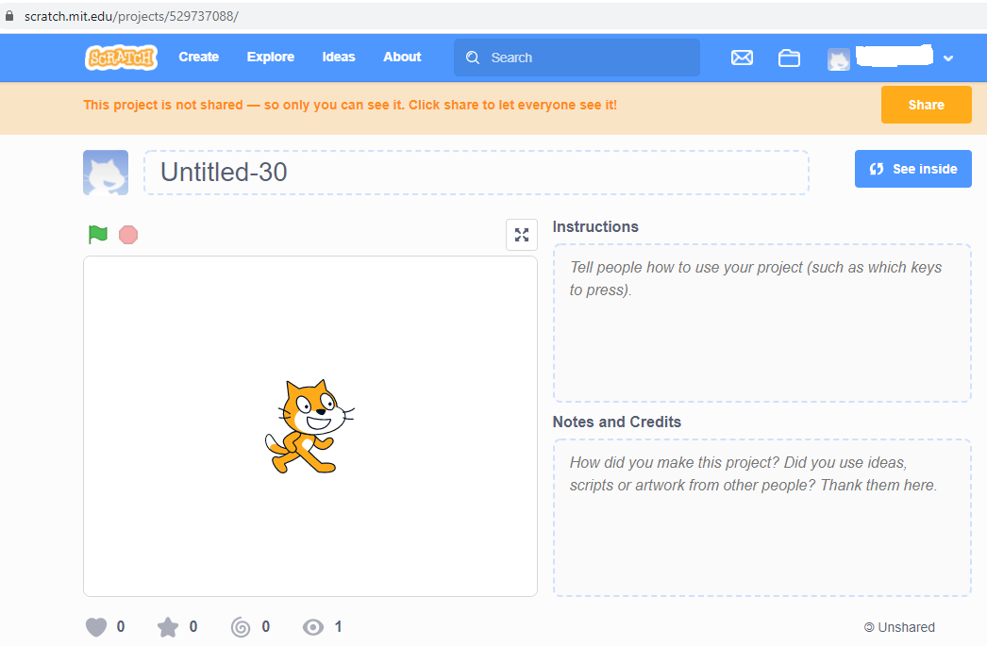

Slide 46
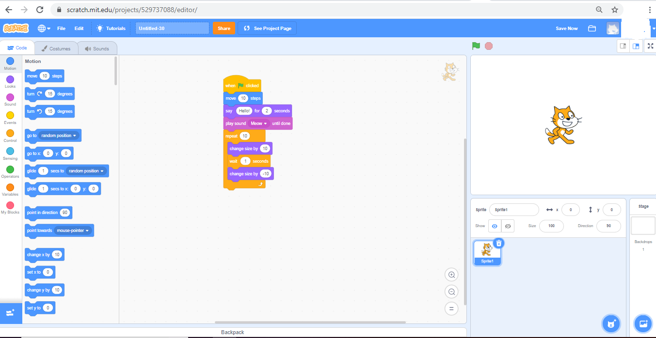
The other view is the See Inside (/Editor). It has 3 parts and this is where the coding and the magic happens!

Slide 47
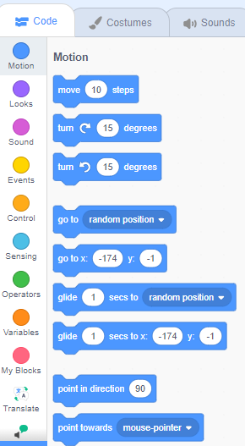
The Block Palette area has groups of blocks, colour coded. Simply pull a block over to the middle section and they will click together to form a stack.
Also on this side of the screen is the Costumes Tab. Some Sprites have several costumes that when switched back & forth show movement.
Sounds Tab has a library of sounds to select as well as the ability to record sounds.

Slide 48
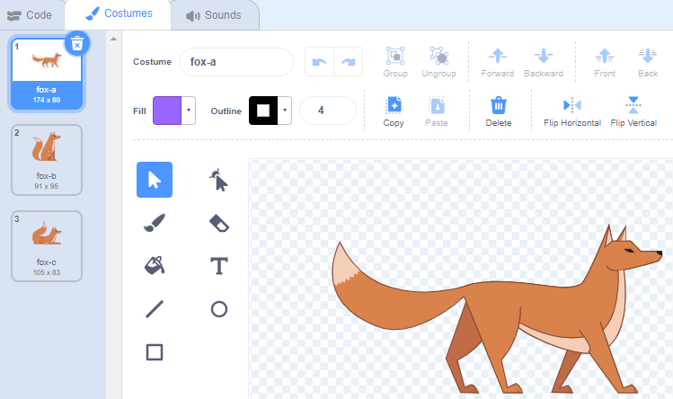

Slide 49
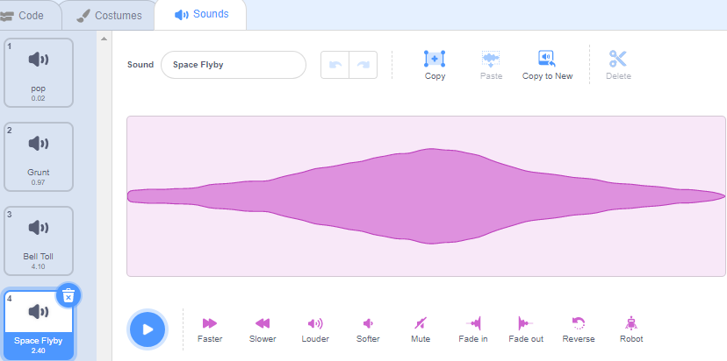

Slide 50
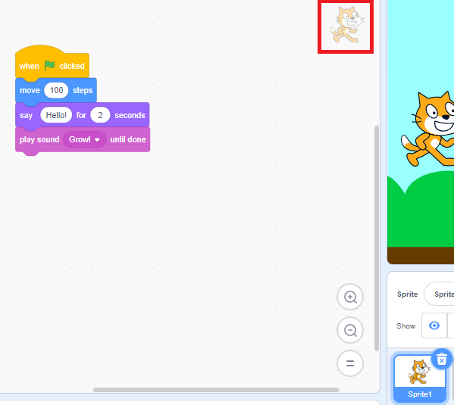
The Coding Area is where the block stacks are assembled and tested out.
Each Sprite will have its own Coding Area. In order to keep track of the coding for more than one sprite the sprite thumbnail at the bottom of the Stage will be highlighted in blue and a ghost image of the sprite will be in the upper righthand corner of the Coding Area.

Slide 51
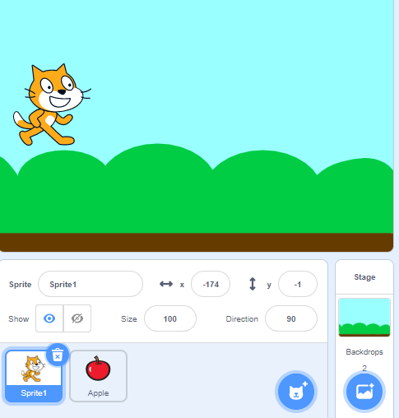
The Stage will show the coding actions. Sprites and backdrops can be added by clicking on the Blue buttons.
Information about the sprite: Name, location by X & Y coordinates, visible or hidden, Size, Direction sprite is facing are directly beneath the Stage.

Slide 52
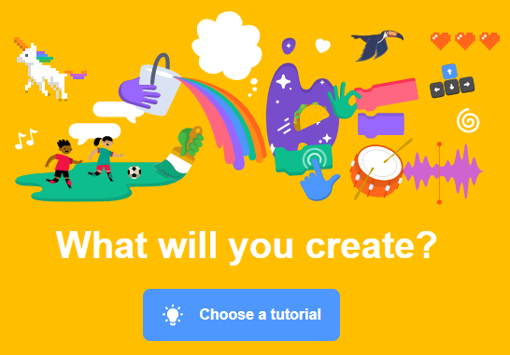
Starting out? Go to Scratch Ideas page for Tutorials (some with Coding cards & Educator Guides)and Starter Projects to remix.
Notes:
https://scratch.mit.edu/ideas https://scratch.mit.edu/starter-projects

Slide 53
In both views (Project Page & See Inside) there are links to Tutorials. Tutorials are the easiest way for you and your students to learn to code in Scratch.

Slide 54
Clicking on the Tutorials button found on each Scratch project screen is a great way to learn simple techniques.
Viewing one with your students and then giving them time to make a project from it is an easy way to learn to code for both you and your students. Getting Started & Imagine a World give the overall view, the rest (23) focus on one concept.

Slide 55
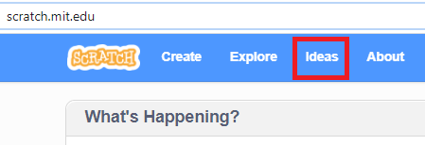
From within a project already started
Selecting a Tutorial will open a new project so the user can view and work at the same time. If a project has been started, selecting a Tutorial will create another project. This might cause some confusion because students will find extra projects in their My Stuff. For example they were working in a project Untitled-4 and then Untitled-5 is in their account as well. They say “I didn’t make that project.” That’s no problem. The next time they want to make a project just open up an empty Untitled one and work on it. Or start from your account home page first.
From account page, not creating a project yet

Slide 56
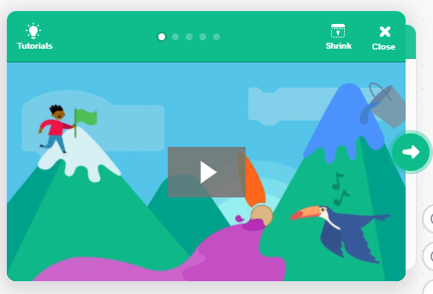
This Tutorial has the video and five interactive slides (five white dots at the top of the image).
The 25 tutorials start with a short introductory video clip and with additional review slides is all you need to start to code.
Notes:
https://scratch.mit.edu/projects/editor/?tutorial=getStarted

Slide 57
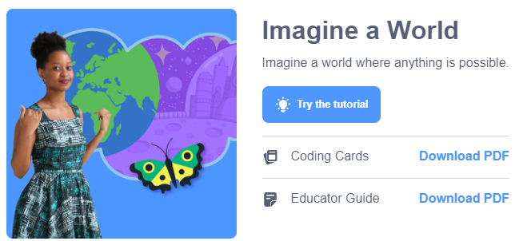
Some Tutorials (9 of them) such as Imagine a World have additional information. The Educator Guide gives step by step instructions for you to use as a lesson plan. The Coding cards can easily be printed off (even in B&W - students soon learn the group names of blocks rather than by their colour. Coding cards can be projected on your computer or on a screen in your classroom.
Notes:
Imagine a World Coding Cards: https://resources.scratch.mit.edu/www/cards/en/imagine-cards.pdf (20 cards)
Imagine a World Educator Guide: https://resources.scratch.mit.edu/www/guides/en/ImagineGuide.pdf (4 pages)

Slide 58
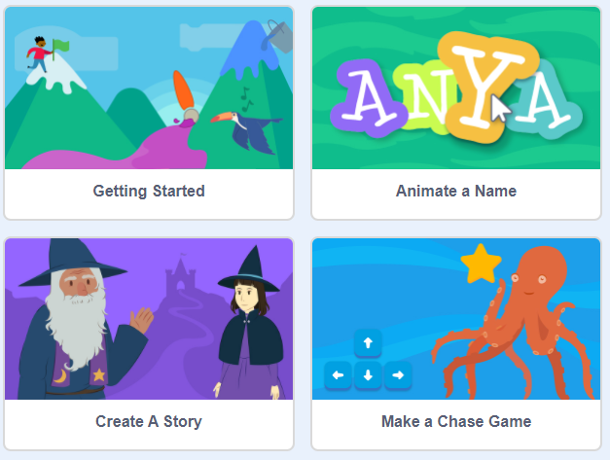
These 25 tutorials could be 25 lessons with your students.
Depending on the age of your students, you could assign 2 students per tutorial and have them teach the rest of the class.
Notes:
Animate a Name (Coding cards & Educator Guide) Create a Story (Coding cards & Educator Guide) Make a Chase Game (Coding cards & Educator Guide)

Slide 59
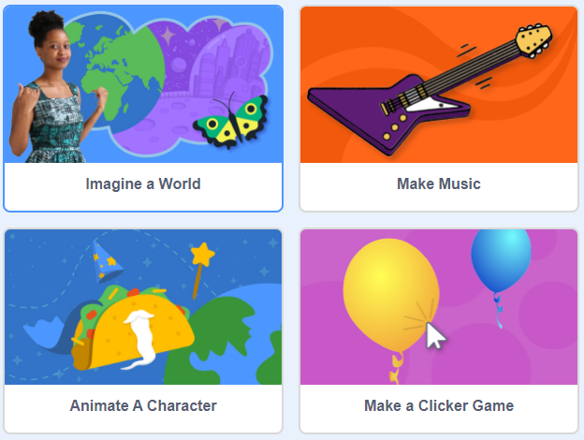
Notes:
Imagine a World (Coding cards & Educator Guide) Make Music (Coding cards & Educator Guide) Animate a Character (Coding cards & Educator Guide)

Slide 60
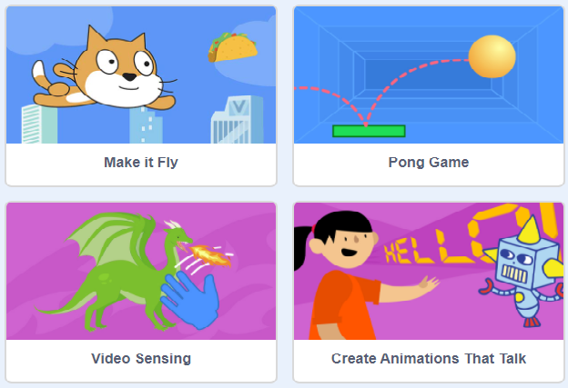
Notes:
Make it Fly (Coding cards & Educator Guide) Pong Game (Coding cards & Educator Guide) Video Sensing (Coding cards & Educator Guide)

Slide 61
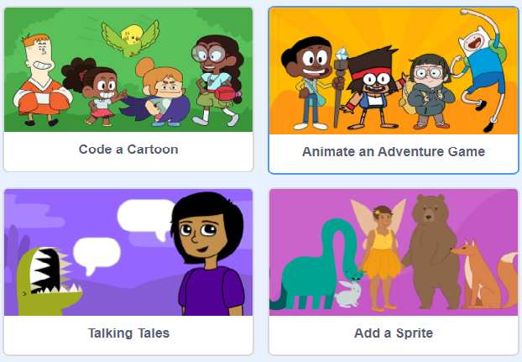

Slide 62
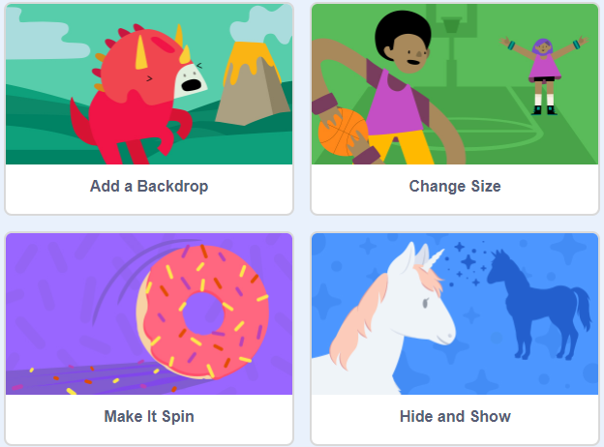

Slide 63
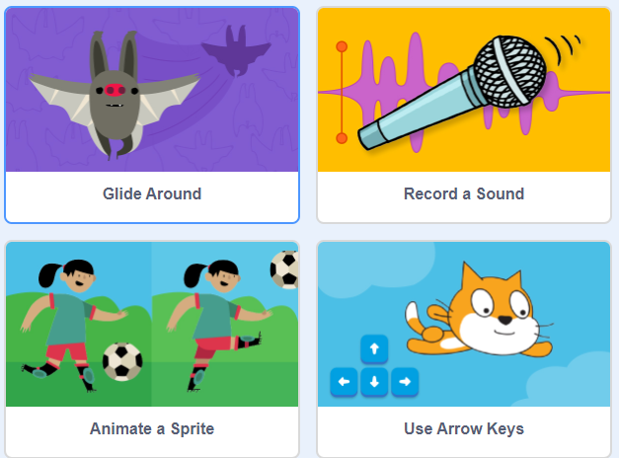
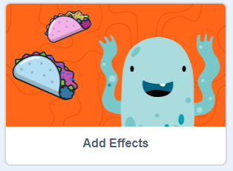

Slide 64
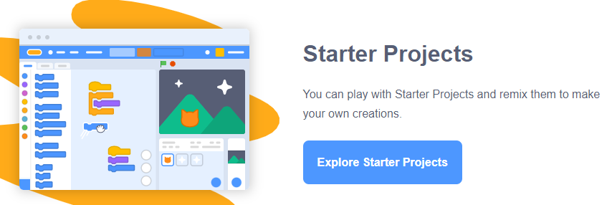
As with the Tutorials, these 24 Starter projects can easily be 24 lessons you use with your students.
“Try out these starter projects from the Scratch Team. Look inside and remix to make changes and add your ideas.”
Notes:
https://scratch.mit.edu/starter-projects

Slide 65
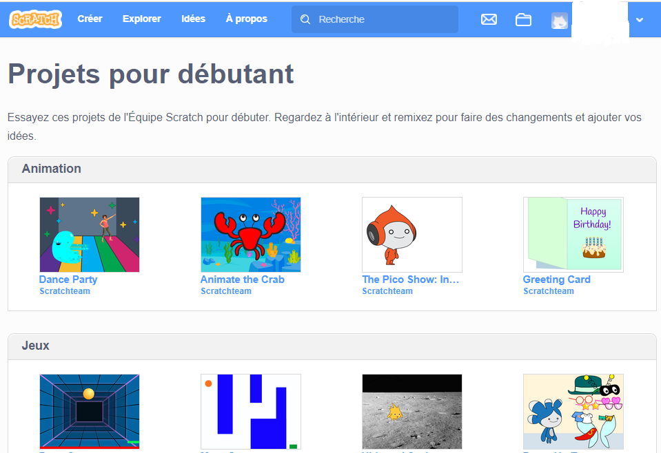
Notes:
If Francais is selected then this link will go to this screen https://scratch.mit.edu/starter-projects

Slide 66
Notes:
https://scratch.mit.edu/projects/10128067/ https://scratch.mit.edu/projects/10015059/ https://scratch.mit.edu/projects/10015060/ https://scratch.mit.edu/projects/11806234/ (top row)
https://scratch.mit.edu/projects/10128515/ https://scratch.mit.edu/projects/10128431/ https://scratch.mit.edu/projects/10128368/ https://scratch.mit.edu/projects/11656680/ (bottom row)

Slide 67
Notes:
https://scratch.mit.edu/projects/10015857/ https://scratch.mit.edu/projects/11829803/ https://scratch.mit.edu/projects/10007296/ https://scratch.mit.edu/projects/11641125/ (top row)
https://scratch.mit.edu/projects/10015792/ https://scratch.mit.edu/projects/10012676/ https://scratch.mit.edu/projects/10128483/ https://scratch.mit.edu/projects/11640429/ (bottom row)

Slide 68
Notes:
https://scratch.mit.edu/projects/10014866/ https://scratch.mit.edu/projects/10063757/ https://scratch.mit.edu/projects/10128197/ https://scratch.mit.edu/projects/11804271/ (top row)
https://scratch.mit.edu/projects/10128168/ https://scratch.mit.edu/projects/10128119/ https://scratch.mit.edu/projects/10123832/ https://scratch.mit.edu/projects/10015802/ (bottom row)

Slide 69
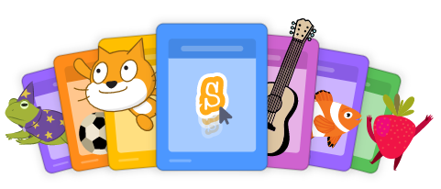
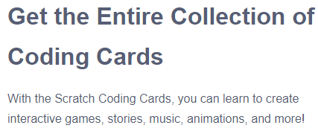
Ready made Activities
https://scratch.mit.edu/ideas
https://resources.scratch.mit.edu/www/cards/en/scratch-cards-all.pdf
Note: made for Scratch 2.0 version but still very easy to use with 3.0
Notes:
https://resources.scratch.mit.edu/www/cards/en/scratch-cards-all.pdf

Slide 70
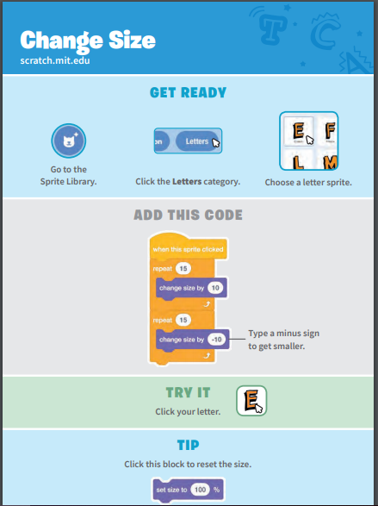
Limited number of instructions on each card. Can be projected on a screen for whole class group.
Were originally made for Scratch 2.0 but no significant changes to use with 3.0 because they are used to start beginners to learn to code.

Slide 72
The Role of a Classroom Teacher
for Coding
TofC Back

Slide 73
Scratch events encourage sharing and to learn by looking at the projects of others. This apprentice style of learning is effective for coders of all ages, so what role does a classroom teacher play? Are we needed at all?
How do we teach our students to “solve problems and create computational representations of mathematical situations using coding concepts and skills” (Ontario Math Curriculum 2020, Algebra Overall Expectation C3)
We make visible the thinking required to “solve problems” in other words, we think aloud.

Slide 74
There is a classic lesson with the teacher standing at the front of the room with a bag of bread, a knife, and a jar of peanut butter. Students tell the teacher the directions to make a peanut butter sandwich. The results, as you might know are hilarious, but also frustrating.
It is the same way with teaching our students computational thinking through the use of coding.
The use of pseudo coding or pathways or flow charts is one way to develop the skills to code successfully to fulfill expectation C3. Here is an example:

Slide 75
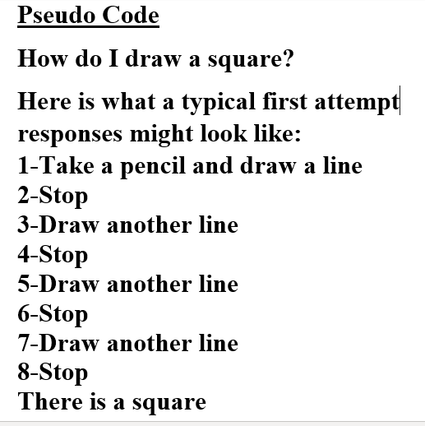
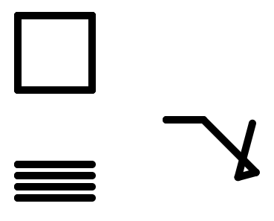
What they expect and what teacher draws!!

Slide 76
Students probably can easily pull over the blocks to make a square after seeing you model it. Scratch blocks with the coding embedded within makes it easy.
As students code more and more intricate projects, things don’t always go as the coder expects. Unexpected situations arise or the coding stack does not complete the actions.
We want students to persevere and debug where needed, but we also want them to fix problems before they happen because they can predict the results of actions taken.

Slide 77
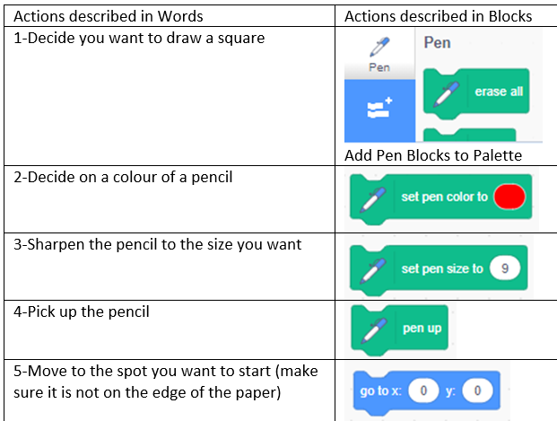
As students learn to write pseudo code they are learning computational thinking. While this is a simple example, the ability to plan out the actions needed is a 21st century skill.

Slide 78
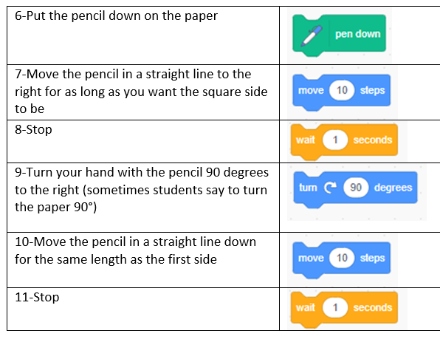
Once they learn the fundamentals of the actions of different groups of blocks and make simple projects, then start to model and refine your students ability to “write” code with words or draw flowcharts.

Slide 79
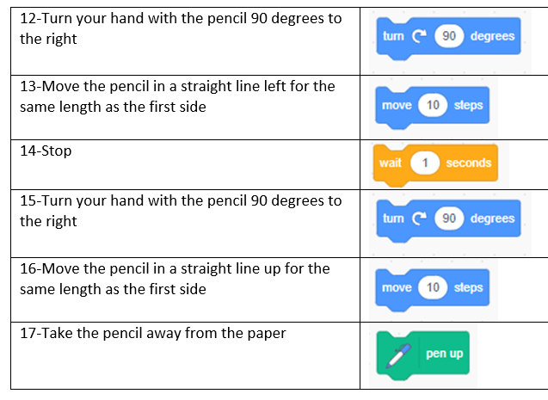
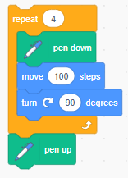
Soon student will see the value in blocks such as the Repeat and eliminate Steps 7-16 with ...

Slide 80
The other important role of a classroom teacher is to build a sense of community to share knowledge. So many of the tasks assigned to students are done individually and any sharing is done when the task is complete.
Consider having a Coding Wall in your classroom or use an online app such as Padlet.
Ask for Advice - Give Advice areas are a practical application within your group to honour the Scratch ideal of information and knowledge is to be shared democratically, no one is excluded.
If, as the teacher your standard response to a coding question is, “I don’t know, let’s find out” students will soon learn to look to each other for assistance.

Slide 81
Ask for Advice - Give Advice
I know how to use IF/THEN/ELSE
Paige
How do I add a Score?
Youssef
How do I get the Sprite to face up?
Yves
How do I make my own Studio?
Pushpa
Ask me about Video Sensing.
Amelia
I can help with X, Y in all quadrants.
Keldan
Hector & Teddy know the Make a Clicker Game tutorial. We will help you

Slide 83
Educators connecting with the World and Scratch:
GU, LCL, & CCC
TofC Back

Slide 84
These 3 programs, GU (Getting Unstuck), LCL (Learning Creative Learning), and CCC (Creative Computing Curriculum) are the places I have learned the most about coding and how to teach coding to others. By placing myself as a learner (a student) I experienced what we ask our students to experience. The vast majority of participants are educators so the projects created are ones I can use with students.
Working through Scratch Tutorials & Starter Projects and participating in these programs has brought me to where I am as a coder. I encourage you to do the same

Slide 85
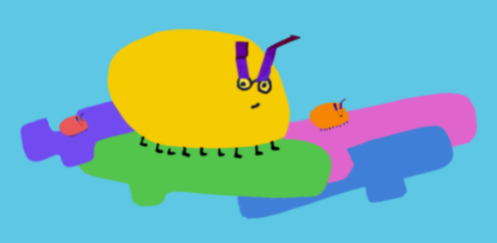
“We designed this learning experience for PK–12 teachers who are passionate or curious about supporting creative work with Scratch (a graphical programming language and online community being used by millions of young people around the world) in the classroom. But anyone who enjoys programming puzzles and learning with others is welcome to participate. Supporting students in pursuing creative work, with all of the twists and turns that can entail, can be tricky. As a teacher, in addition to having an adventurous spirit and genuine curiosity, it can help to have greater familiarity and fluency with Scratch. Our goal for Getting Unstuck is supporting that familiarity and fluency—by inviting you into these daily programming prompts and connecting you with a supportive community of fellow learners”
Notes:
https://gettingunstuck.gse.harvard.edu/ https://gettingunstuck.gse.harvard.edu/about https://gettingunstuck.gse.harvard.edu/prompts https://gettingunstuck.gse.harvard.edu/strategies

Slide 86
Usually offered in October, materials are available any time
Notes:
https://lcl.media.mit.edu/ https://lcl.media.mit.edu/learn-more/

Slide 87
Notes:
https://creativecomputing.gse.harvard.edu/guide/index.html https://creativecomputing.gse.harvard.edu/guide/curriculum.html https://creativecomputing.gse.harvard.edu/guide/about.html https://scratched.gse.harvard.edu/ct/

Slide 88
Students connecting with the World and Scratch:
ScratchPals,
Scratch Camp
TofC Back

Slide 89
ScratchPals is the one I highly suggest.
Enrolling in the project will introduce you to a group of like-minded educators who are supportive and helpful and offer you and your students a way to connect with another class somewhere in the world!
Scratch Camp has online ‘counselors’ for a summer activity.

Slide 90
https://sites.google.com/view/scratchpals/home
Notes:
bit.ly/ScratchPals https://sites.google.com/view/scratchpals/home
ScratchPals logo and site graphics incorporate images from the Lifelong Kindergarten Group at MIT Media Lab and the Creative Computing Lab at the Harvard Graduate School of Education, as well as UNICEF and World's Largest Lesson. Icons adapted from Freepik at www.flaticon.com.

Slide 91
Key Information about Scratch Pals
Created by Kathleen Fugle
Two sessions: October/November and February/March
To join Scratch Pals, complete the online form. Based on the information you provide you and your students will be with other students based on their age (Grades 2 to 5 or Grades 6 & Above) and interests ( for example: The Arts, Physical Computing, Making Connections, and Code the World You Wish to See).
ScratchPal Ambassadors and other educators are available to assist you with draft projects and ways to connect.
Notes:
https://twitter.com/kathleenfugle
Scratch Pals Guide for Educators https://docs.google.com/presentation/d/1TW7eof-RIZcj6YhSwpGS_rbyzDKtkJAFLXzxGfQ9584/present?slide=id.p

Slide 92
Your students will post their projects and, in turn, see projects from other students.
Learning from others, being part of a community, and supporting others are just some of the benefits beyond coding.
There are options to connect with others within the interest groups via an online social media platform.
Find out more at the website and Guide for Educators https://sites.google.com/view/scratchpals/resources
Notes:
https://sites.google.com/view/scratchpals/resources

Slide 93
Here are some themes
Notes:
https://docs.google.com/document/d/1yoQgJ4KeTlXLqMNCHgbybpjygO0fzOvARnCaUBYKYTw/
Kathleen Fuge @kathleenfugle 2020 https://sites.google.com/view/scratchpals/home

Slide 94
Notes:
Kathleen Fugle @kathleenfugle 2020 https://sites.google.com/view/scratchpals/home

Slide 95
Projects created from around the world with ScratchPals.
Notes:
Screenshot, no active links. Go here - https://scratch.mit.edu/users/ScratchPals_create/studios/ https://sites.google.com/view/scratchpals/home

Slide 96
Notes:
Screenshot, no active links. Information is for 2021 calendar year. See Website for timely and current information https://sites.google.com/view/scratchpals/home

Slide 97
Run during the summer months. Open worldwide.
Notes:
For example Week 1 Studio https://scratch.mit.edu/studios/27309144/
Wiki https://en.scratch-wiki.info/wiki/Scratch_Camps Studio Scratch Camp Counselors https://scratch.mit.edu/studios/4160300/

Slide 98
Scratch
Throughout the Year
TofC Back

Slide 99
Where to find information about Scratch Community events during the year?
Scratch News is the place!
If you have not logged into your account just go to the main site page and News is on the right. https://scratch.mit.edu/
If you are in your account, either the Project Page or See Inside, click on the Scratch Logo to go to the main page.
Missed past News items? Click on View All to go to Discussion page and read them https://scratch.mit.edu/discuss/5/
Notes:
https://scratch.mit.edu/discuss/5/

Slide 100
Throughout the year the Scratch Team posts information about themes as Design Studio challenges and invites the Scratch community to create and/or remix projects on that particular theme. Coders can add their project to a studio dedicated to the theme. These themes can have many uses in classroom coding. They can be used as a classroom assignment or for students looking for a challenge, or an opportunity to “read’ the coding of others. They show students a wide variety of ways to approach a theme. The themes are examples of ideas that encourage of low floor, high ceiling, and wide wall projects and will celebrate all levels of coding expertise They can broaden students’ idea of coding past the gamification to other fields such as art, social justice, science, mathematics, etc.
Notes:
Click on Design Studio text or here for link to Scratch Wiki Design Studio article https://en.scratch-wiki.info/wiki/Scratch_Design_Studio

Slide 101
Notes:
Click here for link to latest Scratch Design Studio https://sip.scratch.mit.edu/events/

Slide 102
Scratch Week and Scratchober are like the themes the Scratch Design Studio offer.
Scratch Week in May.
Scratchober in October.
Notes:
Design Studio May 2021 https://scratch.mit.edu/studios/29664386/

Slide 103
With all these activities students create projects based on themes or ideas. The creation of a project can begin with an idea of the user or developed from viewing the projects of others or even remixing another project. Students should develop the habit of acknowledging the work of others on their project page.

Slide 104
SIP (Scratch in Practice is an area to find out upcoming events as well as things to do. You can sign up to get email announcements.
Notes:
https://sip.scratch.mit.edu/

Slide 105
Scratch Week
https://scratch.mit.edu/projects/522762073/

Slide 106
Here is a short video to introduce Scratch Week 2021
https://scratch.wistia.com/medias/j36uw5ue3e
Monday’s challenge Ridiculous Inventions
https://scratch.mit.edu/studios/29712532/
“Do you have a problem you’d like to create a ridiculous invention to solve? A fun or complicated device that doesn’t do anything useful? A silly way to solve a common issue you face? If so, you’ve found the right place! Share your fun, overly complicated, ridiculous inventions with us through your next Scratch project!”
Notes:
https://scratch.wistia.com/medias/j36uw5ue3e Also find link here: https://scratch.mit.edu/discuss/topic/514229/ https://scratch.mit.edu/studios/29712532/

Slide 107
May is Scratch Month. A series of ten prompts are presented over four weeks. Projects can be added to a Studio. For example here are some prompts from May 2020: Recycling Bin Crafts (Make fun things out of stuff you find in your recycling bin!); Interview Anything! (Try interviewing something, like a piece of play-doh, a penny, a plant, a pet, or even a person; and Chain Reaction (Make a real or imaginary ball travel from one place to the next. How will it move? Where will it go next?)
Notes:
Click on screenshot for link or here: https://sip.scratch.mit.edu/scratchmonth/

Slide 108
Scratch Month
Studio example
Notes:
Click the screenshot to go to the Studio for Recycling Bin Crafts or here: https://scratch.mit.edu/studios/26555027/

Slide 109
April 1st is a special day in Scratch. On that date there is a temporary change to the way the blocks look!
Notes:
April Fool’s Day Cat blocks https://en.scratch-wiki.info/wiki/Cat_Block

Slide 111
Studio
https://scratch.mit.edu/studios/27737452/
Notes:
https://scratch.mit.edu/projects/433242236/ Project; https://scratch.mit.edu/studios/27737452/ Studio;

Slide 113
Why not make your own Scratch Week or Month and with your students generate a list of word prompts or phrase prompts?

Slide 115
Finding Help:
People!
TofC Back

Slide 116
Notes:
https://www.meetup.com/pro/scratched

Slide 117
Scratch MeetUps are wonderful places to meet others and have a say in the agenda.
Usually these are face-to-face meetings in large urban areas, one a month during the school year.
Hopefully virtual meetup will continue so educators in rural or isolated areas can participate.
Part of creating Yellow Pages is to follow up with virtual MeetUps for Ontario Educators. Hope you will join in!

Slide 118
There is a Facebook Group that you might find helpful.
My #1 go to is Teaching with Scratch
https://www.facebook.com/groups/TeachingwithScratch/about
This group can answer questions you have. There are students’ projects and events posted as well.
It is sponsored by Harvard Graduate School of Education. HGSE and Scratch @MIT are partners in many endeavors.
Notes:
https://www.facebook.com/groups/TeachingwithScratch/about

Slide 119
Notes:
https://www.facebook.com/groups/TeachingwithScratch/ https://www.facebook.com/groups/TeachingwithScratch/about

Slide 120
Here is an example of a comment in the FB group and answers. They are typical of the responses.

Slide 121
Notice the next 2 responses.
One, offering to help “If you share project link, I can remix.”

Slide 122
The second makes their own new project and posts the link to further explain the answer given.

Slide 123
This responds gives a link to https://scratch.mit.edu/discuss/ Which is like the FB group only with archived information. See next slide for screenshot of Discuss Home page
Notes:
https://scratch.mit.edu/discuss/

Slide 126
Finding Help:
Lesson Plans
TofC Back

Slide 127
I was fortunate to be part of an OAME writing team for the Fall 2020 to Spring 2021. The team wrote coding lessons for Grades 1 to 8 as well as Fractions, Financial Literacy and Mathematical Modelling lessons.
Individual school boards across Ontario have begun to write lessons, coding Scratch projects and create videos for the coding expectations. As they become available to the public the Yellow Pages will be updated with the resources.

Slide 128
OAME/AOEM Ontario Association of Mathematics Educators
https://ontariomath.support/?pg=home&lang=EN
Notes:
https://ontariomath.support/?pg=home&lang=EN https://oame.on.ca/main/index.php

Slide 129
https://ontariomath.support/?pg=home&lang=FR
Notes:
https://ontariomath.support/?pg=home&lang=FR

Slide 130
Notes:
https://code.org/ Hour of Code https://code.org/learn

Slide 131
Notes:
Screenshot not active, Go to: https://studio.code.org/courses?view=teacher

Slide 132
Code.org along with Hour of Code is a massive site. They offer many ways to learn coding. Activities are often self-pacing. I have found that the gamification of these activities leads students to complete the task without learning and reflecting on the block and coding stack actions. It is get-to-the-next-level playing instead.
There are some great unplugged lessons I have added to the Yellow Pages. Students don’t learn computational thinking and coding by always being in front of a device. In particular, I have added a screenshot of unplugged lessons for Course 4 and a bit of one lesson on variables.

Slide 133
Notes:
https://code.org/curriculum/course4

Slide 134
Lessons are well planned out and all the resources are linked in.
Notes:
https://code.org/curriculum/course4/4/Teacher

Slide 135
https://outreach.tvolearn.com/codingintheclassroom/
Notes:
https://outreach.tvolearn.com/codingintheclassroom/

Slide 137
Finding Help:
Videos
TofC Back

Slide 138
My #1 choice for videos is Scratch. Within the Scratch user interface is a link to Tutorials and Starter Projects.
The Scratch Team also has a YouTube channel with clear and concise instructions on specific topics.
Notes:
https://www.youtube.com/c/ScratchTeam/featured

Slide 139
Notes:
https://www.youtube.com/watch?v=-3oCdNIeU_8&t=34s https://www.youtube.com/watch?v=CvSOVWyyjJI https://www.youtube.com/watch?v=7NN5v2wSL4U&t=2s

Slide 140
Boot Up (Jared O’Leary) has a series of 41 videos with accompanying lesson plans. They are labelled with Experience 1st and 1st, 2nd, 3rd, 4th Quarter which sounds confusing. They, of course, are not aligned with Ontario Grade Expectations. They can be used by you and/or your students regardless because the concepts are universal (in other words, a lesson on the Conditionals IF/THEN are the same whomever writes it).
The site has a detailed spreadsheet links to unplugged activities as well.
Notes:
https://bootuppd.org/scratch https://docs.google.com/spreadsheets/d/1IRAs7iRxQnUmpH9aJ2q4INx8f3JOWwSzJl8sRnI7lVA/

Slide 141
Notes:
Here are links to #17 Lesson Plan https://docs.google.com/document/d/1XgDPGP0aXN0hbwaOQycTceBO1NVS8goEHPB5wH2SNP8/
Coder Resources https://docs.google.com/document/d/1osDe__s5AQpbPVum6pWRdfDrptPwRONgfMsTNVjQbGo/

Slide 143
Finding help:
Scratch Wiki
& Books
TofC Back

Slide 144
The Scratch Wiki. https://en.scratch-wiki.info/
At first you might think the articles in th Scratch Wiki aren’t for you as a beginner coder. That is what I thought.
I was overwhelming by looking for help in the Scratch Discussion https://scratch.mit.edu/discuss/ . I soon learned the difference between that forum and the Wiki. Now the Wiki is the first place I go to get information and share links with others for Scratch Coding. Type in a block name or action see what I mean. The article is concise and easy to understand.
P.S. I still don’t wander into the Discussion forum LOL

Slide 145
Notes:
https://scratch.mit.edu/discuss/

Slide 147
Notes:
https://en.scratch-wiki.info/wiki/If_()_Then_(block)

Slide 148
Scratch Wiki is a quick way to read about a specific block or action
https://en.scratch-wiki.info/wiki/Getting_Started_with_Scratch
Notes:
https://en.scratch-wiki.info/wiki/Getting_Started_with_Scratch

Slide 149
Notes:
https://fr.scratch-wiki.info/

Slide 150
Notes:
https://fr.scratch-wiki.info/wiki/Forme_des_blocs

Slide 151
Here are some other articles you might find useful:
https://fr.scratch-wiki.info/wiki/Scratch_3.0
https://fr.scratch-wiki.info/wiki/Scratch_(site)
https://fr.scratch-wiki.info/wiki/%C3%89diteur
https://fr.scratch-wiki.info/wiki/Cat%C3%A9gorie:Tuto
https://fr.scratch-wiki.info/wiki/Forum_Scratch
https://fr.scratch-wiki.info/wiki/Notification

Slide 152
There are many published books about Scratch coding. Most are geared towards children. The content usually shows how to code a series of interactive game projects.
There are several things to consider if you want to use these types of books to teach yourself or teach you students.
First, is the coding will probably cross the grade expectations included in the Ontario Math Curriculum. While the coding concepts in the expectations are meant to be the threshold or minimum concept for that grade it is easy to extend your students’ learning to more advanced concepts.

Slide 153
Second, and to my mind something more to consider is the narrow idea of coding these books (for the most part) present.
Creating video games and simulations is only one facet of coding.
We must not only make coding accessible to all but we must make it interesting and valuable to all.

Slide 154
Seymour Papert, “One might say the computer is being used to program the child. In my vision, the child programs the computer, and in doing so, both acquires a sense of mastery over a piece of the most modern and powerful technology and established an intense contact with some of the deepest ideas from science, from mathematics, and from the art of intellectual model building.” (Author of Mindstorms, Creator of LOGO, mentor of Mitch Resnick)
Mitch Resnick, “Seymour was interested in applying ideas from AI to engage children in thinking about their own thinking — and learning about their own learning.” (creator of Scratch coding)
Notes:
https://mindstorms.media.mit.edu/ Book is available as a PDF https://medium.com/@mres/the-seeds-that-seymour-sowed-c2860379617b

Slide 155
Having said that, I do have a number of those books and have learned from them. The next slides provide information you might find useful.
The first, Max Wainewright’s books. These are very popular with students. When I ask students if they have any coding books, his books are the ones they mention.
The second, a free online book by Al Sweigart.
The third, a Scratch 2.0 book (now 3.0) that has been my personal go-to.

Slide 156
A popular author is Max Wainewright
Website: Max Wainewright has short videos for coding concepts (suitable for late primary/early junior students)
There are many Scratch studios just based on projects from his books.
Notes:
https://maxw.com/ Screenshot of how to search for projects & studios

Slide 157
Online book for Scratch 3.0 Free: https://inventwithscratch.com/book3/ Al Sweigart
Videos also at site
https://scratch.mi.edu/users/AlSweigart/
If you want to buy the book as paper, Ebook, PDF, Mobi
https://nostarch.com/scratch3playground
Notes:
https://inventwithscratch.com/book3/ https://scratch.mi.edu/users/AlSweigart/ https://nostarch.com/scratch3playground

Slide 158
Notes:
Slide Screenshot, does NOT have active links. However, here is Chapter 3 https://inventwithscratch.com/book/chapter3.html

Slide 159
Majed Marji (2014) Author
No Starch Press - Publisher
Written with an older audience in mind and at 250 pages and extensive Table of Contents and Index more like a resource textbook. Even without information on the 3.0 version I go to it first or second after checking Scratch Wiki.
Which leads me to the Wiki ...

Slide 160
Using Scratch with Books
In these examples we have two books that have been used to create various projects for students to engage with their learning.
Jabari Jumps By:
https://scratch.mit.edu/studios/29515853
Ara the Star Engineer
Book by Komal Singh
https://scratch.mit.edu/studios/28565637

Slide 161
Finding Help:
Blogs and Twitter
TofC Back

Slide 162
ScratchTeam Blog https://medium.com/scratchteam-blog
Scratch Stories, Communities, Families, Scratch Day, Scratch in Practice, Team Updates, ScratchJr
Notes:
https://medium.com/scratchteam-blog

Slide 163
Scratch Pals https://twitter.com/scratchpals
Notes:
https://twitter.com/scratchpals

Slide 164
Scratch Team https://twitter.com/scratch

Slide 165
https://twitter.com/Codeorg
https://twitter.com/Teachcode
Notes:
https://twitter.com/Codeorg https://twitter.com/Teachcode

Slide 166
https://twitter.com/ScratchJr
Notes:
https://twitter.com/ScratchJr

Slide 167
https://twitter.com/HGSE_CCL
Notes:
https://twitter.com/HGSE_CCL

Slide 168
https://twitter.com/mres
Notes:
Mitch Resnick Scratch Creator https://twitter.com/mres

Slide 169
Unsure about anything in this slide deck?
Contact me:
Elizabeth Pearsall
Pearsallelizabeth7@gmail.com

