Slide 1
Students can learn Scratch without you getting in their way
You Don’t have to KNOW Scratch
For Your Students to Do Scratch:
Everyone’s learning a new language
Link to this presentation:
www.KPSCobraCoders.weebly.com
EdCamp 2017

Slide 2
The goals of this workshop are:
To provide a practical and informative session for classroom teachers who would like their students to code in Scratch but believe they don’t know enough about coding or Scratch to begin
To showcase useful resources for teachers so they know what they could do to start and what they could do to continue coding
To highlight specific student tasks that provide a common foundation for Scratch coding and are accessible for all
To share failures and successes and pass on hints

Slide 3
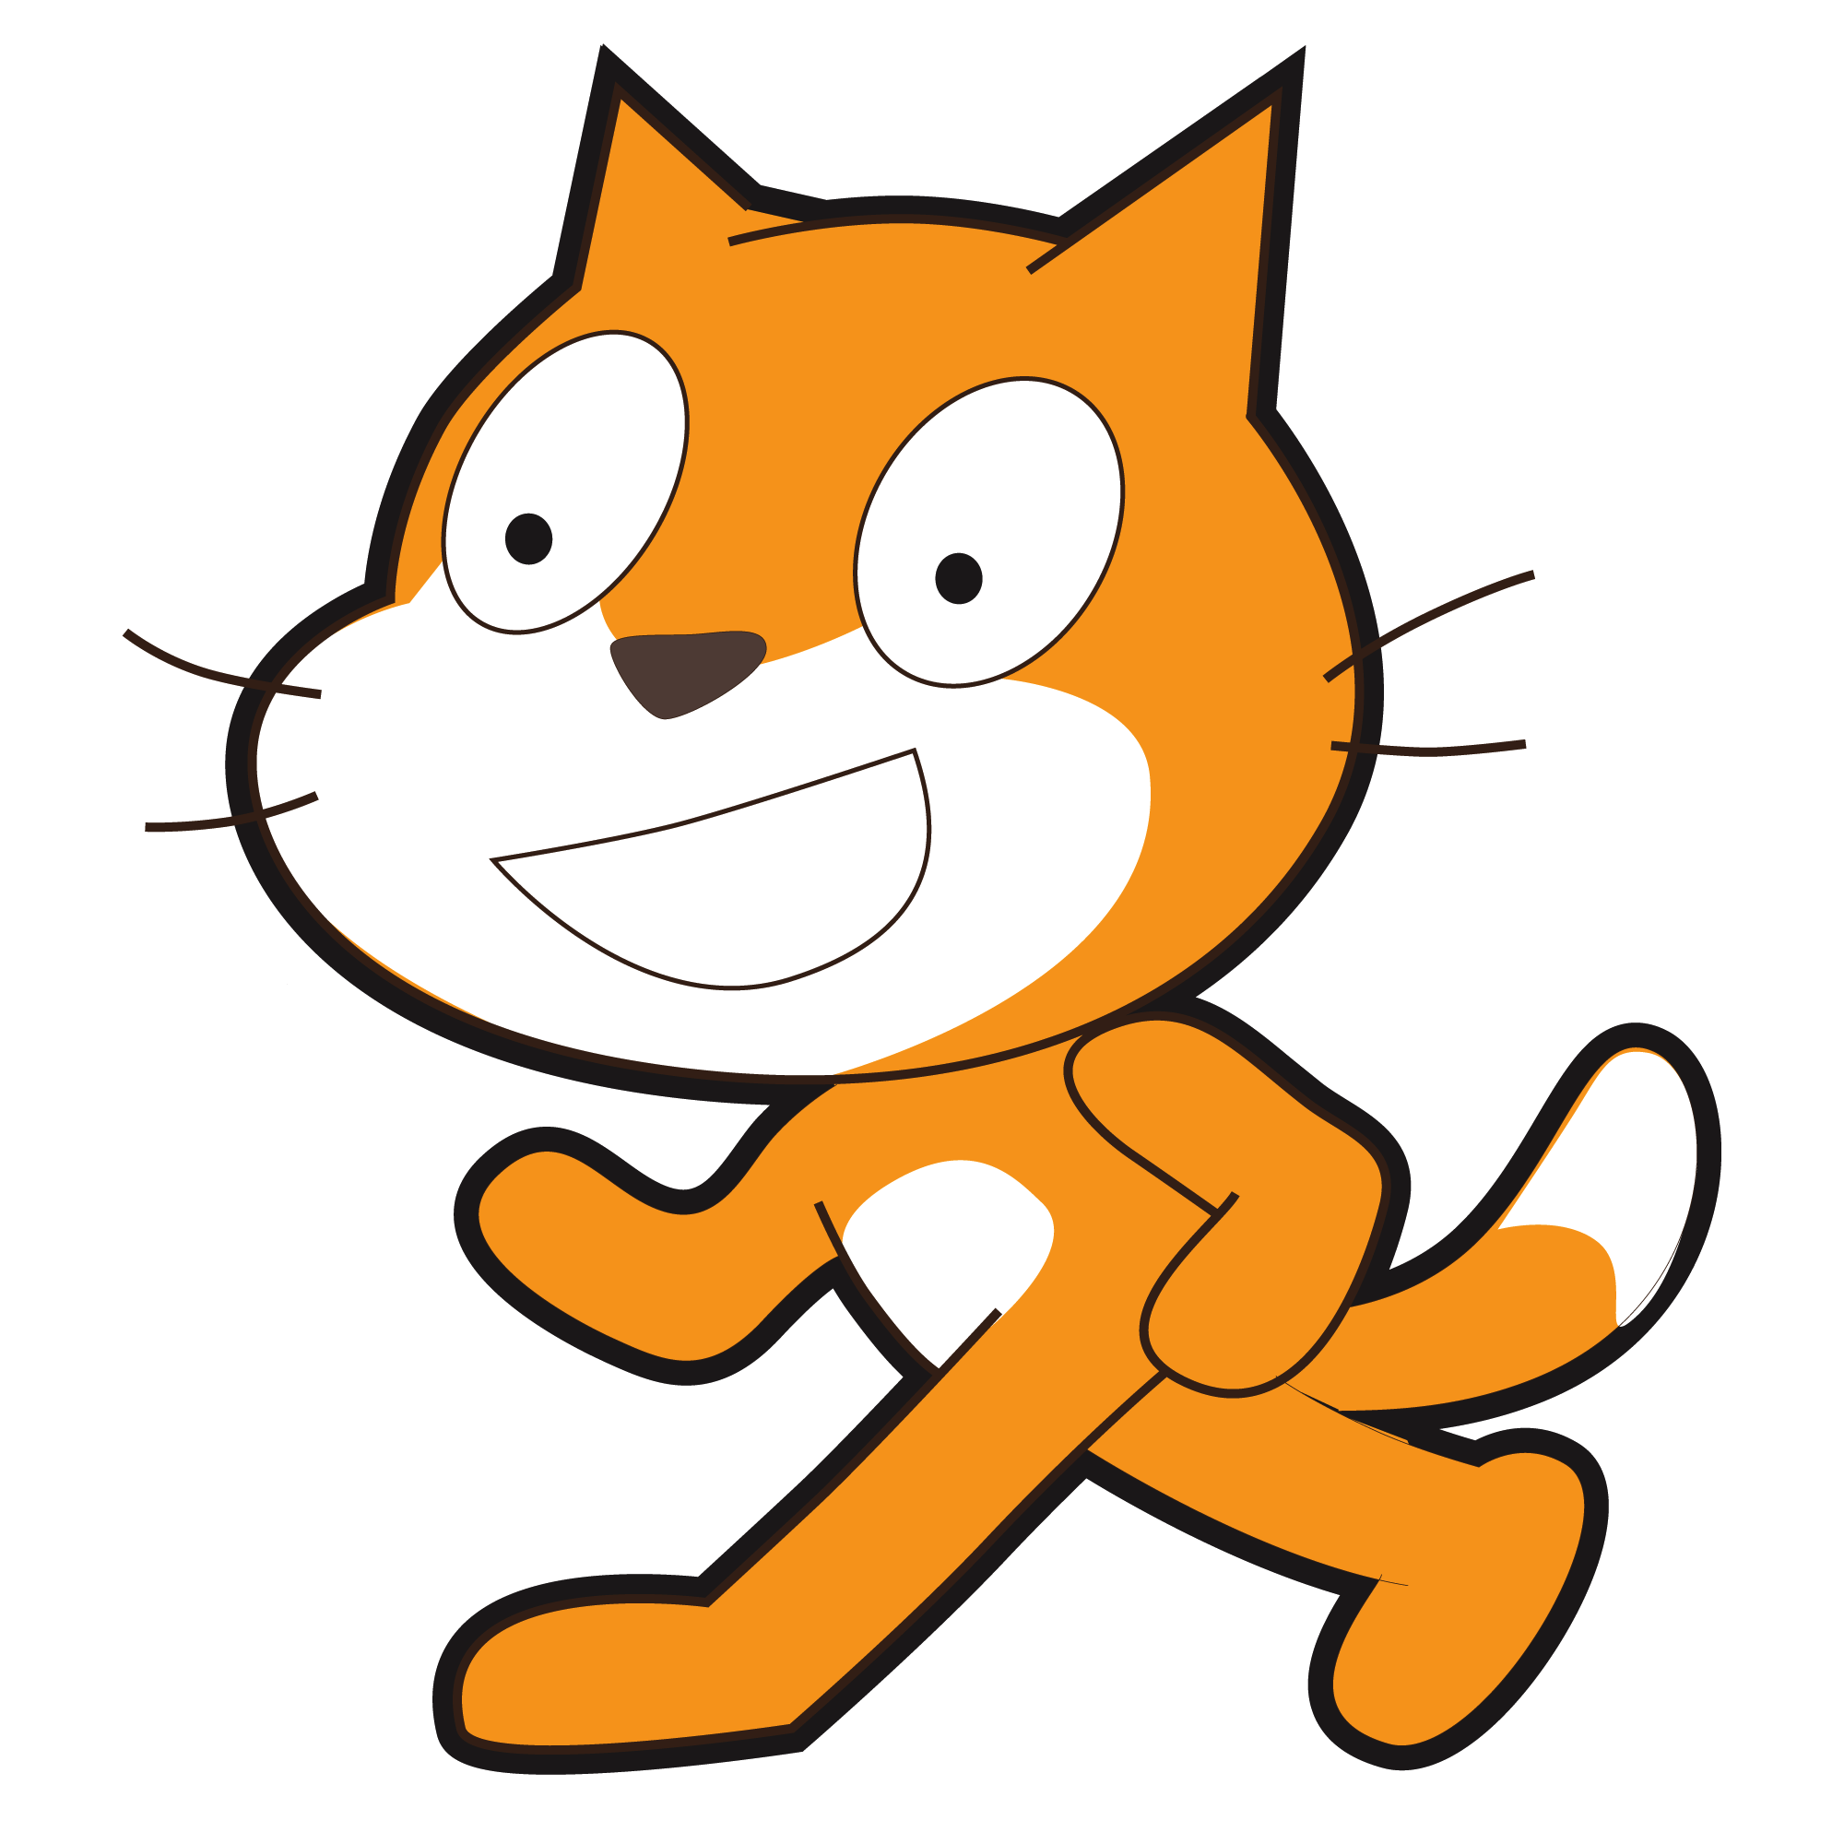
Scratch: https://scratch.mit.edu

Slide 4
How to start your students coding?

Slide 5
All students in our project had experienced Hour of Code activities (https://code.org/learn ) Why? It is a great way to start coding!

Slide 6
Activities for Hour of Code use blocks to code and design coding using popular characters.

Slide 7
http://partners.disney.com/hour-of-code/wayfinding-with-code?cds The goals of the game and each step are clearly identified.

Slide 8
For Moana there are 19 steps, each with simple instructions and limited block choice.

Slide 9
When the blocks are in place the students click Run and watch what happens to the characters in the game.

Slide 10
The program directs the student to try again if the block choice is incorrect …

Slide 11
…or correct and then advances to the next step.

Slide 12
With Hour of Code …
it seemed students didn’t show any sizable connections when transferring block knowledge from one “game” to another and often tried varied combinations of blocks until one “worked”
it seemed students were interested in “beating” the level than learning to code
when students reached the final step (to develop a game) they became easily frustrated and it seemed that final step was too much of a leap from the previous steps
it seemed the gamification factor out-weighed the creativity factor

Slide 13
Hour or Code or Scratch? The answer is BOTH…
Hour of Code is a great way to get started coding
Students learn the basics of Block coding
With Scratch the creativity aspect dominates over the gaming aspect
Scratch enables students to continue to learn as they create
Scratch enables students to connect to a world-wide community
Scratch enables students to code in the virtual world and the real world (with devices such as Makey Makey and robots such as Mbots)

Slide 14
What System Requirements and Devices do you need to get started?
Scratch On-line and an off line version
Off-line version 1.4
On-line version 2.0 (the file extension is .sb2)
Available on Windows, Mac, or Linux computers, Chrome Books NOT iPads
Adobe Flash Player (released on or after 06152016
Web Browsers
Internet Explorer 10+ for Windows only
Chrome for Mac, Windows, or Linux
Firefox for Mac or Windows only
Safari Mac or Windows only
Edge for Windows only

Slide 15
What accounts do you need to get started?
Students can create their own accounts
Students can share or NOT share their work
Teachers can create class accounts
These accounts make it easy for students to see their classmates work
Students can share or NOT share their work

Slide 16
In My School and Other schools I …
worked with individual students,
worked with students in my own class (small groups) learning to code during class time while the rest of the class were working on language and math activities
worked with students from other classes, training a small group of students & then supervising them as they coached their classmates over 5 or 6 days
worked with students from another school, training small groups of students while the homeroom teacher worked with the remaining 2/3 of the class in ONE day
worked with students from another school, training a small group of students and they coached/trained their classmates while the homeroom teacher worked with the remaining students in one day
AND THEY ALL STARTED WITH THE SAME SCRATCH CARD

Slide 17
What resources do you need to do to get started?
Teachers copy off the Create a Story cards in colour
Colour print to help students find the correct block because there are 10 categories of blocks in SCRIPTS & several of the colours are close
Suggestion 1 copy for every 2 or 3 students

Slide 18
In all situations here is what I used to start…

Slide 19
Why Scratch Cards and Student Coaches?
In this set of cards (Create a Story Cards) there are 9 tasks students complete and this is a manageable number even if the students complete all in one day
We have found that all our students can complete the tasks either independently or with student coaches (The effectiveness of Student Coaches is one of the concepts we did not consider in our original proposal)
We believe the idea of Student Coaches is key for teachers who want to have their students code but don’t know how to accomplish it
Using these cards ensures that all students have the same basic knowledge and therefore form a learning community to develop tasks beyond the ones described in the cards

Slide 20
The instructions have minimal text making it easy for students to learn simple tasks. Each task is one page long.

Slide 21
Students are directed to resources already in Scratch libraries

Slide 22
Later they learn how to create their own Sprites and Backdrops:

Slide 23
FYI: Using the device’s camera and/or microphone requires two acceptances

Slide 24
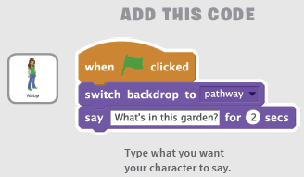
Coding instructions are clear and concise
HINT: At this point I ask students to “read” the blocks so they know what will happen with these blocks …
“When the green flag is clicked, the backdrop will be the pathway and the sprite Abby will have a speech bubble that says, “What’s in this garden?””

Slide 25
Here is the result
Having students talk their way through the coding is an important step
Often problem situations are “debugged” by talking them out to themselves or a peer

Slide 26
By the end of the 9 cards students can …
find and code multiple sprites’ movements separately
code sprites to interact with conversations and movements
code the sprites to move to specific co-ordinates in a four quadrant grid
find multiple backdrops and code them to change on demand
code the sprites to change colour or size
find sound clips and include them in the code
record their own voices to become part of the project
code a button
With this information students can begin to put tasks
together to make a project.

Slide 27
How did I prepare?
made a class account for the students in my Teacher’s Account
completed the sign in process and gave them a simple password
WHY? So that when they went to the site they could begin immediately and I knew all the accounts & passwords worked!
Made a link in School Connect for computers
Made a log-in slip for each of them for agenda (to use at school & home)

Slide 28
How did I start?
Put set of cards between 2 students coaches (trainers)
WHY? To encourage them to discuss how to complete tasks
Showed them to look for Backdrop and Sprite icons at lower LH side of computer screen and look for blocks by colour in screen middle
Explained that these cards were the basic skills that everyone in the class would learn
Connected the cards to learning the alphabet and after they learned the alphabet they could make their own words i.e., “projects”
Explained they would coach others by following the card instructions
Circulated around and when a student completed a card had them “read” the blocks and show me how it worked

Slide 29
Then …
Once coaches has finished 9 cards they then trained 2 other students each with their own computer but … no computer for the coach
WHY? So the coach would give their full attention to peers
In all cases I had the students check in with me by “reading” the blocks and sharing how it worked
I sat back & listened to them guide each other and share their enthusiasm!

Slide 30
Why this worked …
Student coaches took their jobs to heart and made sure they understood how to complete all the tasks on the cards before they worked with their classmates
Any concerns they had about sharing were alleviated because they knew everything they needed was on the cards
Students saved each page’s work as a project to show their families and as references for future work

Slide 31
So let’s try one of the cards …

Slide 32
When the whole class finished the cards…
We came together & with the use of a projector I showed them all the button links on the main screen
Part of it was a review and part new information
WHY? I think they should be successful right away and have a basic understanding of how it works and then build from there
Mention how to extend the backdrops and sprites by designing their own, going out on the internet, and using photographs
Explain the Sharing process, the idea of Remixing, and Scratch Community Guidelines
End with TIPS and direct students to Projects to try

Slide 33
Reviewing the Scratch screen

Slide 34
Reviewing Scratch Main screen

Slide 36
Star Icon
Love this Project
Total Views
View the Remix Tree

Slide 37
Comments and Remixes

Slide 38
Review Community Guidelines
We need everyone’s help to keep Scratch a friendly and creative community where people with different backgrounds and interests feel welcome.
Be respectful.
When sharing projects or posting comments, remember that people of many different ages and backgrounds will see what you’ve shared.
Be constructive.
When commenting on others' projects, say something you like about it and offer suggestions.
Share.
You are free to remix projects, ideas, images, or anything else you find on Scratch – and anyone can use anything that you share. Be sure to give credit when you remix.

Slide 39
Keep personal info private.
For safety reasons, don't give out any information that could be used for private communication - such as real last names, phone numbers, addresses, email addresses, links to social media sites or websites with unmoderated chat.
Be honest.
Don’t try to impersonate other Scratchers, spread rumors, or otherwise try to trick the community.
Help keep the site friendly.
If you think a project or comment is mean, insulting, too violent, or otherwise inappropriate, click “Report” to let us know about it.
Scratch welcomes people of all ages, races, ethnicities, religions, sexual orientations, and gender identities.
Scratch is a project of the Lifelong Kindergarten group at the MIT Media lab. It is available free at http://sctach.mit.edu

Slide 40
After Cards What Next?
Click on Tips
Pick on of the Step-by-Step tutorials
These basic projects are just like the Cards except now they complete multiples pages to rather than just one page

Slide 41
After Tutorials, What Next?
Starter Projects!!!!
https://scratch.mit.edu/starter_projects/
Now, no more instructions
Students study the project’s code and REMIX their projects

Slide 42
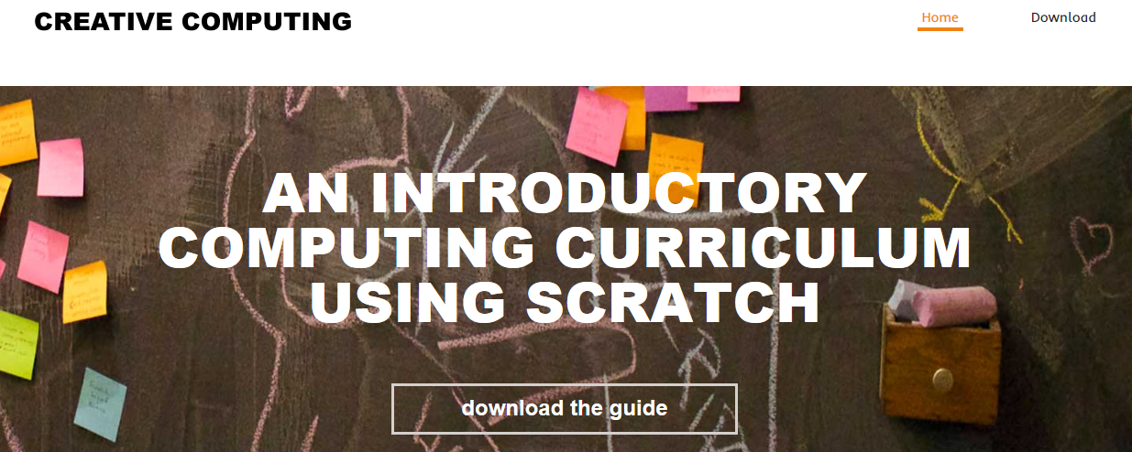
After Cards, Tutorials, & Starter Projects, what’s next for teachers?
There are resources to use:
Follow a series of lesson plans in An Introductory Computing Curriculum Using Scratch http://scratched.gse.harvard.edu/guide/files/CreativeComputing20141015.pdf

Slide 43
Look for a particular type of project or subject area in ScratchEd.

Slide 44
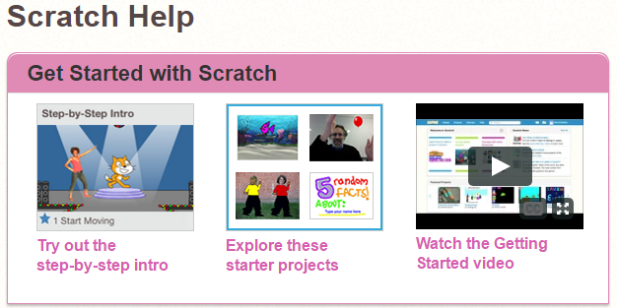
Where can teachers find out more? Scratch Help
https://scratch.mit.edu/help/

Slide 45
Scratch Guides

Slide 46
Searching the Scratch Community

Slide 47
Where can teachers get help? ScratchEd

Slide 48
Where can teachers get help? Scratch Wiki

Slide 49
Where can teachers get help? KPSCobraCoders.Weebly.com

