Slide 1
Students can learn Scratch without you getting in their way
Learning to Code with
Scratch Part 2
Link to this presentation:
www.KPSCobraCoders.weebly.com
Friday, May 11th, 2018
AM Session

Slide 2
http://kpscobracoders.weebly.com/
This slide show and any handouts will be found in our weebly.

Slide 3
Plan for the morning
Say hello to everyone!
● Start learning to code with Scratch cards
● The role of Scratch Coaches
● Discuss Hour of Code
● Continue working with Scratch cards
● Teacher Accounts with Scratch
● Finish working with Scratch cards
● Review Scratch site
● Work on a Scratch Tutorials
● Work on a Scratch Projects
● Lunch and Break then … Join afternoon session

Slide 4
Plan for the morning
● Start learning to code with Scratch cards
● The role of Scratch Coaches
● Discuss Hour of Code
● Continue working with Scratch cards
● Teacher Accounts with Scratch
● Finish working with Scratch cards
● Review Scratch site
● Work on a Scratch Tutorials
● Work on a Scratch Projects
● Lunch and Break then … Join afternoon session

Slide 5
In the past I …
worked with individual students,
worked with students in my own class (small groups) learning to code during class time while the rest of the class were working on language and math activities
worked with students from other classes, training a small group of students & then supervising them as they coached their classmates over 5 or 6 days
worked with students from another school, training a small group of students and they coached/trained their classmates while the homeroom teacher worked with the remaining students in one day
Trained adult robotics instructors for GECDSB Camp Wonder
Worked with teachers in workshops about Scratch
AND THEY ALL STARTED WITH
THE SAME SCRATCH CARD

Slide 6
In all situations I started with…

Slide 7
Why start with Scratch Cards?
Teachers copy off the Create a Story cards in colour - WHY?
Colour print to help students find the correct block because there are 10 categories of blocks in SCRIPTS & several of the colours are close
Suggestion 1 copy for every 2 students

Slide 8
The instructions have minimal text making it easy for students to learn simple tasks. Each task is one page long.
Everything they need is on the screen but they must learn to look for it. Stress that the Story Cards were made to be helpful so the information is there – just look!

Slide 9
Students are directed to resources already in Scratch libraries – Backgrounds Sprites

Slide 10
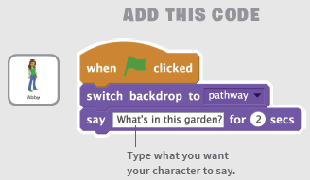
Coding instructions are clear and concise
HINT: At this point I ask coders to “read” the blocks so they know what will happen with these blocks …
“When the green flag is clicked, the backdrop will be the pathway and the sprite Abby will have a speech bubble that says, “What’s in this garden?””

Slide 11
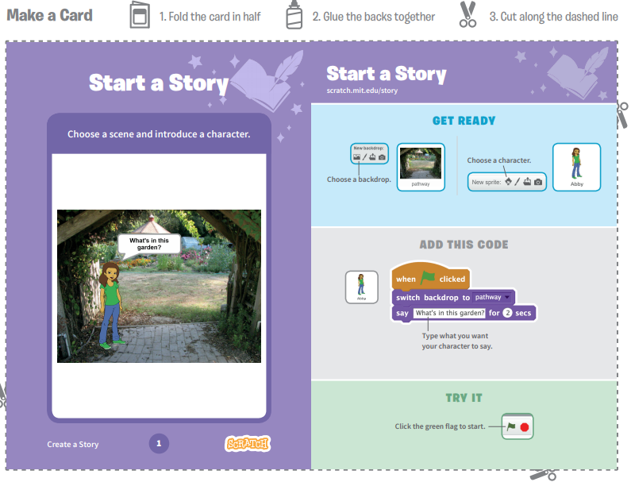
I do not go into detail but rather get right into the coding. The 1st card just needs a little information – where to find the icons for background and sprite. After experiencing all 9 cards I will go through the various aspects of the Scratch main screen. This way coders can connect to their experiences.

Slide 12
Here is the result
Having students talk their way through the coding is an important step
Often problem situations are “debugged” by talking them out to themselves or a peer
Debugging moves from a mistake, wrong, error to “it WILL be fixed
It builds a Community of Practice

Slide 13
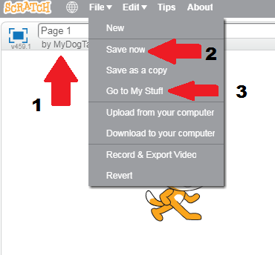
Work with your partner to complete the next several pages.
Before you move on to the second page make sure to save your project.
1 – Give the project a title. These projects can be named for the page #
2 – At File tab click on Save Now
3 –Before clicking on New Project, chick on Go to My Stuff to see it is there
Then at File Tab click New

Slide 14
Plan for the morning
● Start learning to code with Scratch cards
● The role of Scratch Coaches
● Discuss Hour of Code
● Continue working with Scratch cards
● Teacher Accounts with Scratch
● Finish working with Scratch cards
● Review Scratch site
● Work on a Scratch Tutorials
● Work on a Scratch Projects
● Lunch and Break then … Join afternoon session

Slide 15
Why Scratch Cards and Student Coaches?
In this set of cards (Create a Story Cards) there are 9 tasks students complete and this is a manageable number even if the students complete all in one day BUT with your class spread it out over 2 or 3 times (it is a great deal to learn in one day as you are about to find out!)
We have found that all our students can complete the tasks either independently or with student coaches (The effectiveness of Student Coaches is one of the concepts we did not consider in our original proposal)
We believe the idea of Student Coaches is key for teachers who want to have their students code but don’t know how to accomplish it
Using these cards ensures that all students have the same basic knowledge and therefore form a learning community to develop tasks beyond the ones described in the cards

Slide 16
How did I start?
Put set of cards between 2 students coaches (trainers) WHY? To encourage them to discuss how to complete tasks
Explained that these cards were the basic skills that everyone in the class would learn and connected the cards to learning the alphabet and after they learned the alphabet they could make their own words i.e., “projects”
Explained they would coach others by following the card instructions
Circulated around and when a student completed a card had them “read” the blocks and show me how it worked, showed them how to save, then move on to the next card
Kept them on track because they wanted to try out different items – which they can do later, but not as coaches

Slide 17
Then …
Once coaches has finished 9 cards they then trained 2 other students each with their own computer but … no computer for the coach
WHY? So the coach would give their full attention to peers
In all cases I had the students check in with me by “reading” the blocks and sharing how it worked
I sat back & listened to them guide each other and share their enthusiasm!

Slide 18
Why this worked …
Student coaches took their jobs to heart and made sure they understood how to complete all the tasks on the cards before they worked with their classmates
Any concerns they had about sharing were alleviated because they knew everything they needed was on the cards
Students saved each page’s work as a project to show their families and as references for future work
It was the start of building a Community of Practice

Slide 19
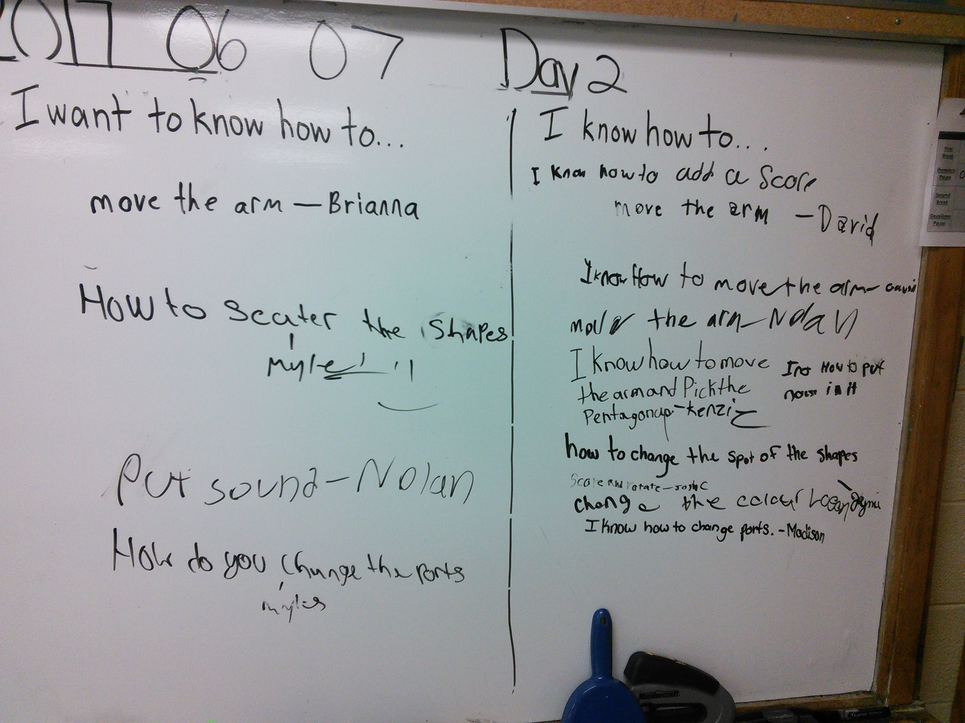

Slide 20
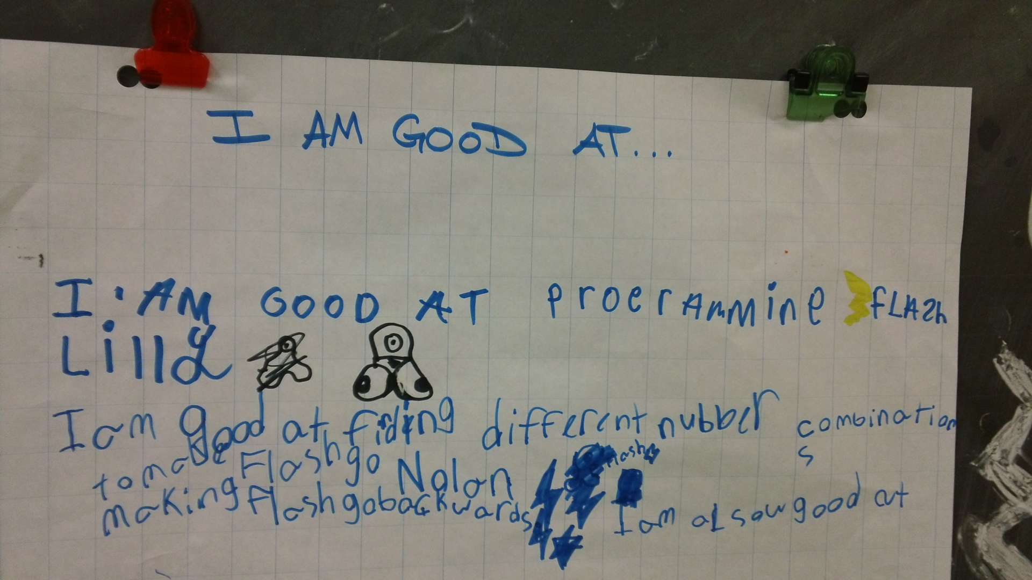

Slide 21
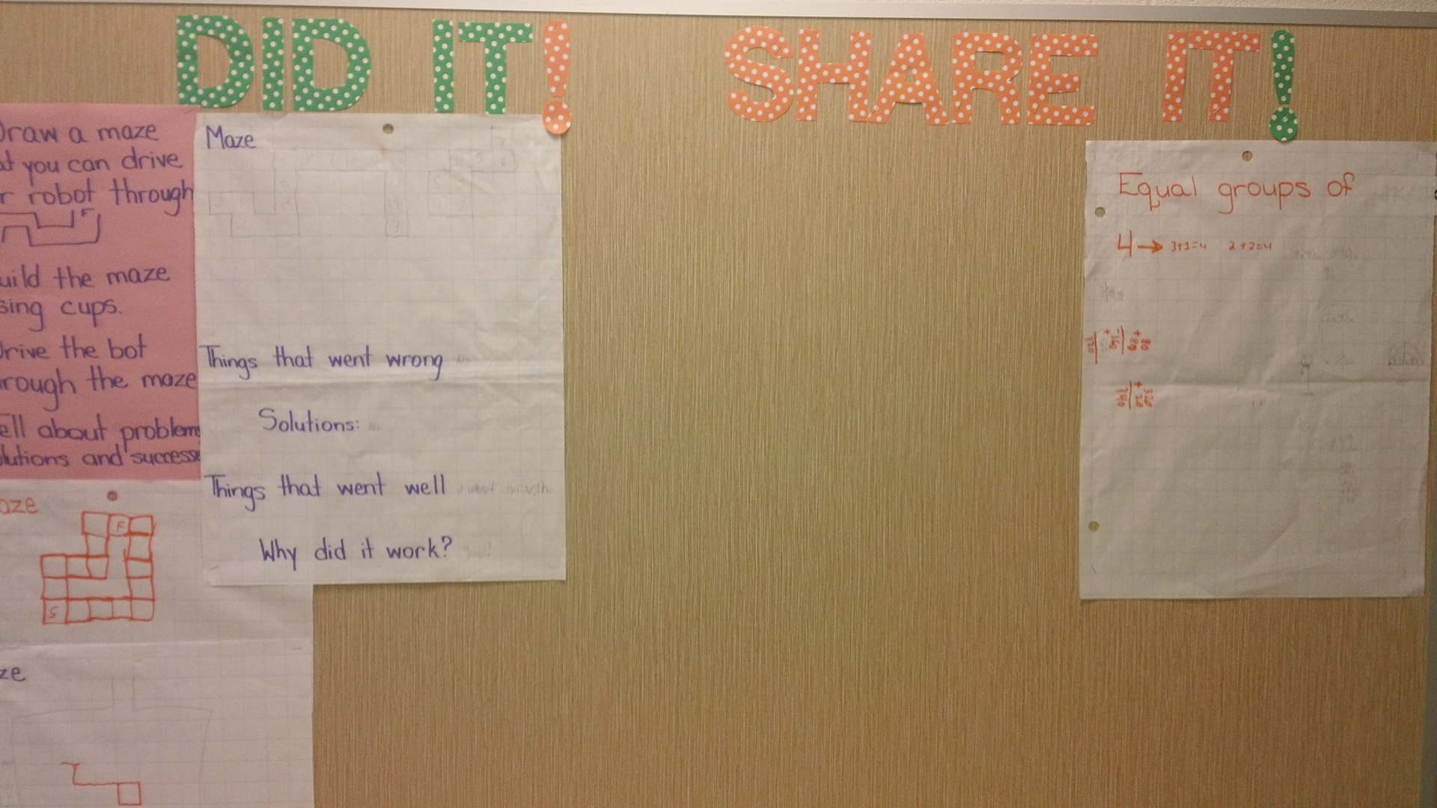

Slide 22
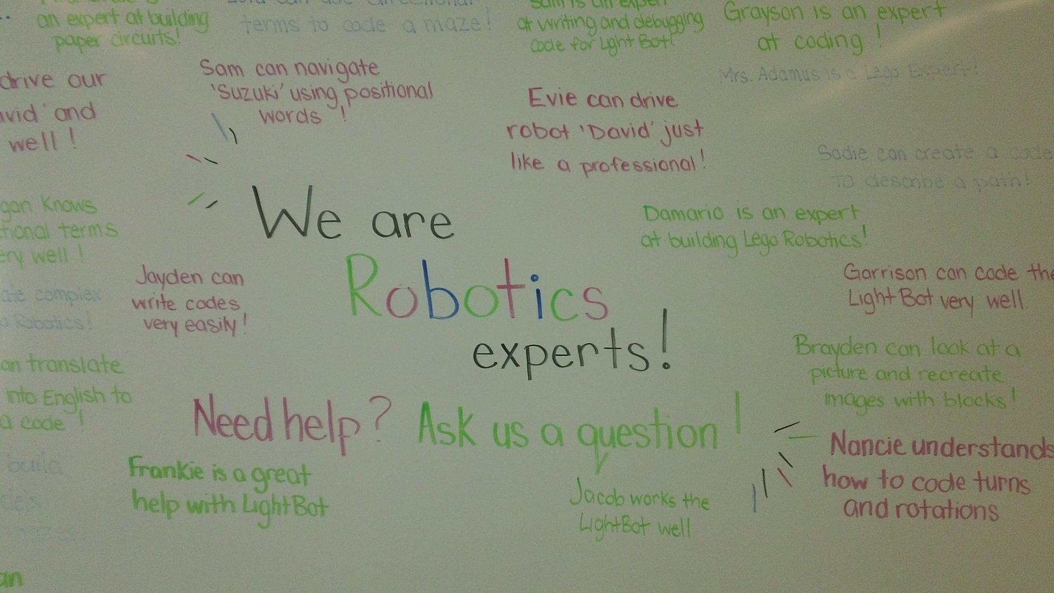

Slide 23
Plan for the morning
● Start learning to code with Scratch cards
● The role of Scratch Coaches
● Discuss Hour of Code
● Continue working with Scratch cards
● Teacher Accounts with Scratch
● Finish working with Scratch cards
● Review Scratch site
● Work on a Scratch Tutorials
● Work on a Scratch Projects
● Lunch and Break then … Join afternoon session

Slide 24
What if you want a little more time to get ready to code with your students?

Slide 25
Consider Hour of Code activities (https://code.org/learn ) Why? It is a great way to start coding AND needs no addition resources.

Slide 26
Activities for Hour of Code use blocks to code and design coding using popular characters.

Slide 27
http://partners.disney.com/hour-of-code/wayfinding-with-code?cds The goals of the game and each step are clearly identified so that coders meet success from the start.

Slide 28
When the blocks are in place the students click Run and watch what happens to the characters in the game.

Slide 29
The program directs the student to try again if the block choice is incorrect …

Slide 30
…or correct and then advances to the next step.
Students can be on Hour of Code activities without any further preparation on your part.

Slide 31
However … With Hour of Code …
it seemed students didn’t show any sizable connections when transferring block knowledge from one “game” to another and often tried varied combinations of blocks until one “worked”
it seemed students were interested in “beating” the level than learning to code
when students reached the final step (to develop a game) they became easily frustrated and it seemed that final step was too much of a leap from the previous steps
it seemed the gamification factor out-weighed the creativity factor

Slide 32
Hour or Code or Scratch? The answer is BOTH…
Hour of Code is a great way to get started coding
Students START to learn the basics of Block coding but …
With Scratch the creativity aspect dominates over the gaming aspect
Scratch enables students to continue to learn as they create
Scratch enables students to connect to a world-wide community
Scratch enables students to code in the virtual world and the real world (with devices such as Makey Makey and robots such as Mbots)

Slide 33
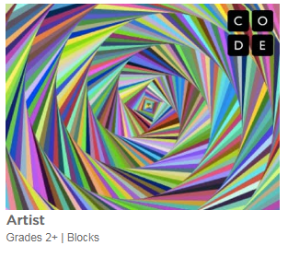
Artist activity is a low floor, high ceiling, & wide wall experience. Not as flashy as some of the others but gives students a chance to be very creative.
Consider it for older students as well even though it says Grade 2+!
https://studio.code.org/s/artist/stage/1/puzzle/1

Slide 34
Plan for the morning
● Start learning to code with Scratch cards
● The role of Scratch Coaches
● Discuss Hour of Code
● Continue working with Scratch cards
● Teacher Accounts with Scratch
● Finish working with Scratch cards
● Review Scratch site
● Work on a Scratch Tutorials
● Work on a Scratch Projects
● Lunch and Break then … Join afternoon session

Slide 35
Work with your partner on the next few cards.
Are you noticing that even though there are new blocks and actions with each card, you are able to continue to learn at a quicker rate?

Slide 36
Plan for the morning
● Start learning to code with Scratch cards
● The role of Scratch Coaches
● Discuss Hour of Code
● Continue working with Scratch cards
● Teacher Accounts with Scratch
● Finish working with Scratch cards
● Review Scratch site
● Work on a Scratch Tutorials
● Work on a Scratch Projects
● Lunch and Break then … Join afternoon session

Slide 37
What accounts do you need to get started?
Students can create their own accounts before they start or even AFTER they start BUT need to give an email
Students can share or NOT share their work
But even without an account any Project (work) can be downloaded & saved & then uploaded back into Scratch with either On- or Off-line versions
Teachers can create class accounts and students DONOT need an email account
These accounts make it easy for students to see their classmates work
Students can share or NOT share their work
Teacher accounts need time to be verified, not instant like a single account

Slide 38
How did I prepare?
made a class account for the students in my Teacher’s Account
completed the sign in process and gave them a simple password
WHY? So that when they went to the site they could begin immediately and I knew all the accounts & passwords worked!
Made a link in School Connect for computers
Made a log-in slip for each of them for agenda (to use at school & home)

Slide 39
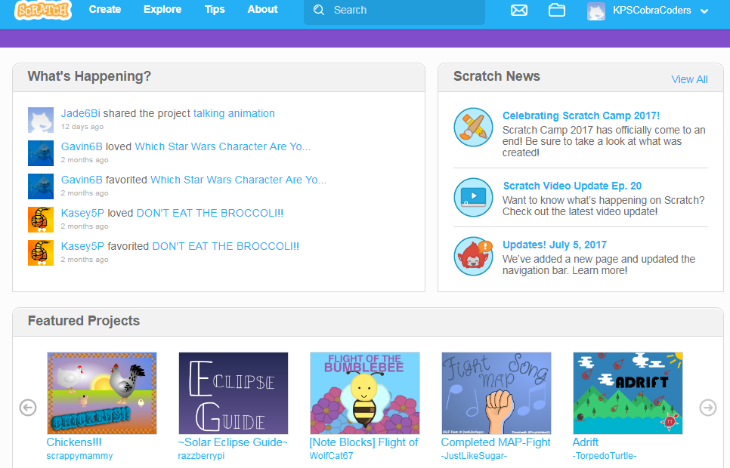
Main Screen in Teacher’s Account – Note updates on Student Activity

Slide 40
Plan for the morning
● Start learning to code with Scratch cards
● The role of Scratch Coaches
● Discuss Hour of Code
● Continue working with Scratch cards
● Teacher Accounts with Scratch
● Finish working with Scratch cards
● Review Scratch site
● Work on a Scratch Tutorials
● Work on a Scratch Projects
● Lunch and Break then … Join afternoon session

Slide 41
FYI: Using the device’s camera and/or microphone requires two acceptances

Slide 42
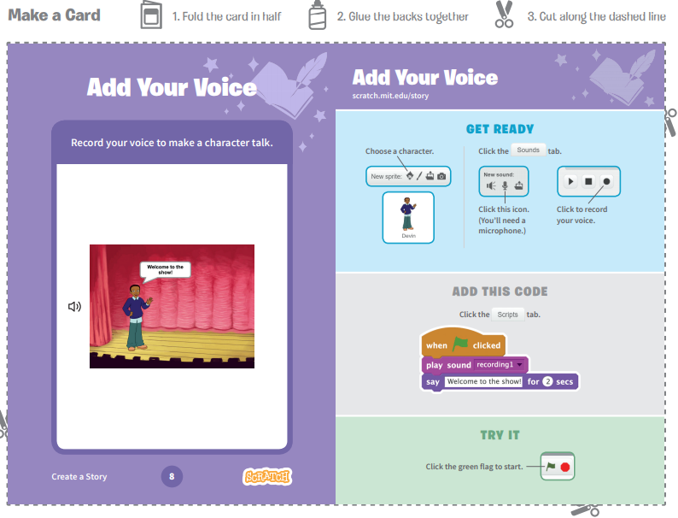
Almost done!

Slide 43
By the end of the 9 cards coders can …
find and code multiple sprites’ movements separately
code sprites to interact with conversations and movements
code the sprites to move to specific co-ordinates in a four quadrant grid
find multiple backdrops and code them to change on demand
code the sprites to change colour or size
find sound clips and include them in the code
record their own voices to become part of the project
code a button
With this information coders can begin to put tasks
together to make a project.

Slide 44
Plan for the morning
● Start learning to code with Scratch cards
● The role of Scratch Coaches
● Discuss Hour of Code
● Continue working with Scratch cards
● Teacher Accounts with Scratch
● Finish working with Scratch cards
● Review Scratch site
● Work on a Scratch Tutorials
● Work on a Scratch Projects
● Lunch and Break then … Join afternoon session

Slide 45
When the whole class finished the cards…
We came together & with the use of a projector I showed them all the button links on the main screen
Part of it was a review and part new information
WHY? I think they should be successful right away and have a basic understanding of how it works and then build from there
Mention how to extend the backdrops and sprites by designing their own, going out on the internet, and using photographs
Explain the Sharing process, the idea of Remixing, and Scratch Community Guidelines, AND REPORTING
End with TIPS and direct students to Tutorials to try
You might want to review the Scratch main page several times, depending on questions asked by your students as time goes on

Slide 46
Reviewing the Scratch screen

Slide 47
Later coders learn how to create their own Sprites and Backdrops:

Slide 48
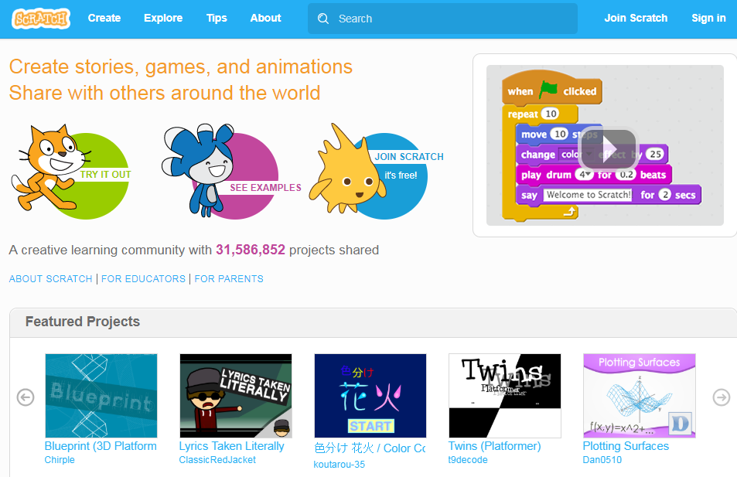
Reviewing Scratch Main screen

Slide 50
Other items for each project
Star Icon
Love this Project
Total Views
View the Remix Tree

Slide 51
Comments and Remixes … leading to Scratch community Guidelines

Slide 52
Review Community Guidelines
We need everyone’s help to keep Scratch a friendly and creative community where people with different backgrounds and interests feel welcome.
Be respectful.
When sharing projects or posting comments, remember that people of many different ages and backgrounds will see what you’ve shared.
Be constructive.
When commenting on others' projects, say something you like about it and offer suggestions.
Share.
You are free to remix projects, ideas, images, or anything else you find on Scratch – and anyone can use anything that you share. Be sure to give credit when you remix.

Slide 53
Keep personal info private.
For safety reasons, don't give out any information that could be used for private communication - such as real last names, phone numbers, addresses, email addresses, links to social media sites or websites with unmoderated chat.
Be honest.
Don’t try to impersonate other Scratchers, spread rumors, or otherwise try to trick the community.
Help keep the site friendly.
If you think a project or comment is mean, insulting, too violent, or otherwise inappropriate, click “Report” to let us know about it.
Scratch welcomes people of all ages, races, ethnicities, religions, sexual orientations, and gender identities.
Scratch is a project of the Lifelong Kindergarten group at the MIT Media lab. It is available free at http://sctach.mit.edu

Slide 54
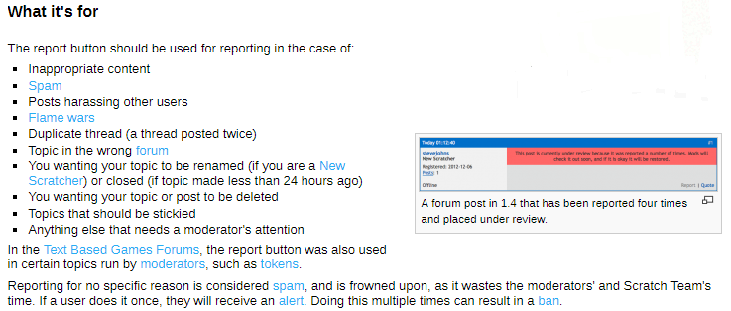
https://en.scratch-wiki.info/wiki/Report
You might choose to discuss this entry during your review of the Scratch main screen or on its own since there are important ideas regarding cyberbullying. It is also a good page to share with any families who are worried about Scratch and the Internet (also remember the Scratch program can be downloaded to a computer and then used without Internet access).

Slide 55
Plan for the morning
● Start learning to code with Scratch cards
● The role of Scratch Coaches
● Discuss Hour of Code
● Continue working with Scratch cards
● Teacher Accounts with Scratch
● Finish working with Scratch cards
● Review Scratch site
● Work on a Scratch Tutorials
● Work on a Scratch Projects
● Lunch and Break then … Join afternoon session

Slide 56
After Cards What Next?
Click on Tips
Pick on of the Step-by-Step tutorials
These basic projects are just like the Cards except now they complete multiples pages to rather than just one page

Slide 57
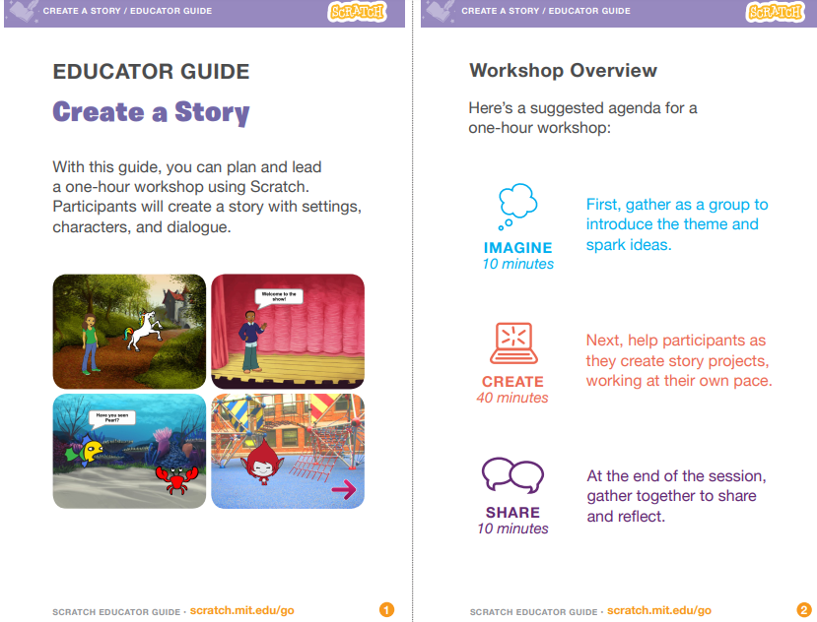

Slide 58
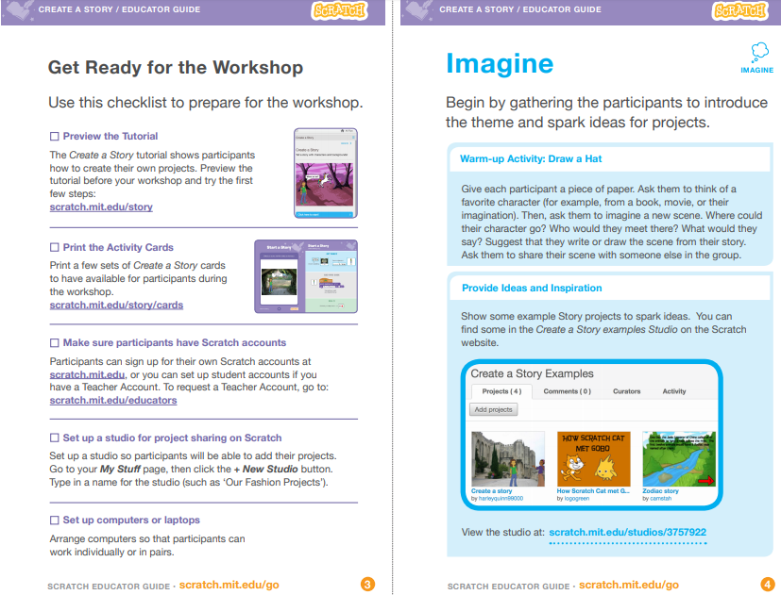

Slide 59
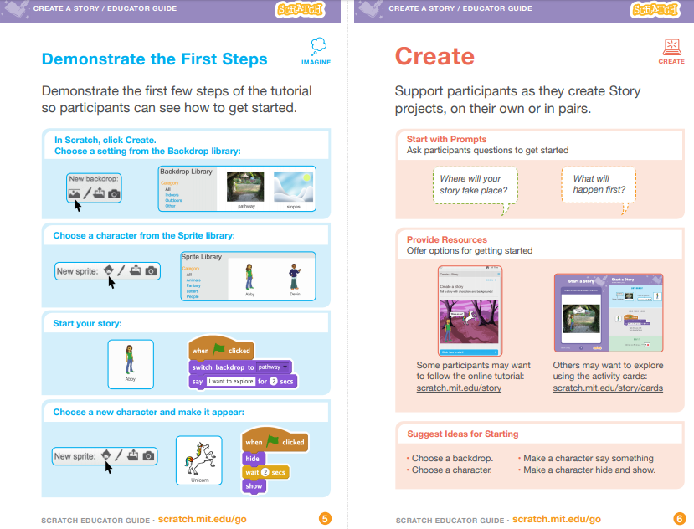

Slide 60
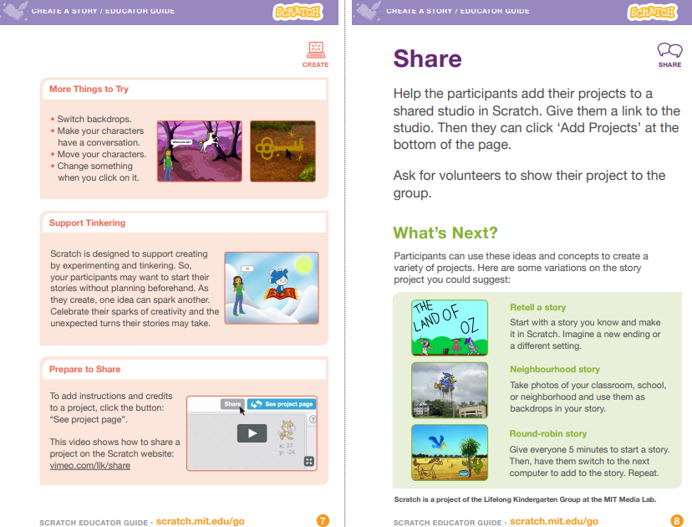

Slide 61
Plan for the morning
● Start learning to code with Scratch cards
● The role of Scratch Coaches
● Discuss Hour of Code
● Continue working with Scratch cards
● Teacher Accounts with Scratch
● Finish working with Scratch cards
● Review Scratch site
● Work on a Scratch Tutorials
● Work on a Scratch Starter Projects
● Lunch and Break then … Join afternoon session

Slide 62
After Tutorials, What Next?
Starter Projects!!!!
https://scratch.mit.edu/starter_projects/
Now, no more instructions
However, there are NOTES inside the project to give hints about the actions of Block stacks
Students study the project’s code and REMIX their projects

Slide 63
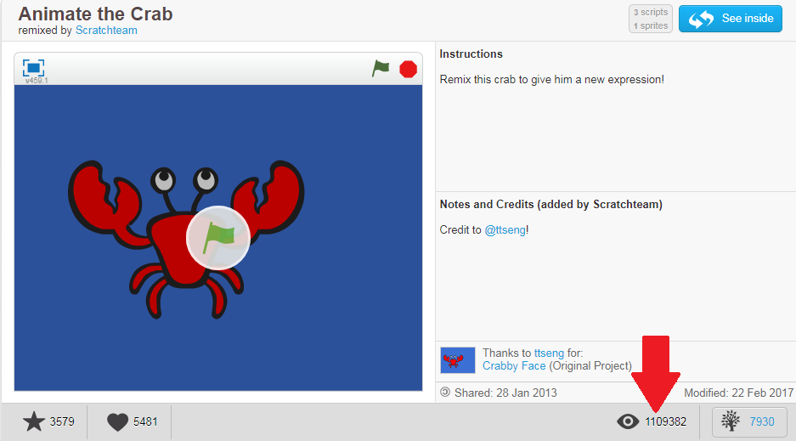
https://scratch.mit.edu/projects/10015059/

Slide 64
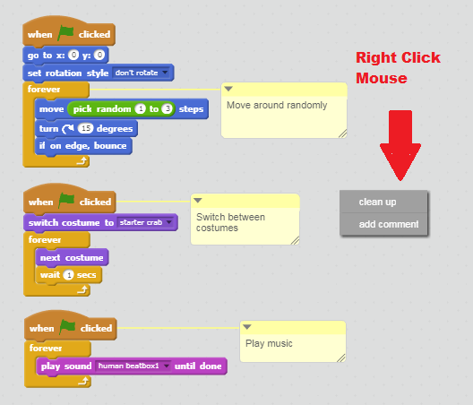
No more instructions for Starter Projects
However there are these Comments
That give information about the actions of these three block stacks
Encourage your students to add these to their own projects to help others understand their coding and, if needed, to debug it

Slide 65
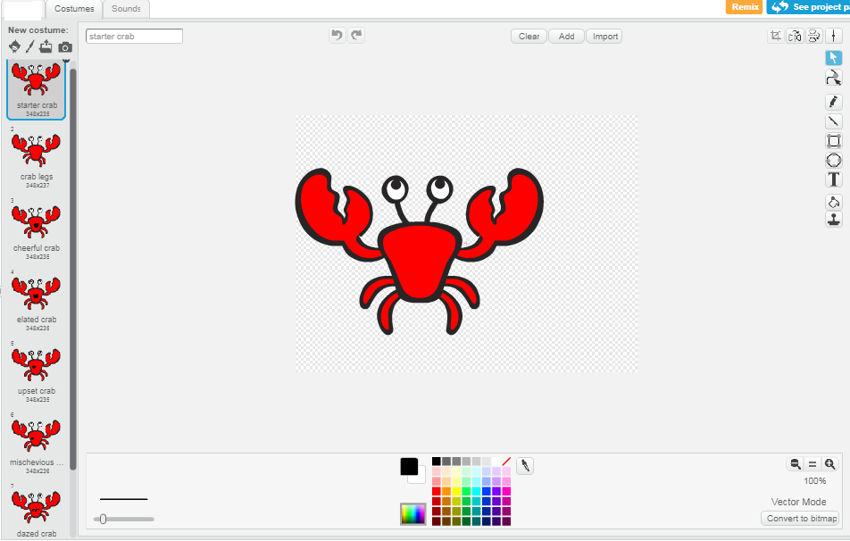
Introduction to animation

Slide 66
Plan for the morning
● Start learning to code with Scratch cards
● The role of Scratch Coaches
● Discuss Hour of Code
● Continue working with Scratch cards
● Teacher Accounts with Scratch
● Finish working with Scratch cards
● Review Scratch site
● Work on a Scratch Tutorials
● Work on a Scratch Starter Projects
● Lunch and Break then … Join afternoon session

