Slide 1
Students can learn Scratch without you getting in their way
Learning to Code with
Scratch: Before the Workshop
Link to this presentation:
www.KPSCobraCoders.weebly.com
Tuesday AM or Tuesday PM 11/27
or Wednesday AM 11/28

Slide 2
The purpose of this slide show is:
● To show you how to apply for an individual SCRATCH account
and
● To show you how to apply for a teacher SCRATCH account
If you have an account set up before the workshop you can play around ahead of time. If you have questions about any pre-workshop coding you do, save it, and we can talk about it during the workshop.
If you do NOT have an account set up before the workshop, an individual account can be created instantly when you get here and you can save your workshop coding immediately.
A teacher account is NOT created instantly. Responses can take up to 24 hours. There are “vetting” procedures in place so be sure to use your PublicBoard email address.

Slide 3
Question:
Should I make an individual account or a teacher’s account?
I suggest you create both. With your individual account you can try out your own coding and, if you don’t “SHARE” it with the rest of the Scratch community, no one will see it. You have that option.
A Teacher’s account will give you the ability to make an account for each of your students and with a teacher’s account you can monitor their activity. If you intend to share your coding with your students, you simply log in to your teacher’s account and code there for all your students to see.

Slide 4
The goals of this workshop are:
To provide a practical and informative session for educators to begin to feel comfortable using Scratch coding with their students
To showcase a series of activities teachers can use over a period of time and systematically to develop their students’ coding ability
To introduce the various components of the Scratch developed by the Lifelong Kindergarten Group of MIT
To show some of the changes for Scratch 3.0 that will launch January 2nd 2019 (don’t work 2.0 will still work!)

Slide 5
Scratch: https://scratch.mit.edu
By the day of your workshop please go to this site and join Scratch by following the next several slides.

Slide 6
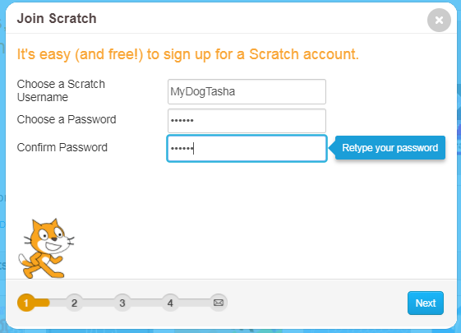
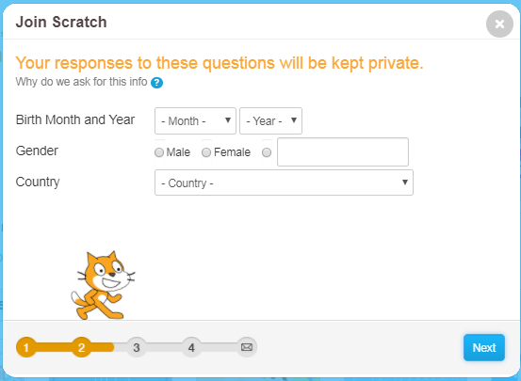
Here are the first two screens to create your account

Slide 7
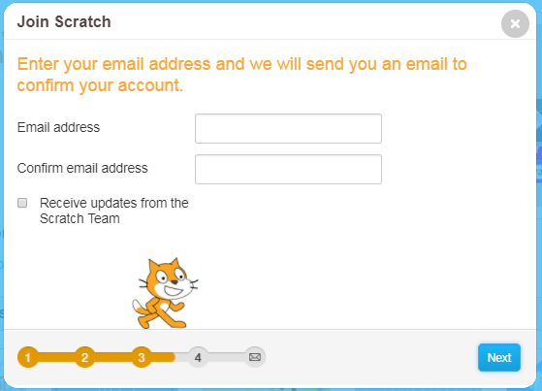
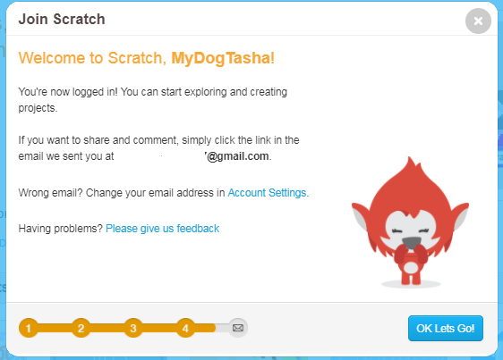
Here are the 3rd and 4th screens to complete your new account

Slide 8
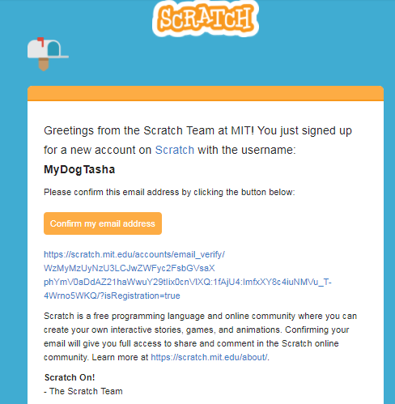
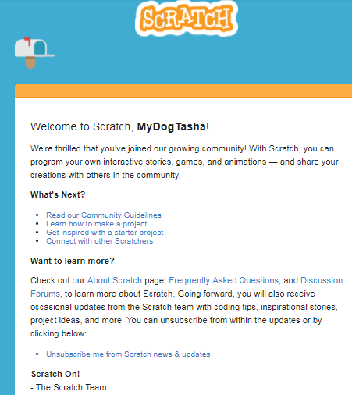
You will get an email to confirm your email for the account and
then an email of Welcome

Slide 9
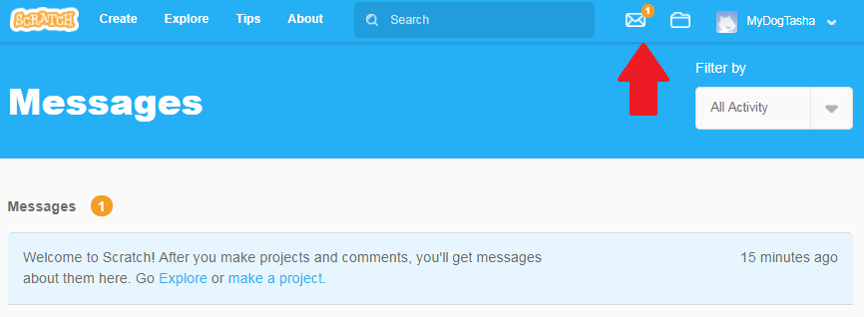
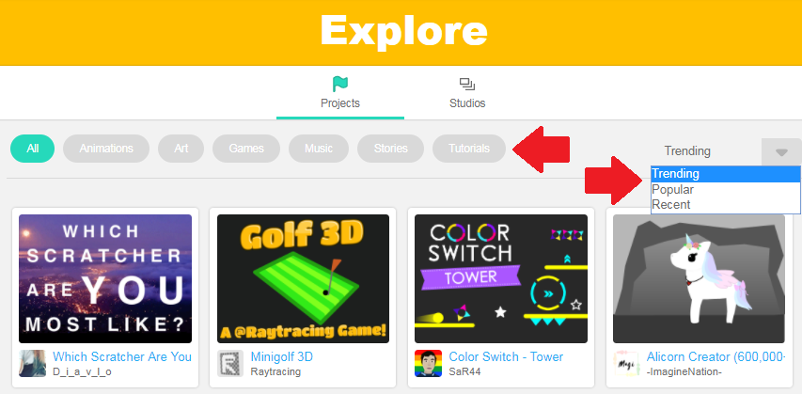
Notice your account name now appears in the upper RH corner. You will have a message that looks like this giving you the links and the choice to go Explore …

Slide 10
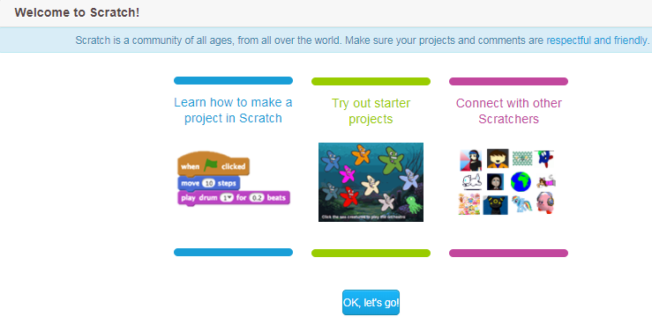
… or make a project

Slide 11
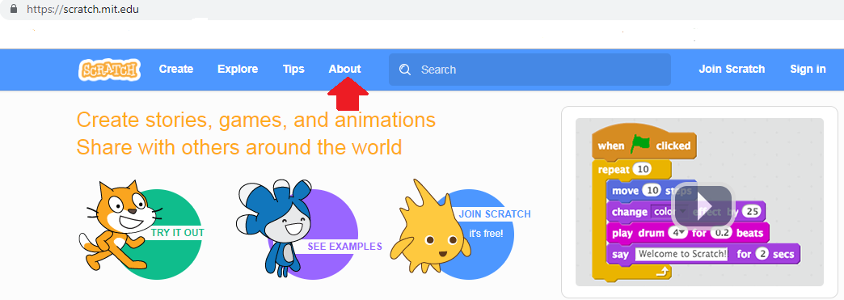
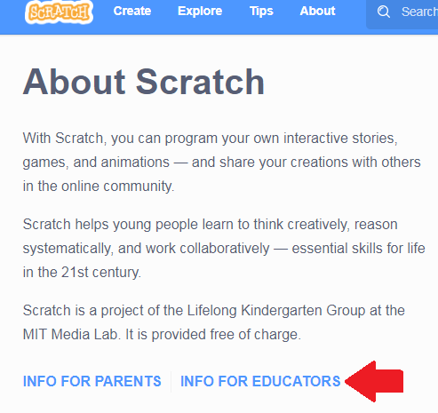
Here are the steps to make a Teacher Account… Click on About … Info for Educators …
https://scratch.mit.edu/about

Slide 12
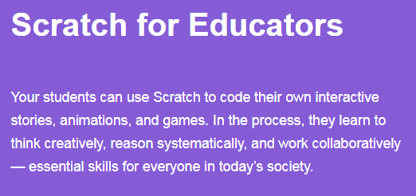
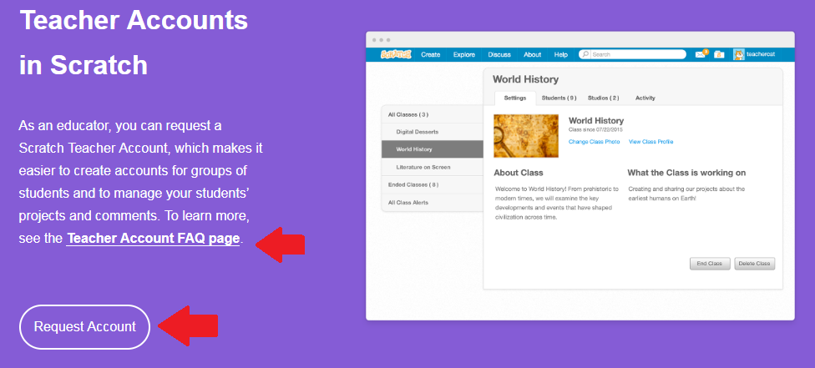
https://scratch.mit.edu/educators/
Scroll down for FAQ and click Request Account

Slide 13
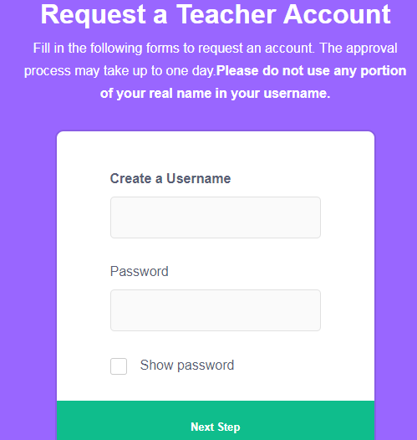
https://scratch.mit.edu/educators/register
There are 8 screens of information to complete …
HINT: pick as simple a name and password as you can because you will be typing it often, especially if you make student accounts. Later, when you have your account, log into each student account BEFORE giving them out. This may seem like extra work but it saves confusion when they are used for the first time.

Slide 14
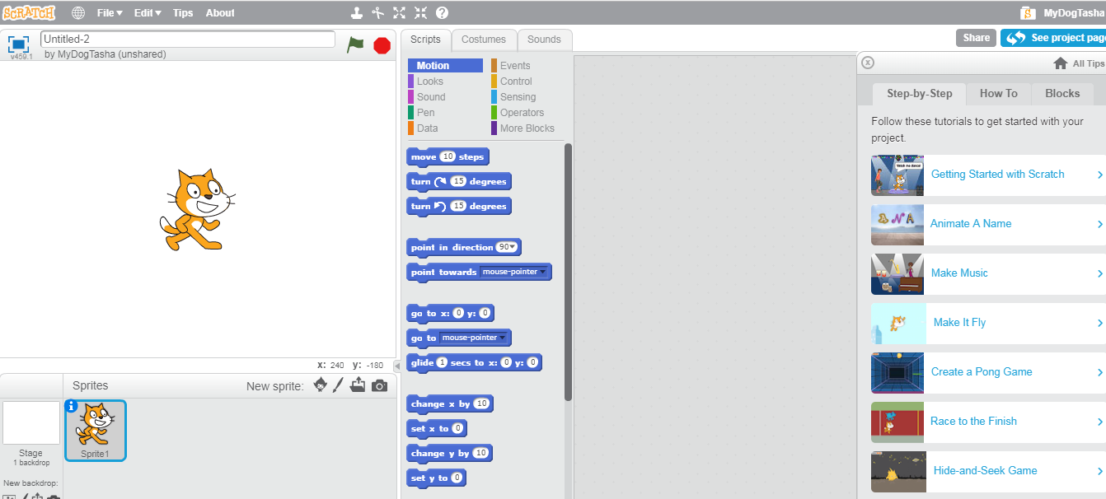
Ready, Set, Go! See you on Tuesday or Wednesday!

