Slide 1
Students can learn Scratch without you getting in their way
Scratch
Developing Lesson Plans
Link to this presentation:
www.KPSCobraCoders.weebly.com
April 27 Workshop

Slide 2
Welcome!
After you get settled please look around the room at the files I have set out. Start to think if there is an idea or project that not only looks interesting to you but is something that you might be able to incorporate into your day. The files are grouped by subject.
If possible I would like you to work in pairs. You could:
Pair up with someone from your school or
Pair up as a beginner and more experienced coder or
Pair up with someone who teaches the same grade as you or
Pair up with someone who wants to work on the same project as you.

Slide 3
http://kpscobracoders.weebly.com/
This slide show and any handouts will be found in our weebly.

Slide 4
The goals of this workshop are:
To provide a practical and informative session for educators who would like their students to code in Scratch
To showcase useful resources for teachers to develop their students’ ability to code projects assigned to them or of their own creation
To develop a community of teachers working together within GECDSB to share resources and assistance

Slide 5
Scratch: https://scratch.mit.edu

Slide 6
Plan for the Afternoon
● Quick Introduction
● How to find a project you can use
● How to determine how you can use a project
● A Generic Project
● Work on a coding lesson
● Unplugged Introduction to a project
● Continue to work on a coding lesson
● Classroom jobs
● Continue to work on a coding lesson

Slide 7
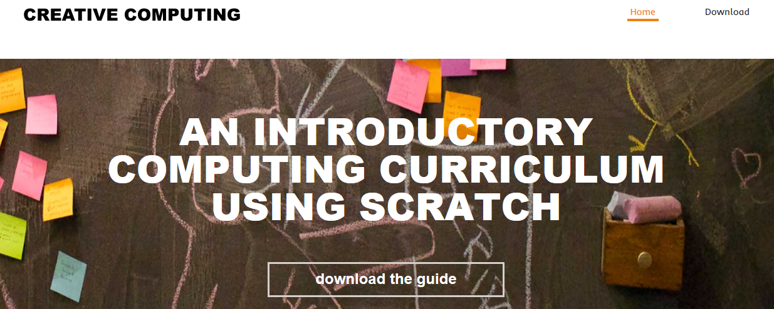
After Cards, Tutorials, & Starter Projects, what’s next for teachers?
Follow a series of lesson plans in An Introductory Computing Curriculum Using Scratch http://scratched.gse.harvard.edu/guide/files/CreativeComputing20141015.pdf
But … is there a way to not add on to our day and yet have our students code?

Slide 8
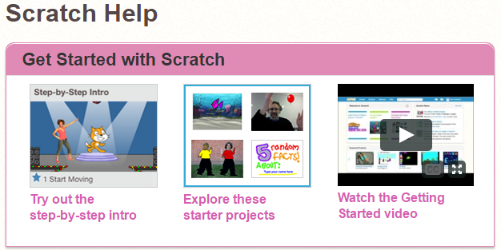
Where can teachers find out more? Scratch Help
https://scratch.mit.edu/help/

Slide 9
Scratch Guides

Slide 10
Where can teachers get help? ScratchEd

Slide 11
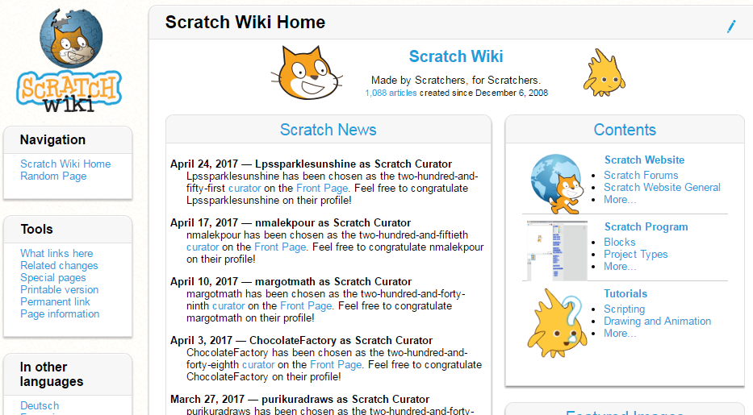

Slide 12
When I started I never looked in the Scratch Wiki because I thought it was too technical. I looked a the Main Page and didn’t see how any of the information would help me. I was wrong. I go to it constantly, more so than even ScratchEd now. It has entries about basic blocks all the way up to information I still don’t understand. But as I learn more I go to the Wiki more. The information I need is always there. Later this afternoon I will suggest another use for the Wiki.

Slide 13
Plan for the Afternoon
● Quick Introduction
● How to find a project you can use
● How to determine how you can use a project
● A Generic Project
● Work on a coding lesson
● Unplugged Introduction to a project
● Continue to work on a coding lesson
● Classroom jobs
● Continue to work on a coding lesson

Slide 14
Here is how I used to look for projects …

Slide 15
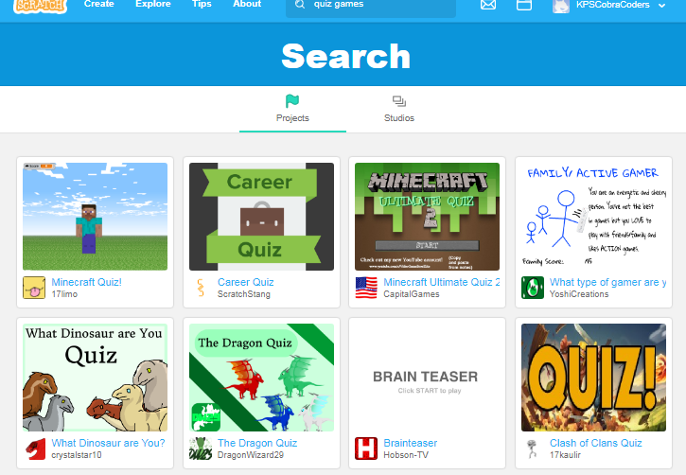
First I would search for project ideas in Scratch

Slide 16
When creating a project or studio coders may add up to 3 Tags.
See Scratch Wiki https://en.scratch-wiki.info/wiki/Project_Tags

Slide 17
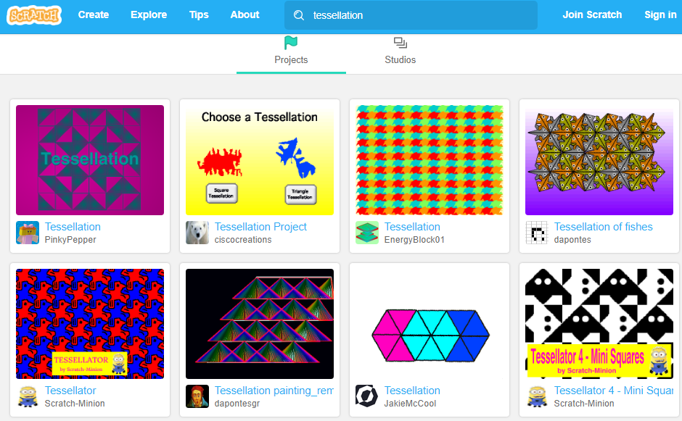

Slide 18
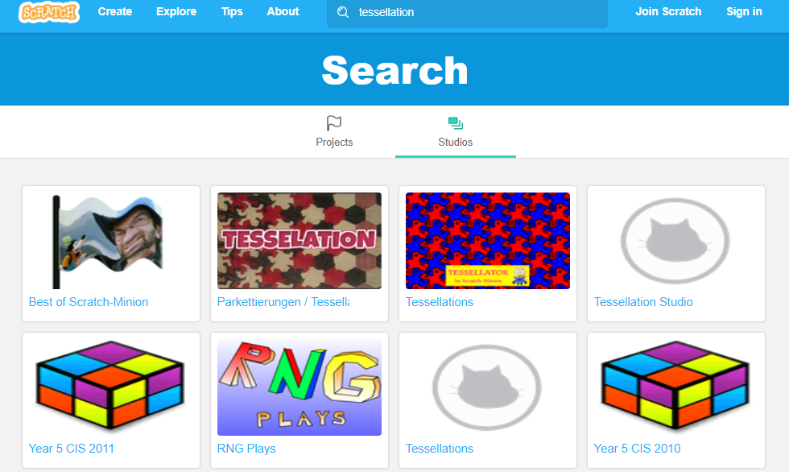

Slide 19
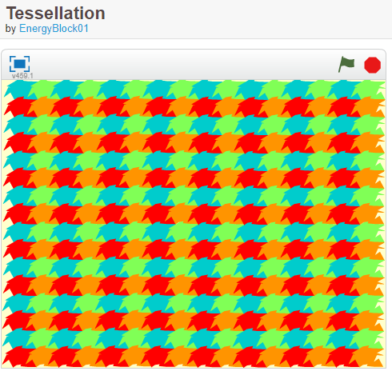
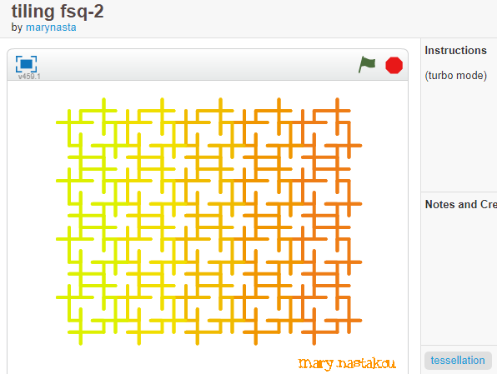
The Scratch search engine “picks” up these projects because one has Tessellation as the TITLE and the other has tessellation as a TAB.

Slide 20
Second, I would look for a particular type of project or subject area in ScratchEd.
I couldn’t always find what I wanted

Slide 21
But.. when I start with a Google search I:
● Found Dynamic Paper creator at NCTM https://illuminations.nctm.org/Activity.aspx?id=3509
● Found Scratch Ireland site with resources
● Found a site dedicated to Tessellations http://www.tessellations.org/index.shtml

Slide 22
Here is how I search now …

Slide 23
I start by using a search engine - Google and type in search terms. For example:
Scratch projects + explorers
I am finding Scratch projects as well as outside sources with projects &/or lesson plans.

Slide 24
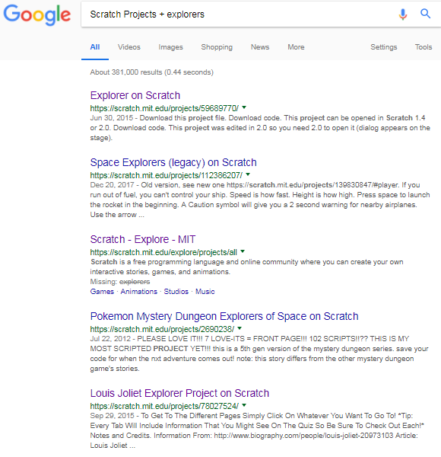
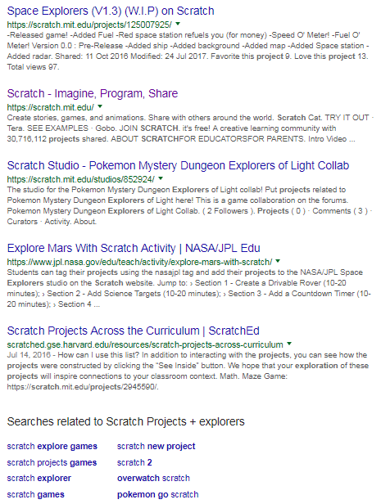

Slide 25
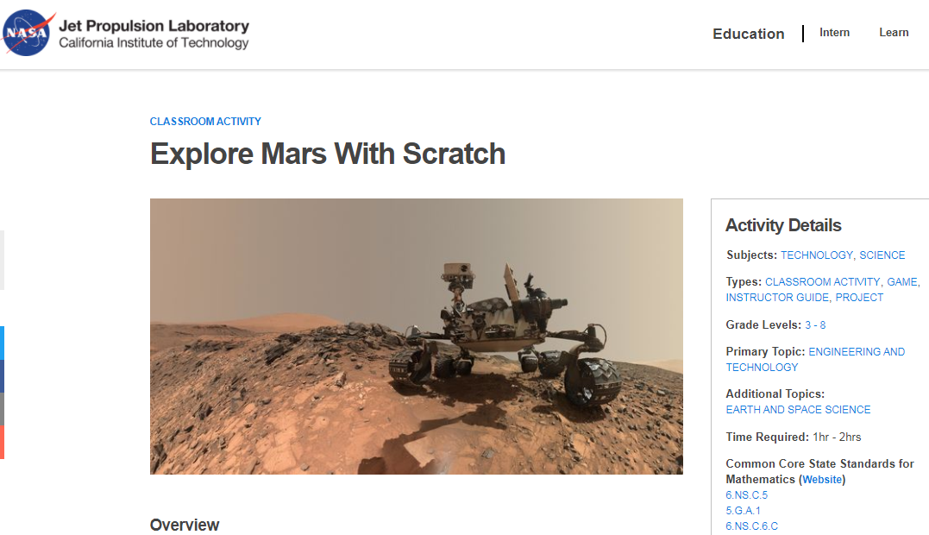
https://www.jpl.nasa.gov/edu/teach/activity/explore-mars-with-scratch/
I add this to a new file even though this isn’t what I was searching for it is a great project!

Slide 26
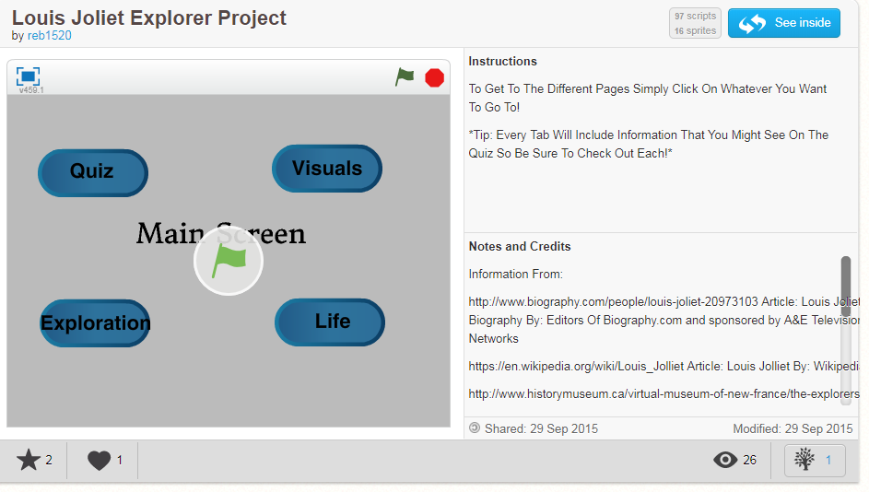
https://scratch.mit.edu/projects/78027524/

Slide 27
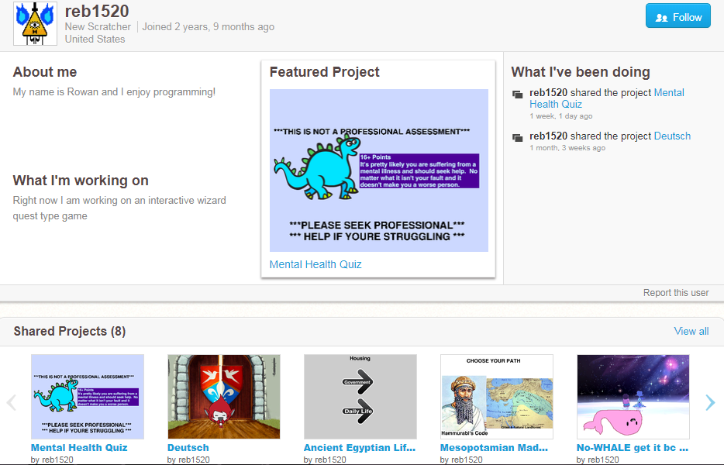
Then I continue my search in Scratch. I search with the TABS if there are any. I also click on the coder’s User Name and check out their other projects and studios. If I see something that might be suitable I start a Word file and use Paint to copy part of the project so I can recall it later on.

Slide 28
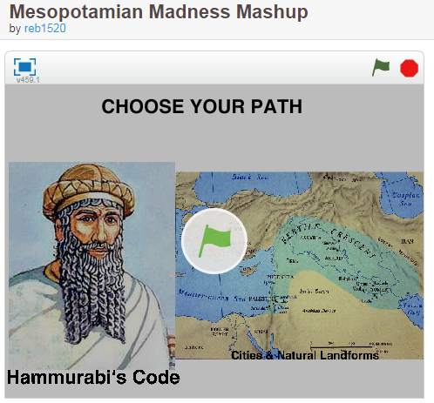
https://scratch.mit.edu/projects/126218863/
https://scratch.mit.edu/projects/122160960/
These would make good examples to show students how to code a research project. If you find a project that looks promising you could do the same thing and then we could share what we find.

Slide 29
Plan for the Afternoon
● Quick Introduction
● How to find a project you can use
● How to determine how you can use a project
● A Generic Project
● Work on a coding lesson
● Unplugged Introduction to a project
● Continue to work on a coding lesson
● Classroom jobs
● Continue to work on a coding lesson

Slide 30
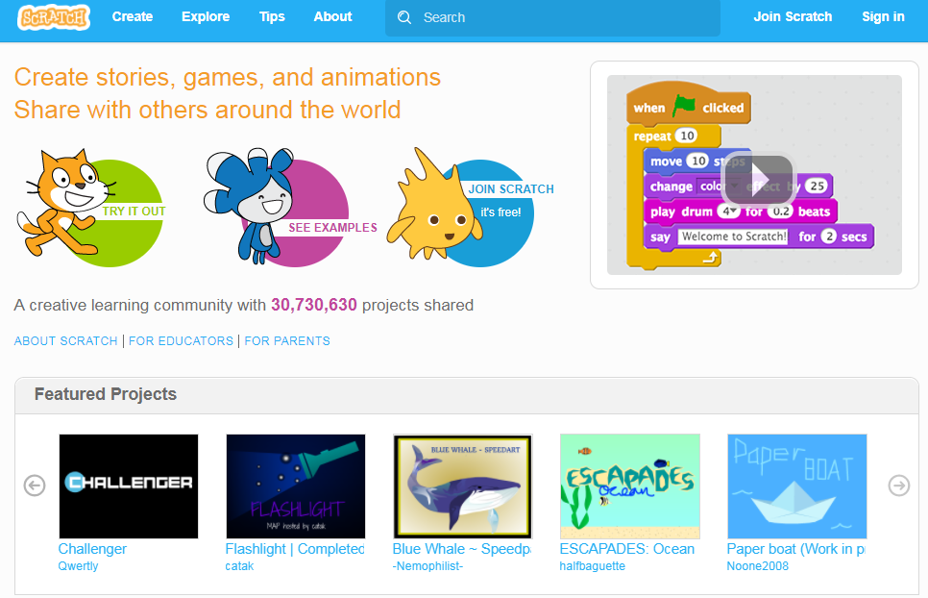

Slide 31
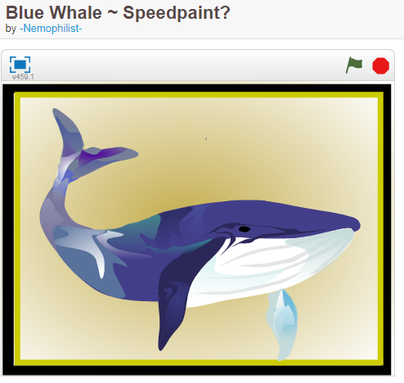
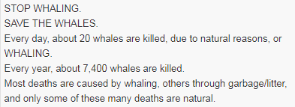
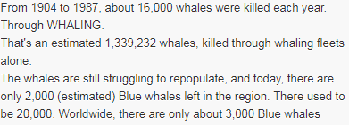
https://scratch.mit.edu/projects/209556851/

Slide 32
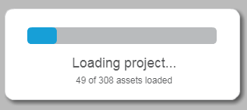
What to check out when deciding whether or not to use an existing project:
Do you intend to use it to …
Have your students learn from it?
Have your students gather coding ideas from it?
Have your students remix it?
If so, check out the number of scripts and sprites as well as the number of assets (sounds & images) when the project is loading.

Slide 33
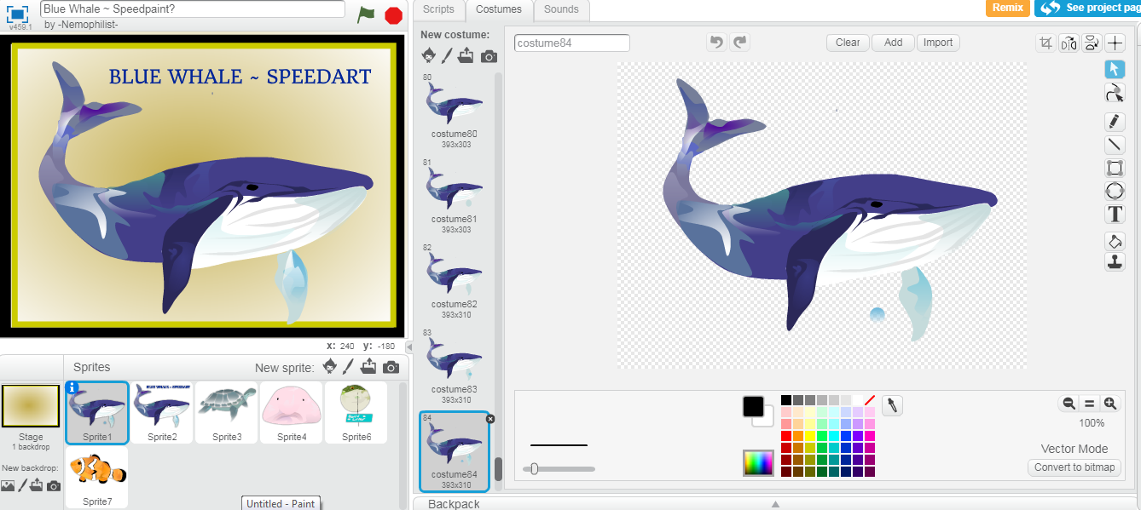
This is not suitable to remix and most probably beyond the artistic skills of our students and probably days to createso this project can just be enjoyed when viewed.

Slide 34
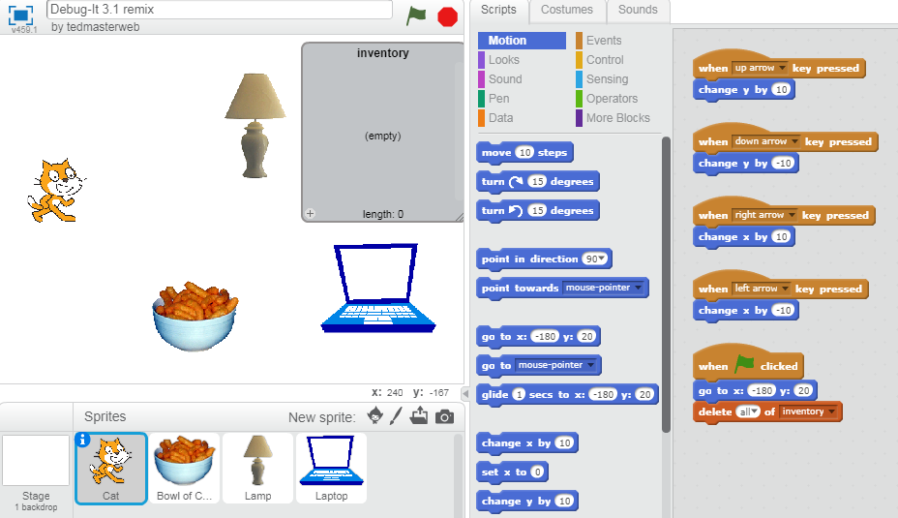
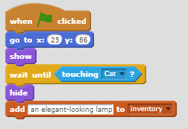
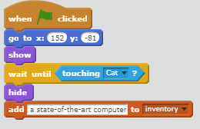
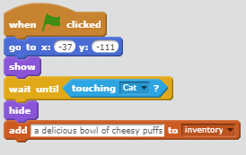
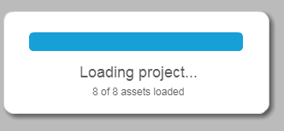
Few assets (sound or image), 4 sprites, 8 scripts 3 of which are similar with slight changes – this can be remixed or used for coding ideas

Slide 35
Plan for the Afternoon
● Quick Introduction
● How to find a project you can use
● How to determine how you can use a project
● A Generic Project
● Work on a coding lesson
● Unplugged Introduction to a project
● Continue to work on a coding lesson
● Classroom jobs
● Continue to work on a coding lesson

Slide 36
Here is the first project I am going to share with you. I classify it as a Generic Project.
It is a project example of the idea of low floor, high ceiling, and wide walls.
This project has minimal coding (low floor) to be successful and yet, the coding can be enhanced and added on to (high ceiling) in any number of ways.
The information needed to be include in the project can be from any subject area and any grade level (wide walls).

Slide 37
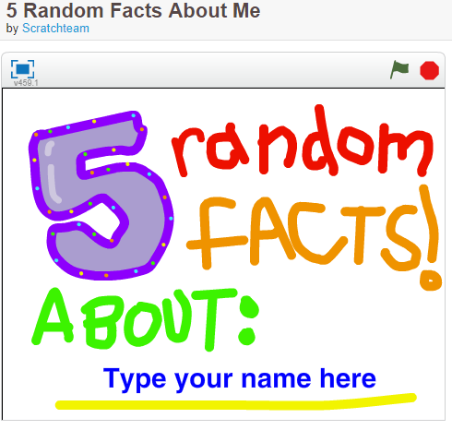
https://scratch.mit.edu/projects/10014866/

Slide 38
Plan for the Afternoon
● Quick Introduction
● How to find a project you can use
● How to determine how you can use a project
● A Generic Project
● Work on a coding lesson
● Unplugged Introduction to a project
● Continue to work on a coding lesson
● Classroom jobs
● Continue to work on a coding lesson

Slide 39
Plan for the Afternoon
● Quick Introduction
● How to find a project you can use
● How to determine how you can use a project
● A Generic Project
● Work on a coding lesson
● Unplugged Introduction to a project
● Continue to work on a coding lesson
● Classroom jobs
● Continue to work on a coding lesson

Slide 40
Guess My Number Game
How do we introduce the ideas to our students so they can develop a coding algorithm?
One way is to act it out.

Slide 41
Plan for the Afternoon
● Quick Introduction
● How to find a project you can use
● How to determine how you can use a project
● A Generic Project
● Work on a coding lesson
● Unplugged Introduction to a project
● Continue to work on a coding lesson
● Classroom jobs
● Continue to work on a coding lesson

Slide 42
Plan for the Afternoon
● Quick Introduction
● How to find a project you can use
● How to determine how you can use a project
● A Generic Project
● Work on a coding lesson
● Unplugged Introduction to a project
● Continue to work on a coding lesson
● Classroom jobs
● Continue to work on a coding lesson

Slide 43
How else can we integrate Scratch coding into our day AND develop our understanding of coding at the same time?
Handout: Scratch Classroom Jobs

Slide 44
Plan for the Afternoon
● Quick Introduction
● How to find a project you can use
● How to determine how you can use a project
● A Generic Project
● Work on a coding lesson
● Unplugged Introduction to a project
● Continue to work on a coding lesson
● Classroom jobs
● Continue to work on a coding lesson

Slide 45
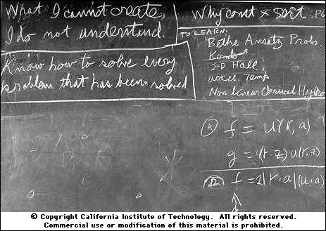
What I cannot create
I do not understand
Thanks Doug Peterson
Richard Feynman’s blackboard at the time of his death

