Slide 1
Students can learn Scratch without you getting in their way
Learning to Code with
Scratch
Link to this presentation:
www.KPSCobraCoders.weebly.com
Friday, April 27th, 2018
AM Session

Slide 2
The goals of this workshop are:
To provide a practical and informative session for educators to begin to feel comfortable using Scratch coding with their students
To showcase a series of activities teachers can use over a period of time and systematically to develop their students’ coding ability
To introduce the various components of the Scratch developed by the Lifelong Kindergarten Group of MIT

Slide 3
Scratch: https://scratch.mit.edu
By Friday’s workshop please go to this site and join Scratch

Slide 4
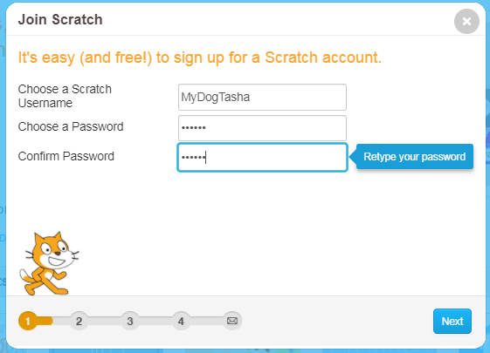
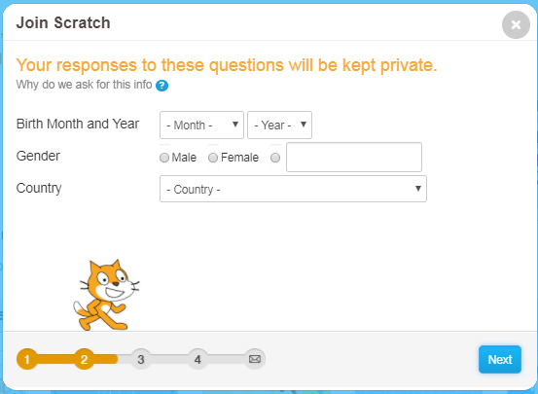
Here are the first two screens to create your account

Slide 5
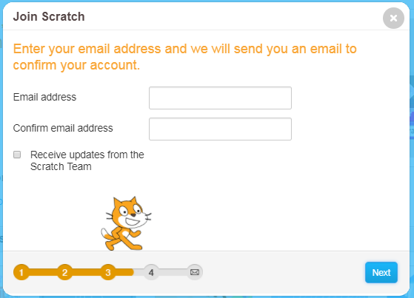
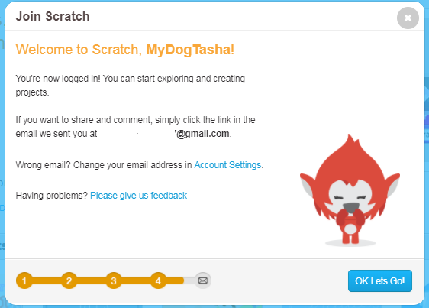
Here are the 3rd and 4th screens to complete your new account

Slide 6
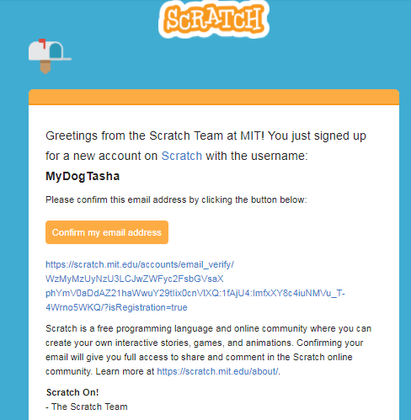
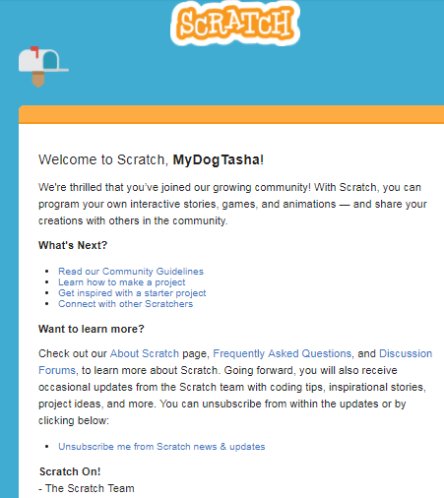
You will get an email to confirm your email for the account and
then an email of Welcome

Slide 7
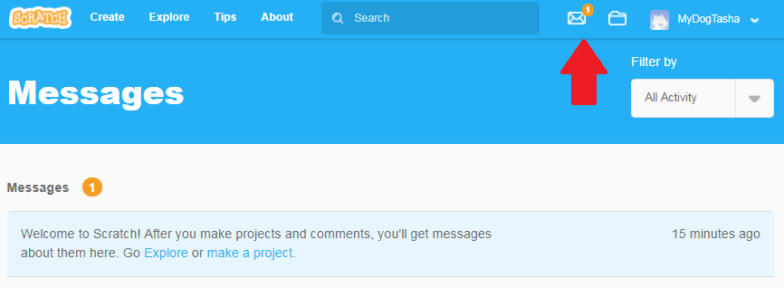
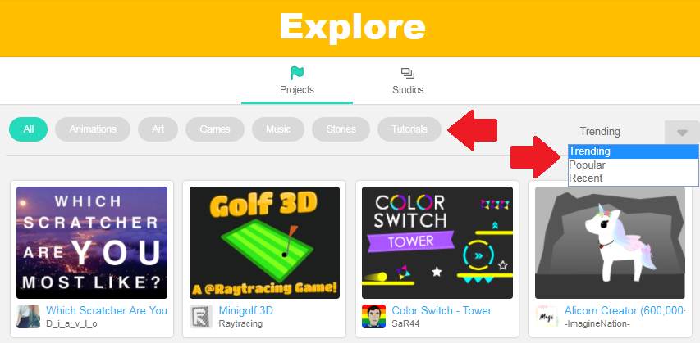
You will have a message that looks like this giving you the choice to Go Explore …

Slide 8
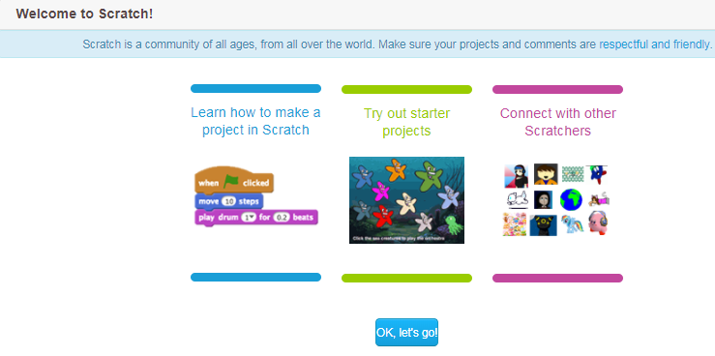
… or make a project

Slide 9
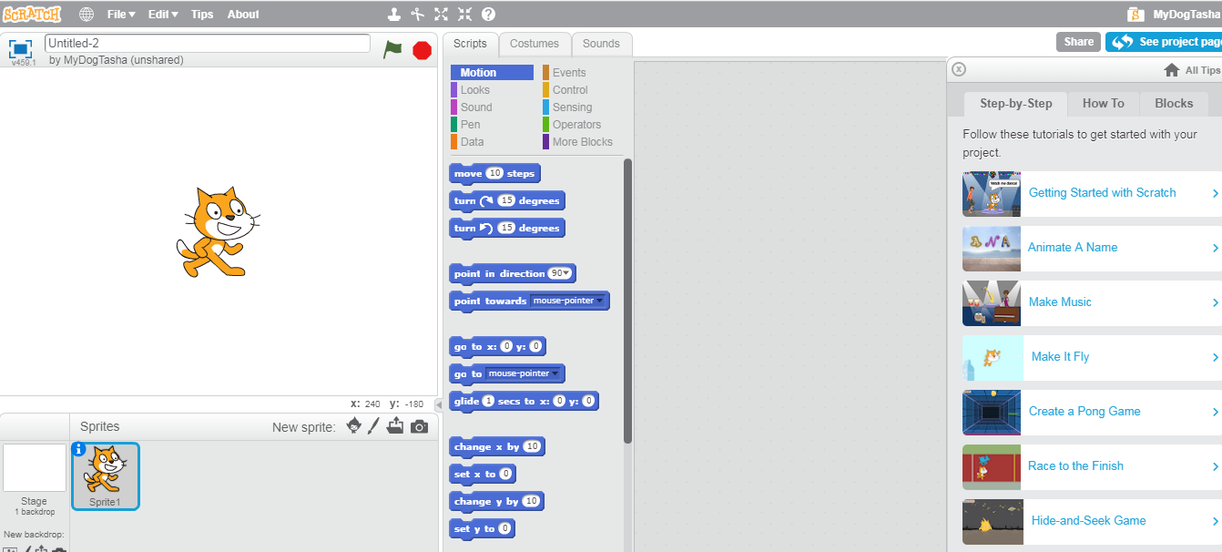
Ready, Set, Go! See you on Friday!

