Slide 1
Students can learn Scratch without you getting in their way
Further
Development of Scratch
Link to this presentation:
www.KPSCobraCoders.weebly.com
November 28 PM Workshop

Slide 2
http://kpscobracoders.weebly.com/
This slide show and any handouts will be found in our Weebly. I am updating it continuously. My colleagues and I will be writing several STEAM lessons as part of our STAO Makerspace Kit certification and we will add them to our Weebly when complete.

Slide 3
The goals of this workshop are:
To provide a practical and informative session for educators who would like their students to code in Scratch
To showcase useful resources for teachers to develop their students’ ability to code projects assigned to them or of their own creation
To develop a community of teachers working together within GECDSB to share resources and assistance
To incorporate Scratch 3.0 and the extensions, for example, Makey Makey and Microbit into our students’ coding

Slide 4
Scratch 2.0: https://scratch.mit.edu Scratch 3.0 https://beta.scratch.mit.edu
With the person beside you check out 2.0 and 3.0 and find out what is different and what is the same…

Slide 5
Plan for the Afternoon
● Quick Introduction
● How to find a project you can use
● How to determine how you can use a project
● A Generic Project
● Work on a coding lesson
● Classroom jobs
● Makey Makey and Microbit “Try it, you’ll like it!”

Slide 6
After Cards, Tutorials, & Starter Projects, what’s next for teachers?
Follow a series of lesson plans in An Introductory Computing Curriculum Using Scratch http://scratched.gse.harvard.edu/guide/files/CreativeComputing20141015.pdf
http://scratched.gse.harvard.edu/resources/sneak-peek-third-edition-creative-computing-curriculum-guide

Slide 7
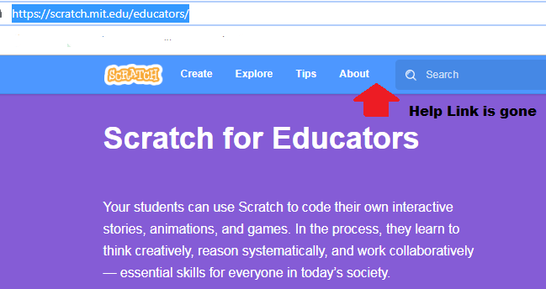
Where can teachers find out more? Not Scratch Help any more! Now go to: https://scratch.mit.edu/educators/

Slide 8
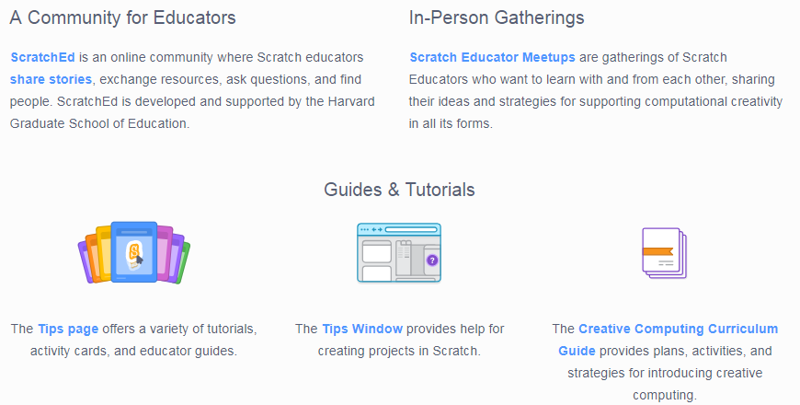
Scroll down to find…

Slide 9
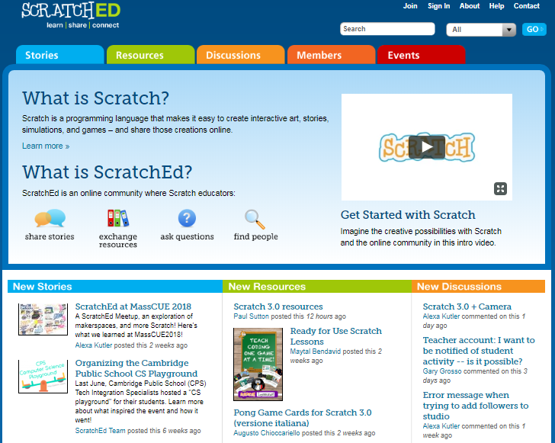
Where can teachers get help? At ScratchEd http://scratched.gse.harvard.edu/

Slide 10
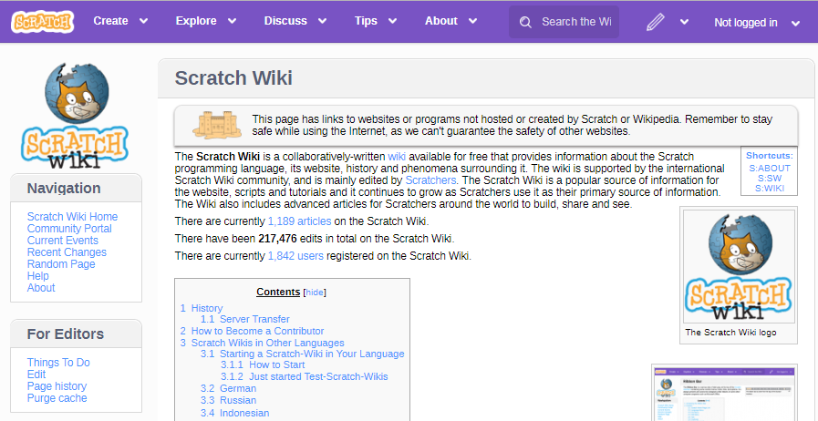
https://en.scratch-wiki.info/wiki/Scratch_Wiki

Slide 11
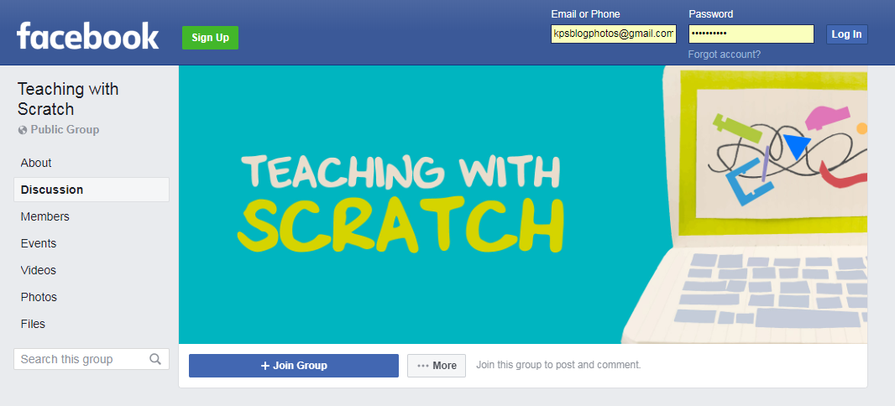
https://www.facebook.com/groups/TeachingwithScratch/

Slide 12
When I started I never looked in the Scratch Wiki because I thought it was too technical. I looked a the Main Page and didn’t see how any of the information would help me. I was wrong. I go to it constantly, more so than even ScratchEd now. It has entries about basic blocks all the way up to information I still don’t understand. But as I learn more I go to the Wiki more. The information I need is always there. Later in this slide show I will suggest another use for the Wiki.

Slide 13
Plan for the Afternoon
● Quick Introduction
● How to find a project you can use
● How to determine how you can use a project
● A Generic Project
● Work on a coding lesson
● Classroom jobs
● Makey Makey and Microbit “Try it, you’ll like it!”

Slide 14
Here is how I used to look for projects …

Slide 15
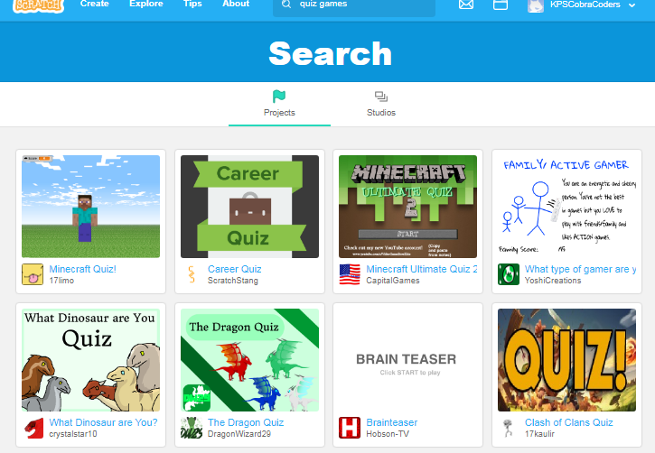
First I would search for project ideas in Scratch

Slide 16
When creating a project or studio coders may add up to 3 Tags.
See Scratch Wiki https://en.scratch-wiki.info/wiki/Project_Tags

Slide 17
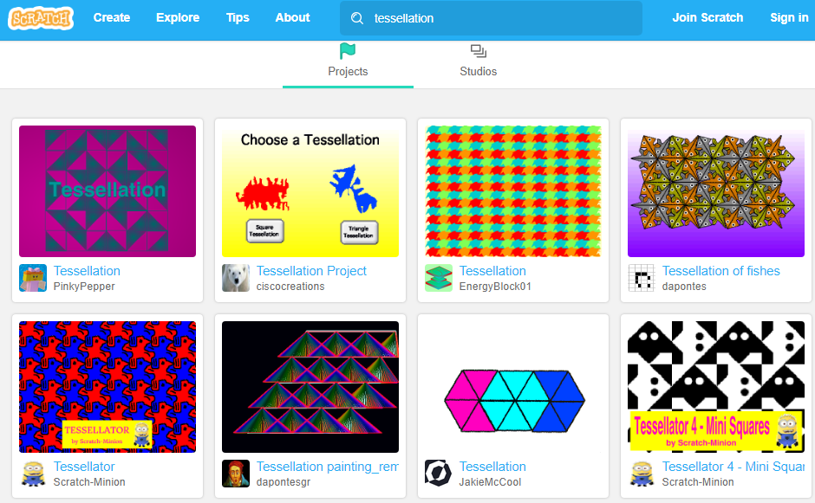

Slide 18
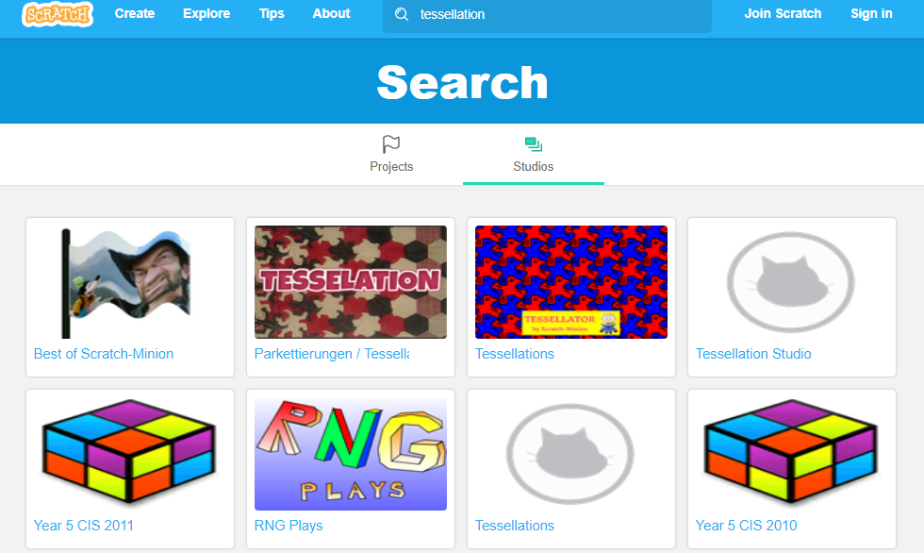

Slide 19
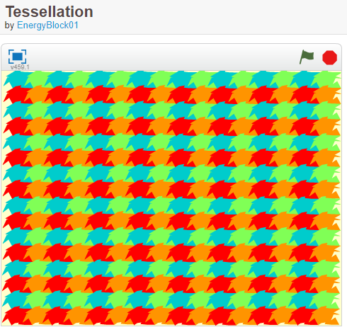
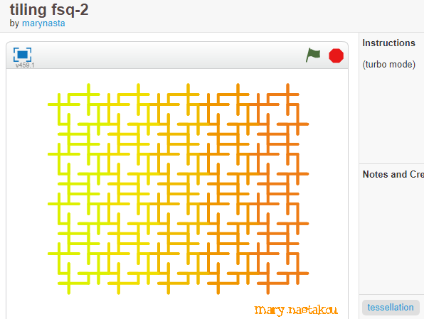
The Scratch search engine “picks” up these projects because one has Tessellation as the TITLE and the other has tessellation as a TAB.

Slide 20
Second, I would look for a particular type of project or subject area in ScratchEd.
I couldn’t always find what I wanted

Slide 21
But.. when I start with a Google search I:
● Found Dynamic Paper creator at NCTM https://illuminations.nctm.org/Activity.aspx?id=3509
● Found Scratch Ireland site with resources
● Found a site dedicated to Tessellations http://www.tessellations.org/index.shtml

Slide 22
Here is how I search now …

Slide 23
I start by using a search engine - Google and type in search terms. For example:
Scratch projects + explorers
I am finding Scratch projects as well as outside sources with projects &/or lesson plans.

Slide 24
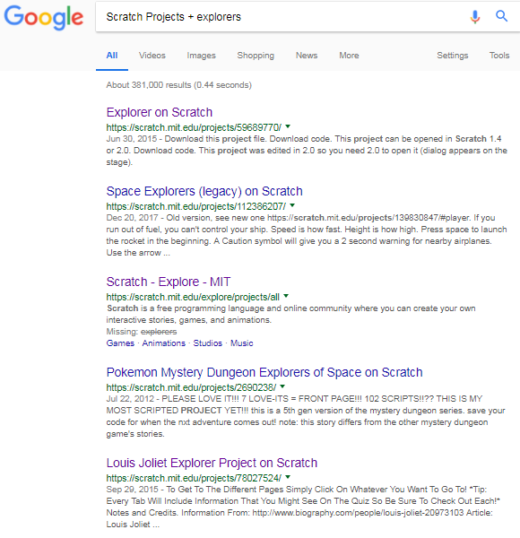
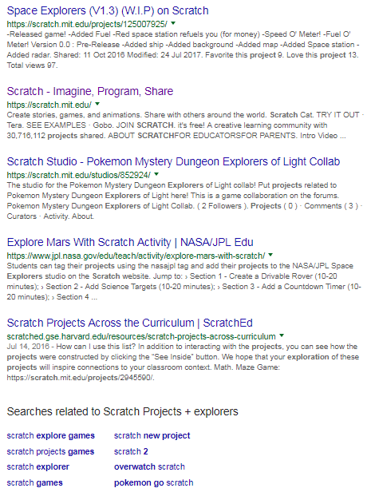

Slide 25
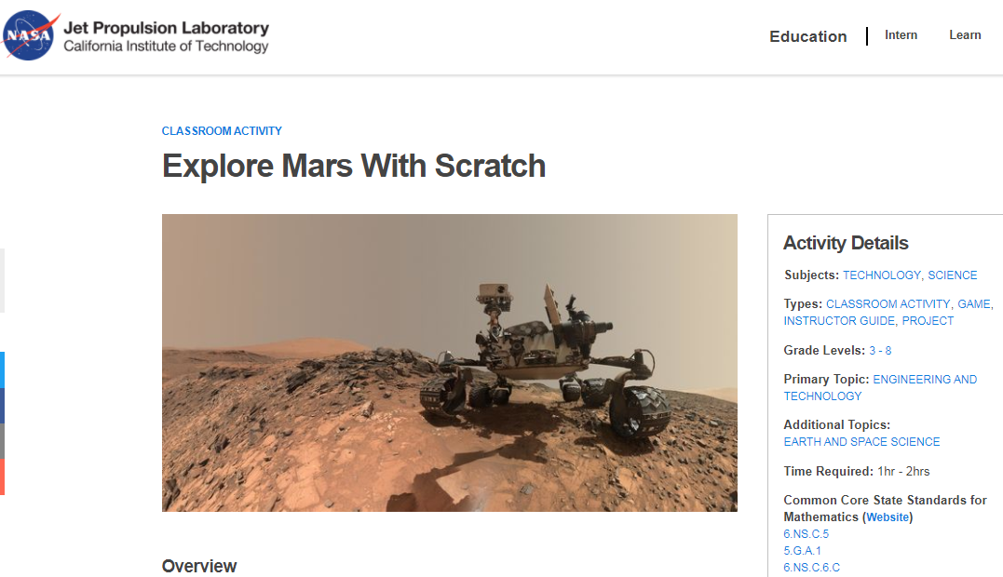
https://www.jpl.nasa.gov/edu/teach/activity/explore-mars-with-scratch/
I add this to a new file even though this isn’t what I was searching for it is a great project!

Slide 26
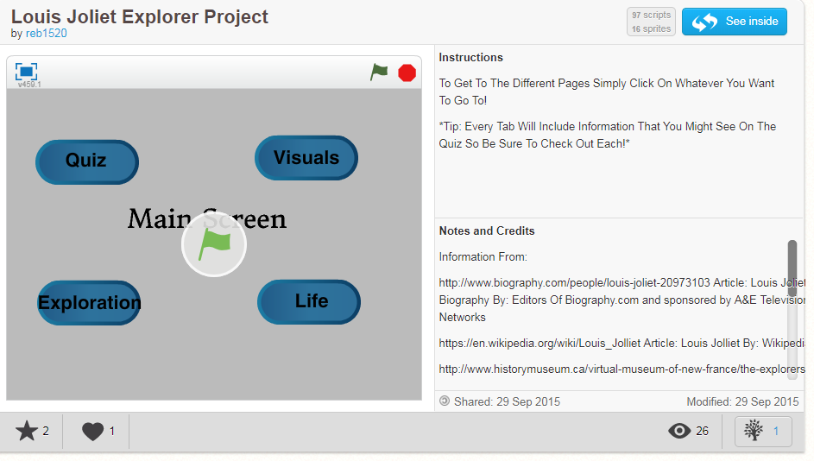
https://scratch.mit.edu/projects/78027524/

Slide 27
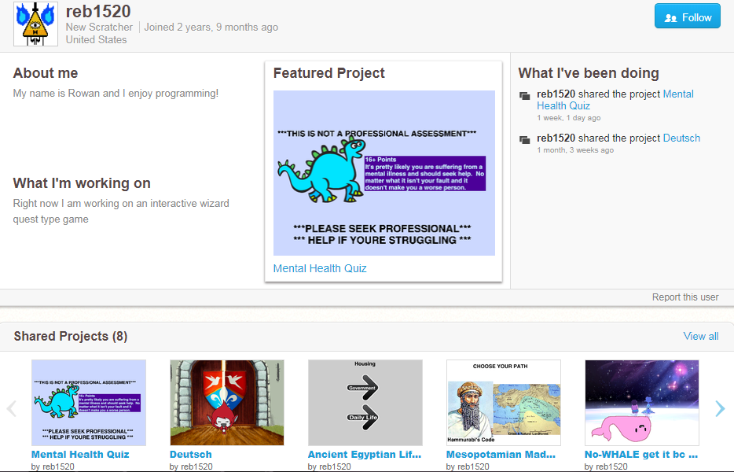
Then I continue my search in Scratch. I search with the TABS if there are any. I also click on the coder’s User Name and check out their other projects and studios. If I see something that might be suitable I start a Word file and use Paint to copy part of the project so I can recall it later on.

Slide 28
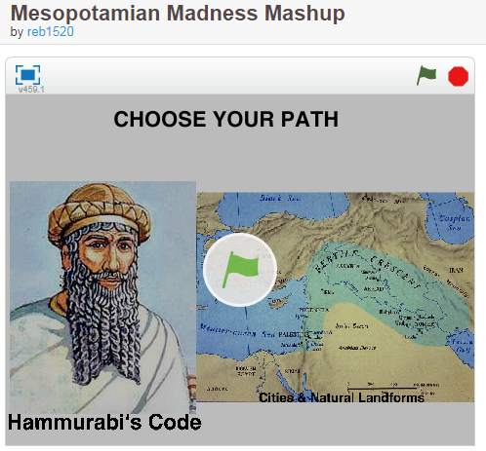
https://scratch.mit.edu/projects/126218863/
https://scratch.mit.edu/projects/122160960/
These would make good examples to show students how to code a research project. If you find a project that looks promising you could do the same thing and then we could share what we find.

Slide 29
Plan for the Afternoon
● Quick Introduction
● How to find a project you can use
● How to determine how you can use a project
● A Generic Project
● Work on a coding lesson
● Classroom jobs
● Makey Makey and Microbit “Try it, you’ll like it!”

Slide 30
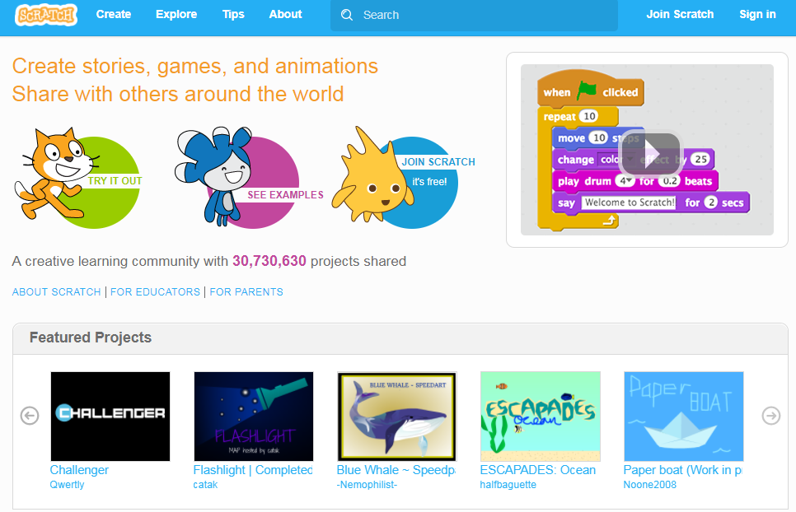

Slide 31
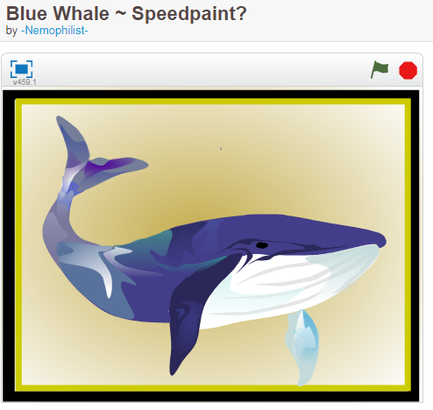
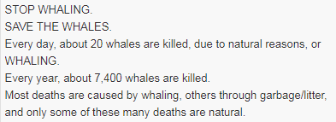
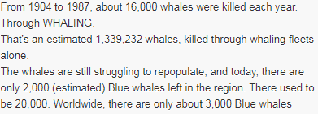
https://scratch.mit.edu/projects/209556851/

Slide 32
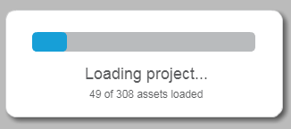
What to check out when deciding whether or not to use an existing project:
Do you intend to use it to …
Have your students learn from it?
Have your students gather coding ideas from it?
Have your students remix it?
If so, check out the number of scripts and sprites as well as the number of assets (sounds & images) when the project is loading.

Slide 33
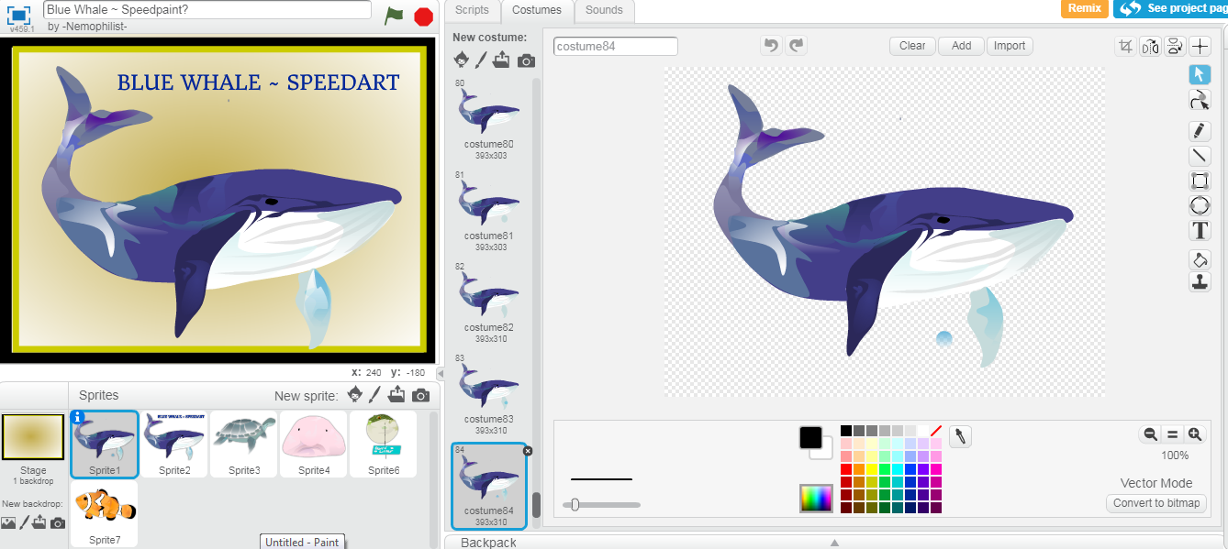
This is not suitable to remix and most probably beyond the artistic skills of our students and probably days to create, so this project can just be enjoyed when viewed.

Slide 34
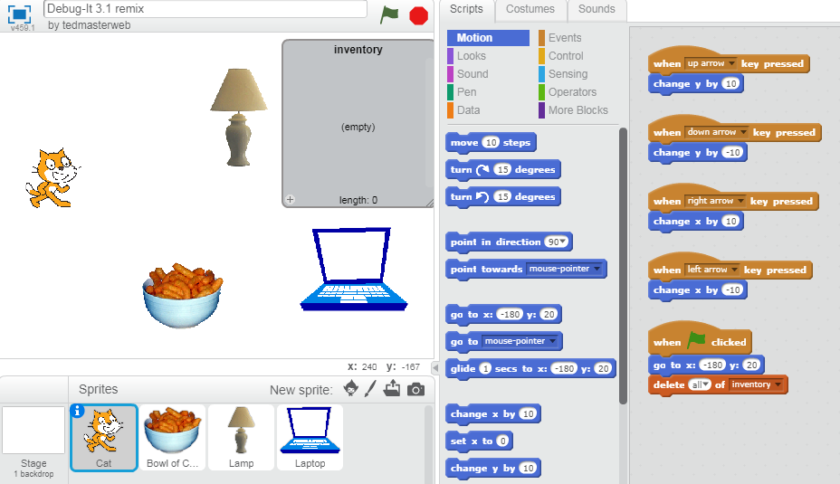
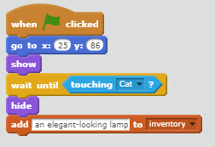
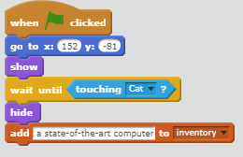
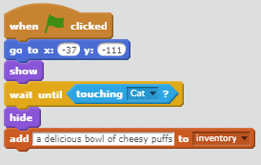
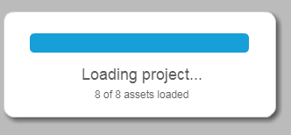
Few assets (sound or image), 4 sprites, 8 scripts 3 of which are similar with slight changes – this can be remixed or used for coding ideas

Slide 35
Plan for the Afternoon
● Quick Introduction
● How to find a project you can use
● How to determine how you can use a project
● A Generic Project
● Work on a coding lesson
● Unplugged Introduction to a project
● Continue to work on a coding lesson
● Classroom jobs
● Continue to work on a coding lesson

Slide 36
Here is the first project I am going to share with you. I classify it as a Generic Project.
It is a project example of the idea of low floor, high ceiling, and wide walls.
This project has minimal coding (low floor) to be successful and yet, the coding can be enhanced and added on to (high ceiling) in any number of ways.
The information needed to be include in the project can be from any subject area and any grade level (wide walls).

Slide 37
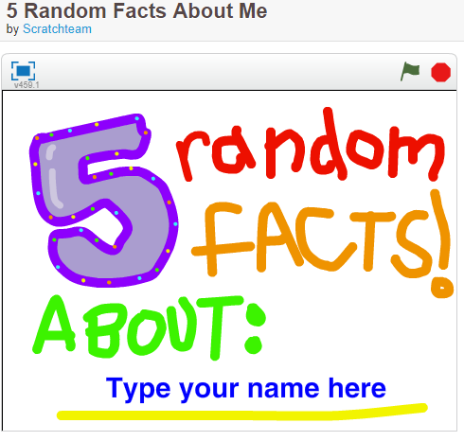
https://scratch.mit.edu/projects/10014866/

Slide 38
Plan for the Afternoon
● Quick Introduction
● How to find a project you can use
● How to determine how you can use a project
● A Generic Project
● Work on a coding lesson
● Classroom jobs
● Makey Makey and Microbit “Try it, you’ll like it!”

Slide 39
Plan for the Afternoon
● Quick Introduction
● How to find a project you can use
● How to determine how you can use a project
● A Generic Project
● Work on a coding lesson
● Classroom jobs
● Makey Makey and Microbit “Try it, you’ll like it!”

Slide 40
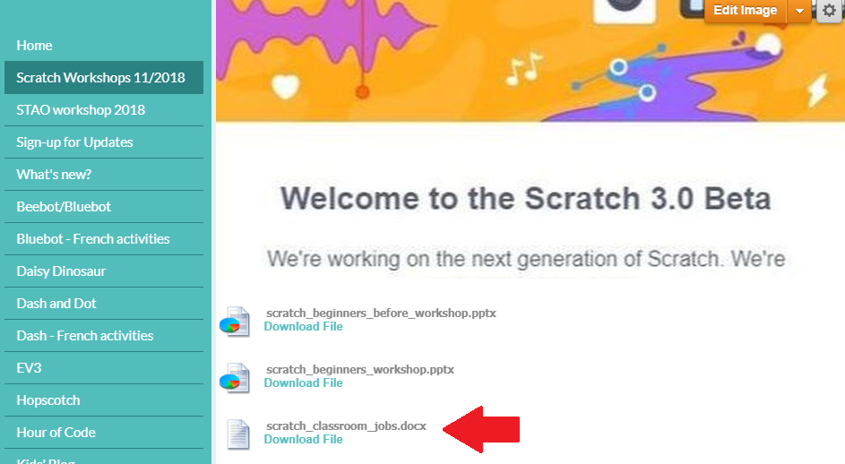

Slide 41
Plan for the Afternoon
● Quick Introduction
● How to find a project you can use
● How to determine how you can use a project
● A Generic Project
● Work on a coding lesson
● Classroom jobs
● Makey Makey and Microbit “Try it, you’ll like it!”

Slide 42
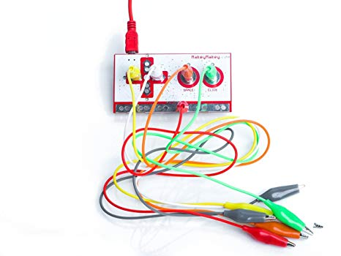
https://makeymakey.com/

Slide 43
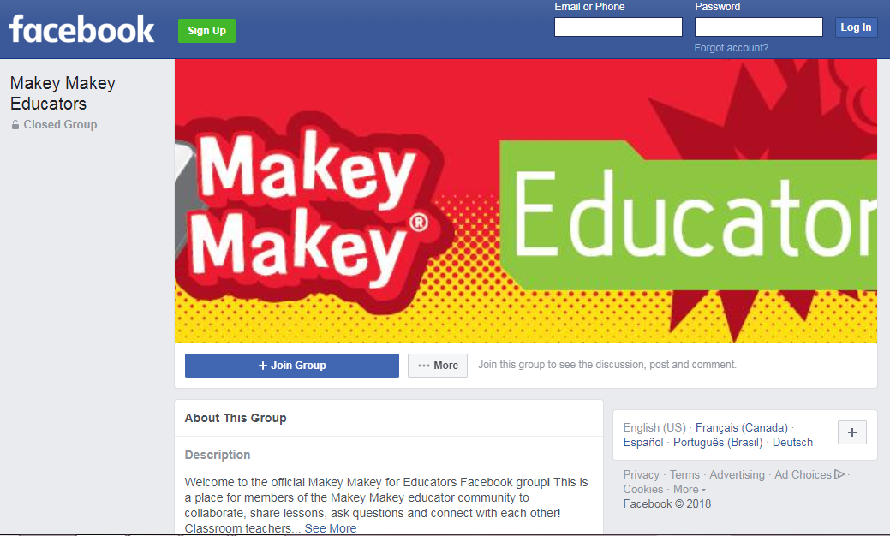
https://www.facebook.com/groups/makeymakeyeducators/

Slide 44
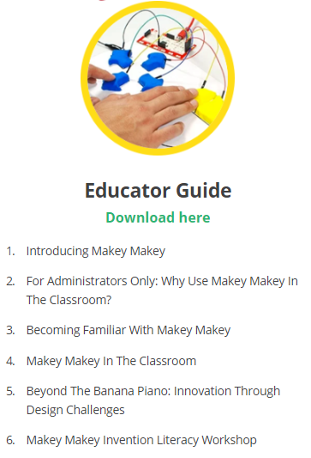
https://cdn.shopify.com/s/files/1/0162/8612/files/Makey_Makey_Educators_Guide.pdf?16481577170705338427

Slide 45
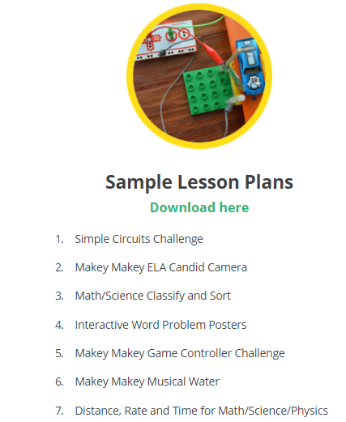
https://cdn.shopify.com/s/files/1/0162/8612/files/lesson-plans.pdf?16481577170705338427

Slide 46
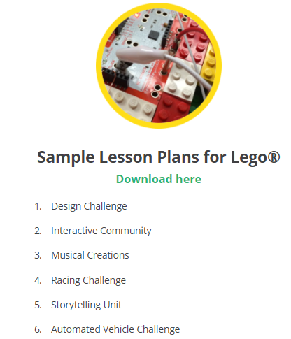
https://cdn.shopify.com/s/files/1/0162/8612/files/lesson-plans-lego.pdf?16481577170705338427

Slide 47
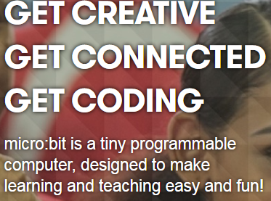
https://microbit.org/

Slide 48
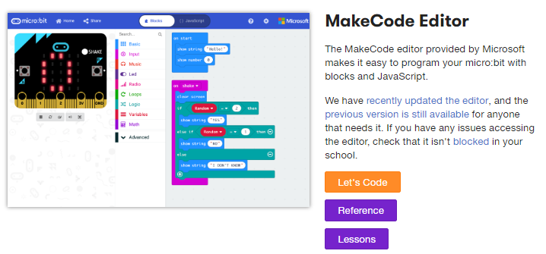

Slide 49
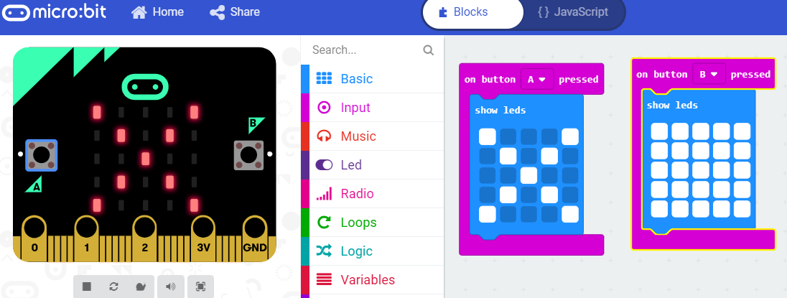
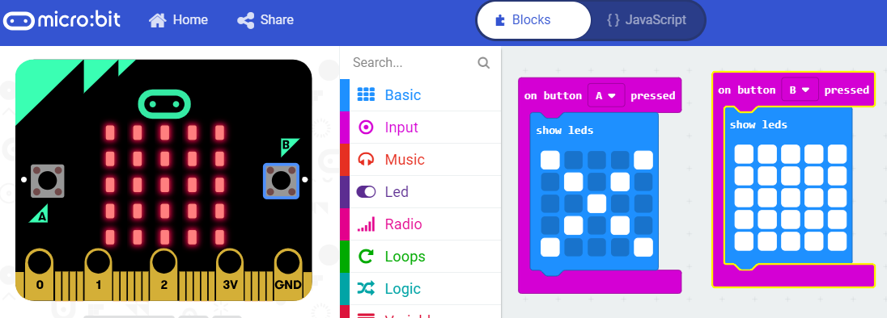

Slide 50
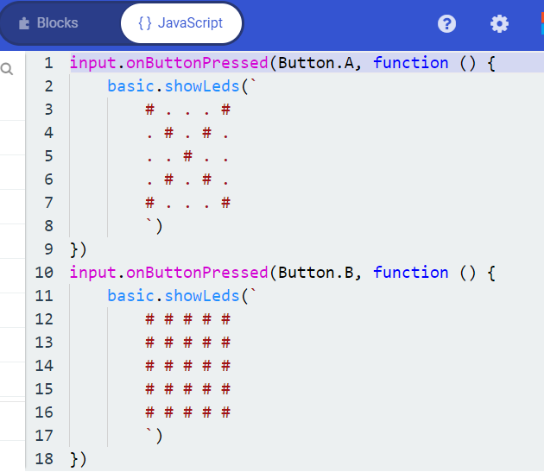

Slide 51
Only concerns you if you coded on the old site. If you go to the Microbit site this won’t be a problem
https://support.microbit.org/support/solutions/articles/19000065686-how-do-i-update-my-editor-scripts-and-hex-files

Slide 52
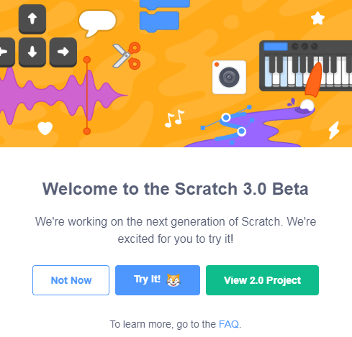
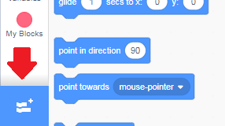
Click on Extensions Tab at bottom of Block column

Slide 53
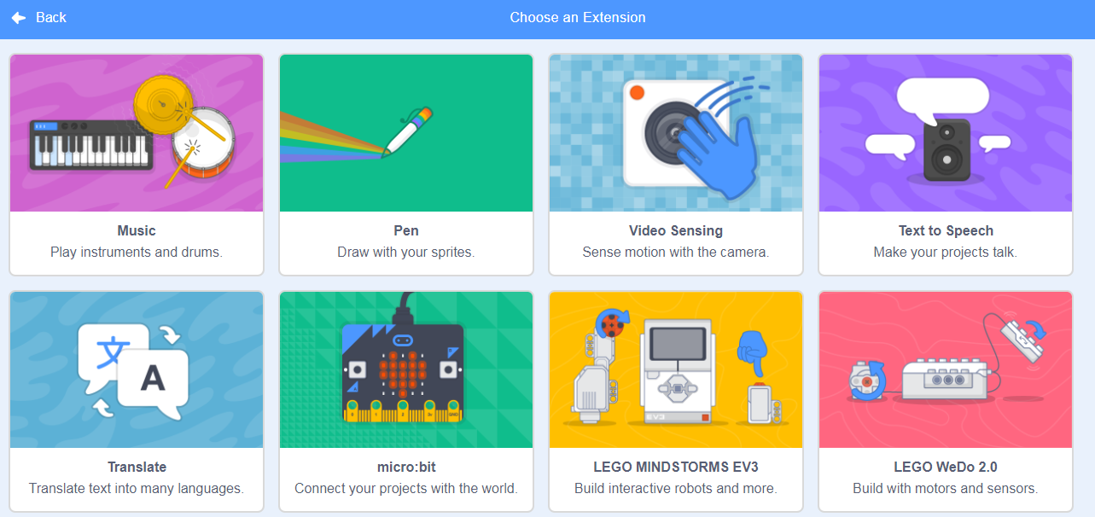

Slide 54
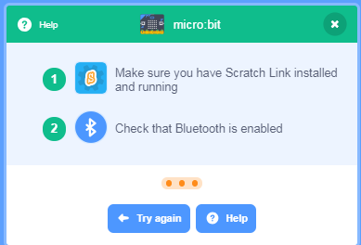
https://scratch.mit.edu/microbit
Click on Help button

Slide 55
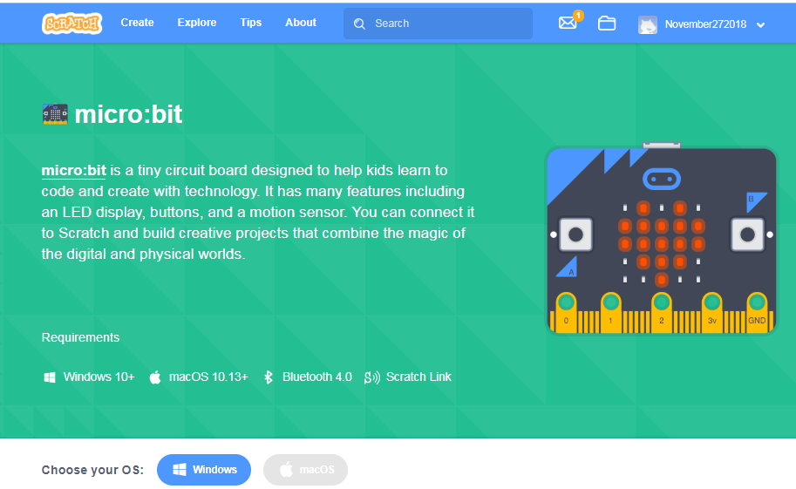

Slide 56
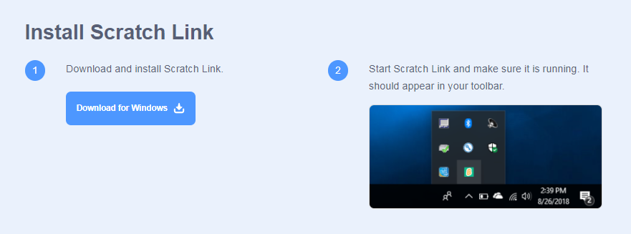

Slide 57
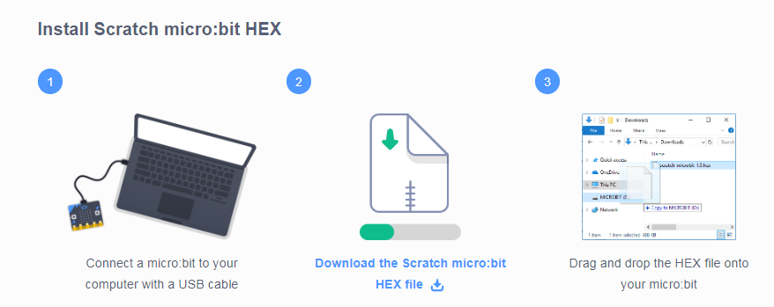

Slide 58
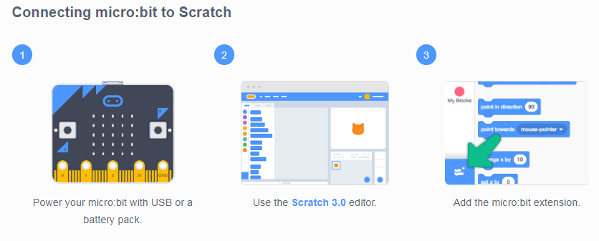

Slide 59
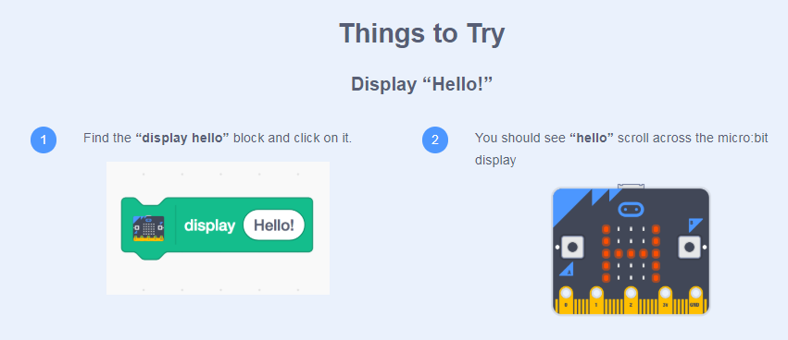
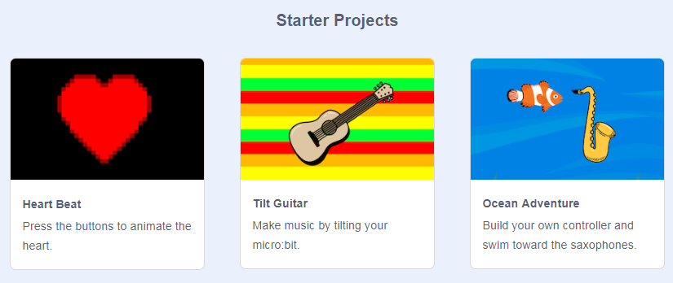

Slide 60
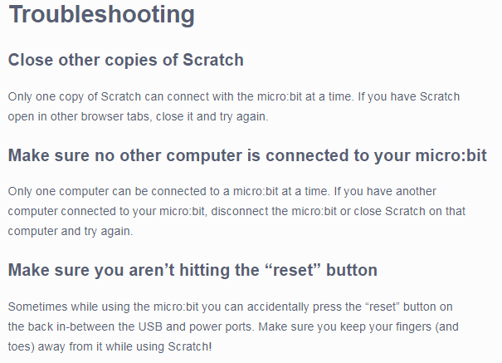

Slide 61
Use the MicroBit blocks in conjunction with the other Scratch 3.0 blocks

Slide 62
What I cannot create
I do not understand
Thanks Doug Peterson
Richard Feynman’s blackboard at the time of his death

