Slide 1
Coding
Bringing Coding and Robotics Into Your Primary Classroom
Elizabeth Pearsall. Janet Molzan. Cindy Loop Snyder. Sharon Jones
http://kpscobracoders.weebly.com

Slide 2
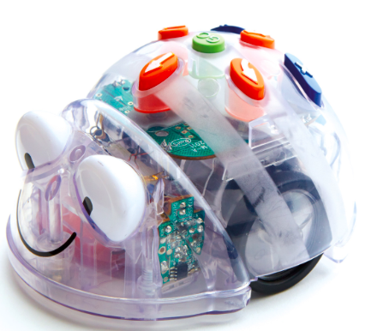
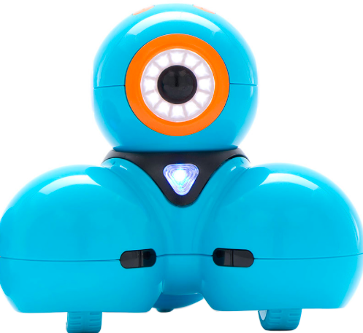
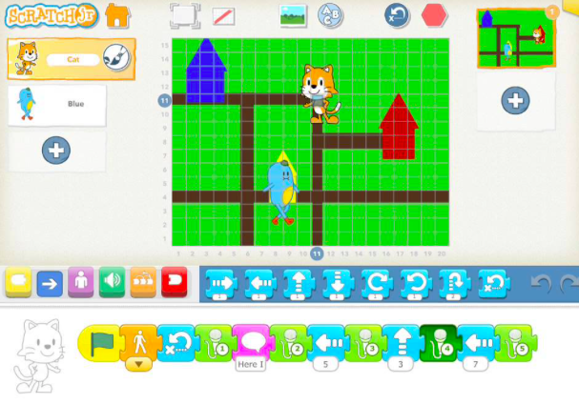
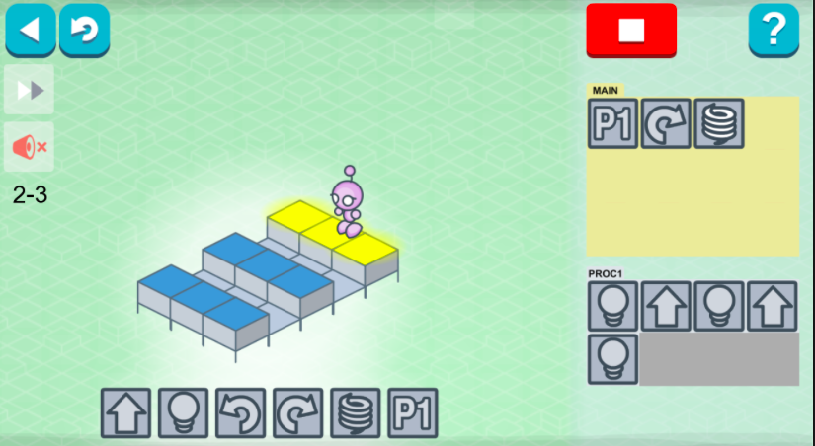
Learning to Code and Coding to Learn
Coding tasks with BlueBot and DASH robots and hands on applications of LightBot, Scratch Jr & unplugged
Integrating Math, Language and Beyond

Slide 3
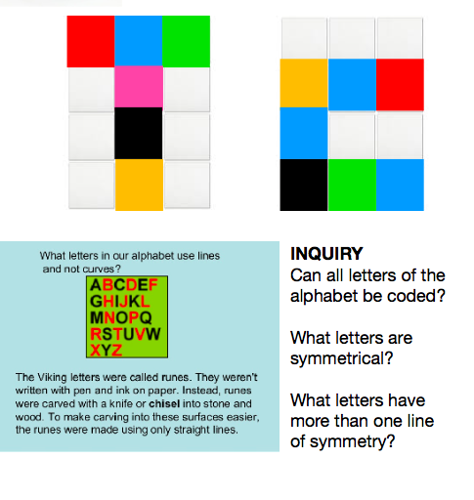
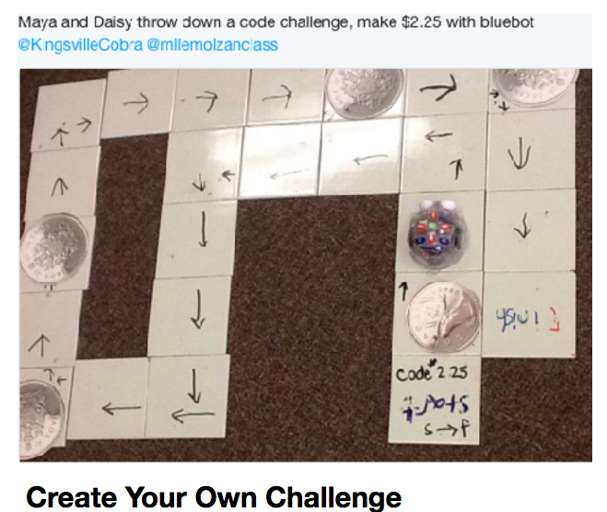
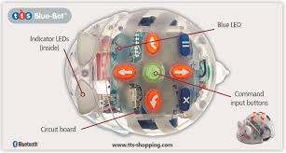
BlueBot
Concrete Coding
Focus on perspective, location, orientation and movement on a grid
Spatial Language and Integrated Learning

Slide 4
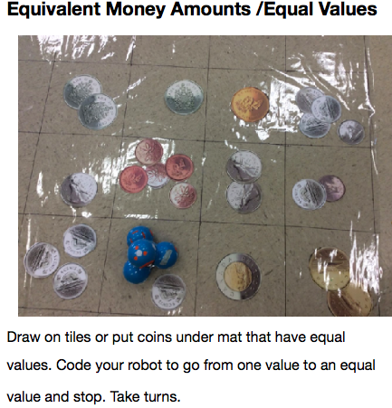
DASH
Spatial Reasoning with Coding
Perspective, Location, Orientation, Movement on a grid,
Integrating measurement, angles, geometry, number sense...

Slide 5
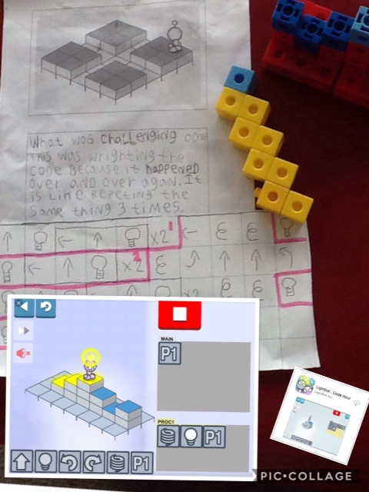
Light Bot
Transitional challenges from real world to virtual
Build structure -->code perspective --> run your code-->debug
Integrates spatial concepts and processes with writing and coding.

Slide 6
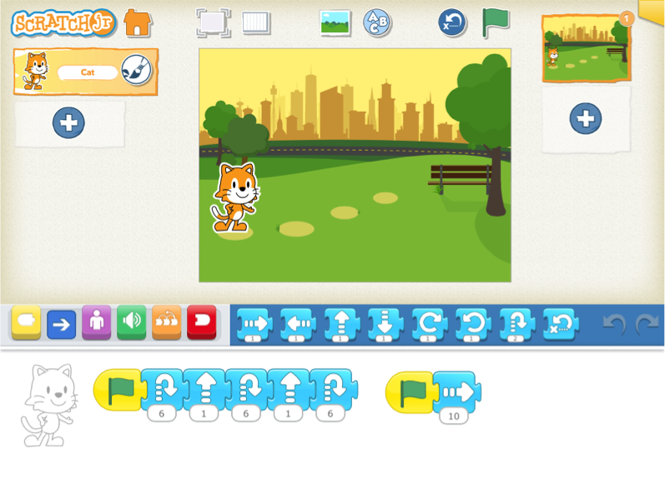
ScratchJr
A visual programming language
Creating projects means thinking creatively, expressing ideas & reasoning systematically
Students
●solve problems
●learn to debug
●develop sequencing skills
●develop computational thinking
●apply math & language learning
Free & Available for
iPads & Chrome Books

Slide 7
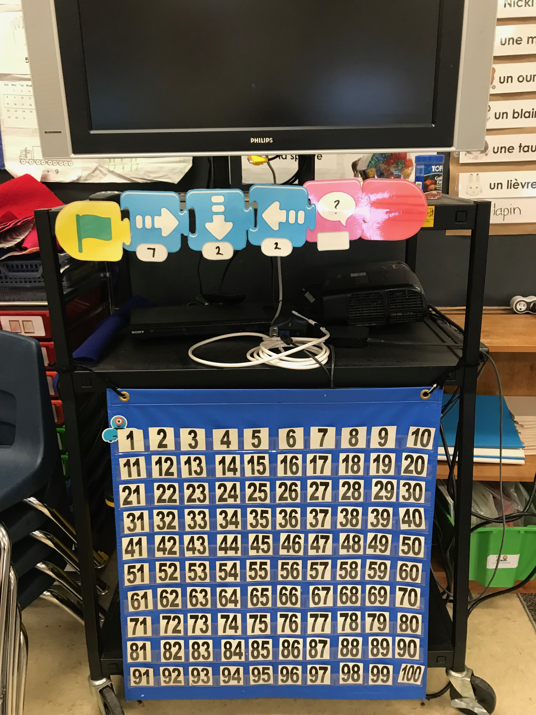
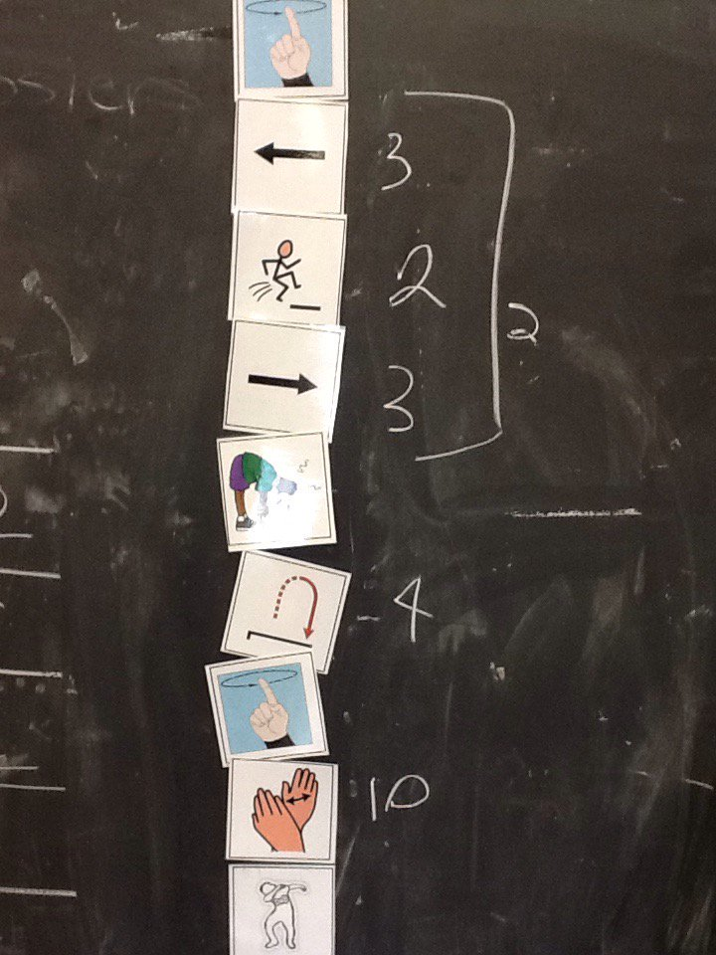
Unplugged?
Guess My Number?
Guess My Pattern?
Code A Dance

Slide 8
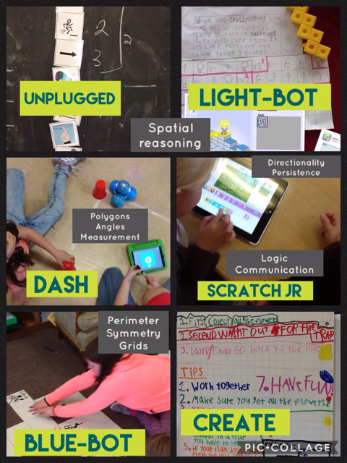
Sandbox of Coding
kpscobracoders.weebly.com

