Slide 1
OAMe Workshop F5.28 Bring Coding & Robotics into Your Classroom 2:30 to 3:45 Room E338
Elizabeth Pearsall, Cindy Loop Snyder,
Janet Molzan, Sharon Jones

Slide 2
Three primary teachers participated in TLLP 2016-2017.
During the past year they have developed activities to address the dual nature of coding and robotics.
Students learn to code and then, take this knowledge and apply it, in other words, code to learn. In particular students in K to Grade 4 learn to code with apps such as BeeBot & BlueBot and LightBot; BlueBot and DASH robots; and ScratchJr. Next comes the integration of coding and robotics into language, mathematics, and inquiry activities.
This workshop takes on a playground atmosphere where participants get hands-on time with all the applications and devices.
They will see actual student work.
We will share lesson plans (English and French Immersion) and connections to curriculum.
Participants do not need any background knowledge in coding and robotics to attend this workshop.

Slide 3
We have brought some devices with us for you to use during our playground workshop. If however you would like to try out our activities using your own device here is information about a link for downloads.

Slide 4
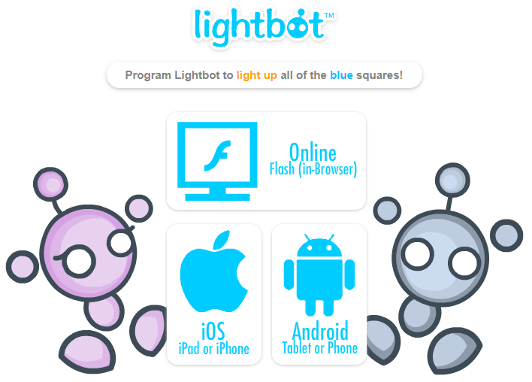
If you want to download Lightbot
http://lightbot.com/hour-of-code.html

Slide 5
For more information about LIGHTBOT
http://lightbot.com/resources.html
Or
http://lightbot.com/hoclearn.html
But also check out OUR resources at our weebly …
http://www.kpscobracoders.weebly.com

Slide 6
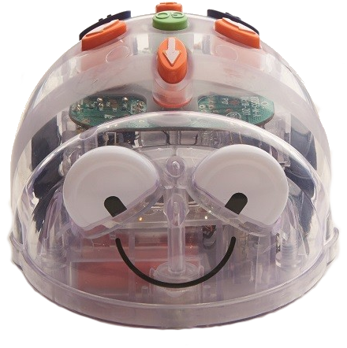
If you want to download BlueBot app before our workshop here is the link:
https://www.bee-bot.us/downloads.html

Slide 7
Here is the link to download the app for the DASH robot. There are several. Pick Blockly and if you want a 2nd one pick Wonder
https://www.makewonder.com/apps
https://www.makewonder.com/apps/wonder

Slide 8
If you would like to download ScratchJr on your iPad or Chrome Book here is the link https://www.scratchjr.org/

Slide 9
We look forward to seeing you Friday afternoon.
If you want to meet us before hand we are volunteering in the Exhibitor and Sponsor Hall
- just ask for Elizabeth, Janet, Cindy, or Sharon.

