Slide 1
June 26 2017 SLP Workshop
http://kpscobracoders.weebly.com

Slide 2
Today you are going to learn about three coding applications:

Slide 3
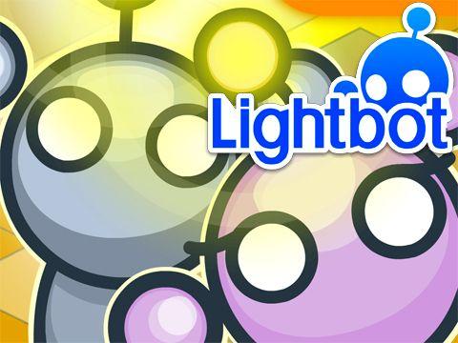
LightBot
Focus on coding and spatial reasoning

Slide 4
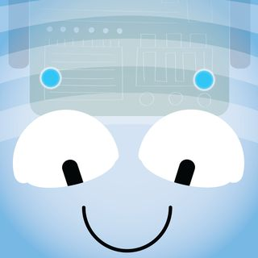
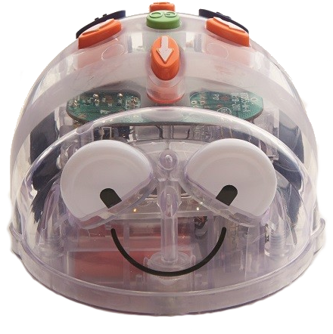
BlueBot
Focus on coding & creating and solving problems

Slide 5
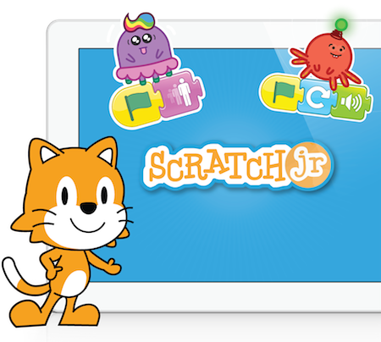
Scratch Jr
Focus on Block Coding and Story-telling

Slide 6
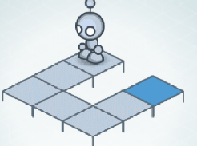
LightBot Level 1-2

Slide 7
● Several of my students were struggling with the one-to-one correspondence of the symbol and the command.
● Used connecting blocks and a Lego person to act out the coding.
In so doing saw an opportunity to develop my students’ spatial reasoning.
● So before they coding in the LightBot app they build the structure and decided on the code and acted it out, THEN they coding in the app.
● Growth of students ability to re-create the structure and code correctly improved remarkably.
Hint: Scaffold your questions. Instead of “That’s not correct” try “Imagine you are the Lightbot, which way do you need to move on the structure?”

Slide 8
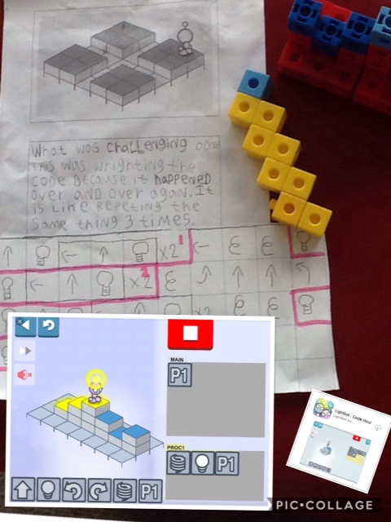
We created planning sheets for each level
Students build structure
Write their code on graph chart paper
Reflect on their learning to develop metacognition on how they are learning to code

Slide 9
How to extend the task?
Students build their own structures and ask a classmate to code the Bot’s journey.
Then the coding is confirmed or debugged by the two students

Slide 10
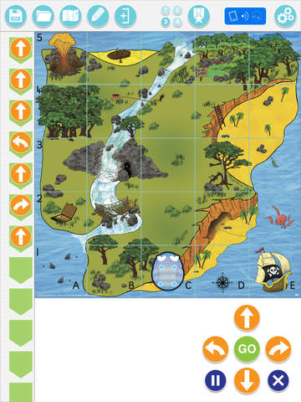
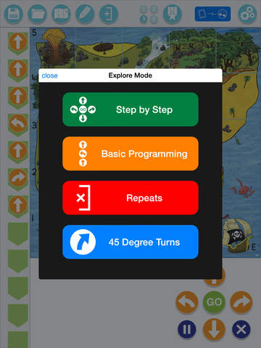
BlueBot

Slide 11
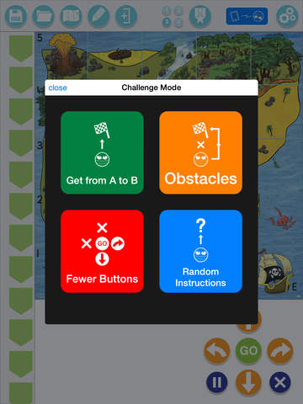
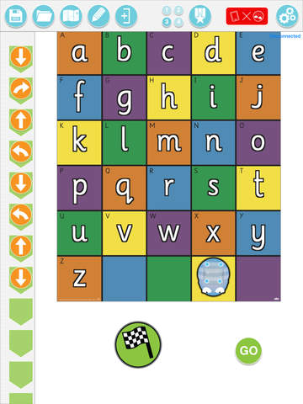

Slide 12
How to extend the task?
Students design their own background, take a photo of it and insert into the BlueBot App.
Then create their own problems.

Slide 13
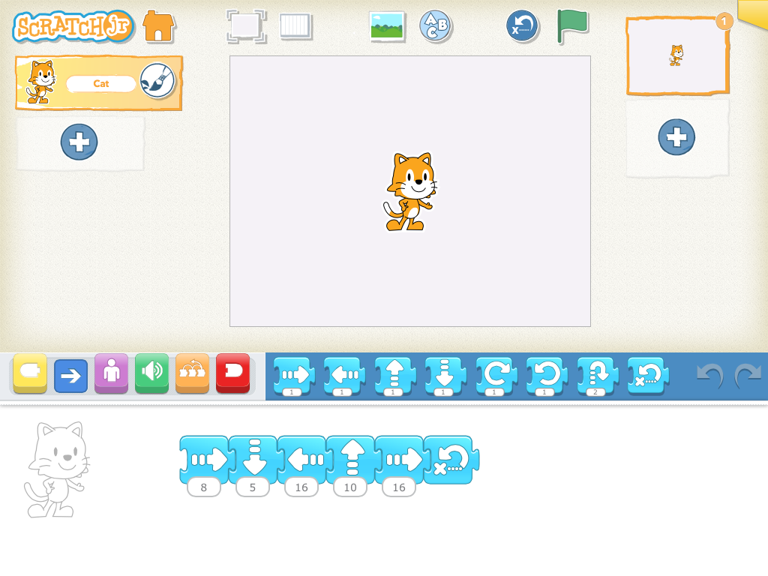

Slide 14
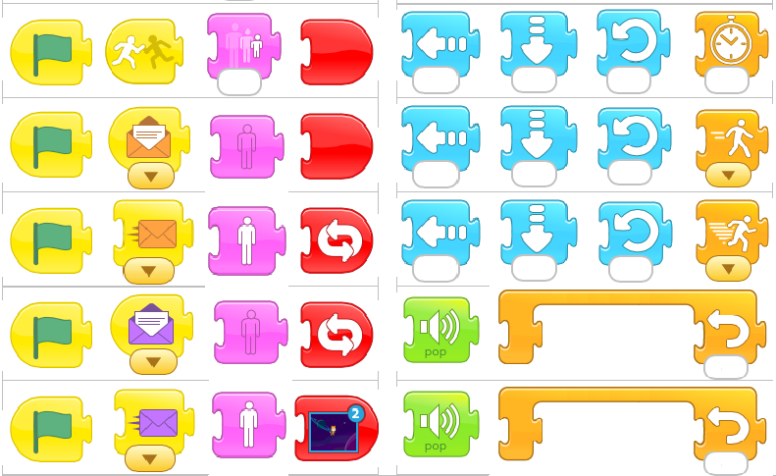
Students need to learn to “read” blocks and
understand the power of each block to change the coding

Slide 15
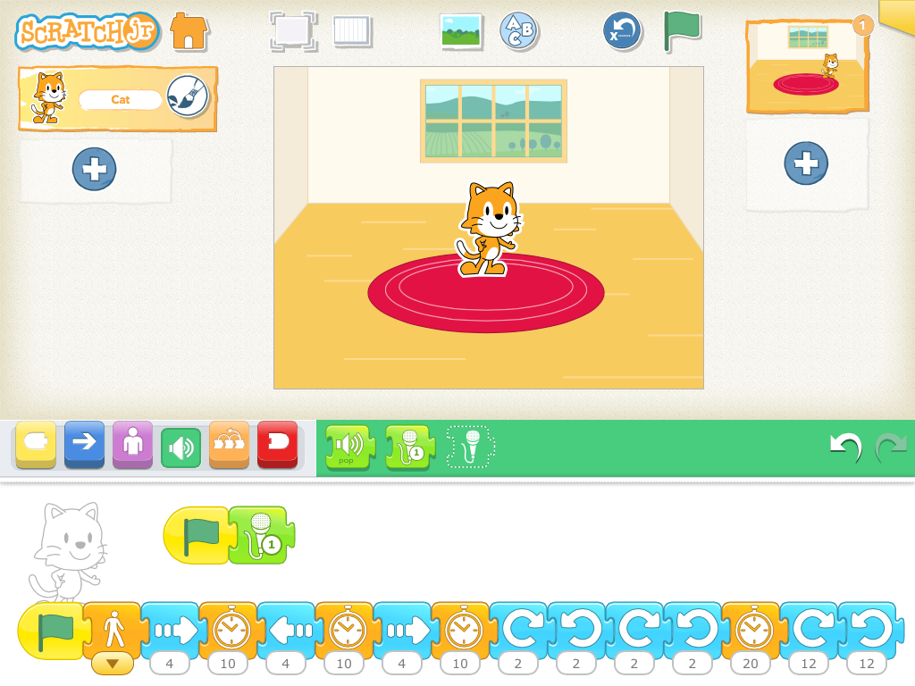
“Tell me what the cat will do by reading the blocks”

Slide 16
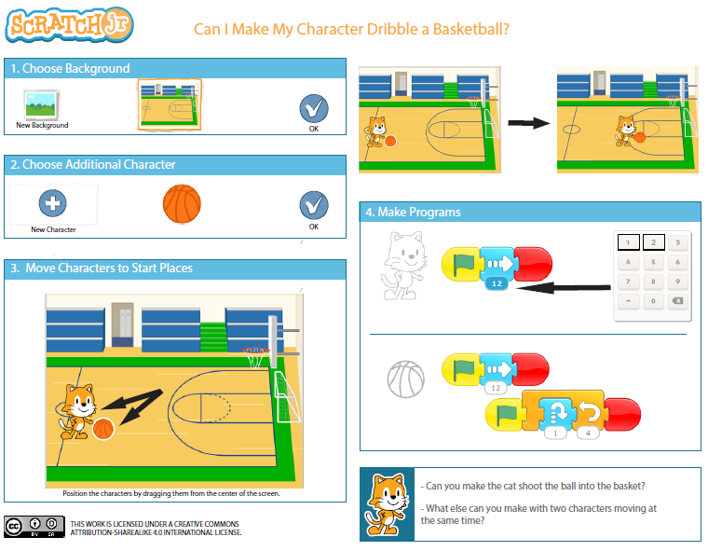
Coding creates the illusion the cat is bouncing the ball …

Slide 17
How to extend in Scratch Jr?
Students can design their own games.
Students can retell a story.

Slide 18
Use coding to develop
the campers’
Growth Mindset
and
21st Century Competencies

Slide 20
