Slide 1
Creating Opportunities for Literacy and Mathematics Learning in the K-3 Classroom August 29, 2017 ●Coding and robotics
http://kpscobracoders.weebly.com/

Slide 2
DASH has several apps. Go, Wonder, and Blocky.
Go Icon
Go is a low floor but low ceiling application.
In other words, immediately easy to do, but not much to develop and build on
Think of it like a remote control car interface.

Slide 3
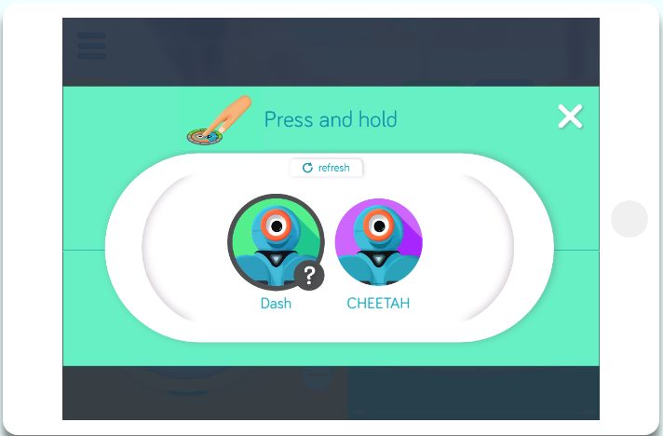
Make sure DASH is turned on. Hint: have robot on floor - it moves around and talks when turned on. Connect device to DASH.

Slide 4
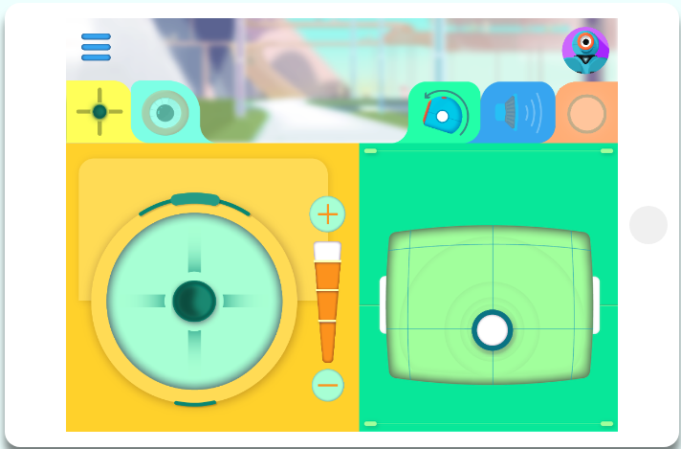
Find out what all these icons do …
What do you do to make DASH move, make sounds, or light up?

Slide 5
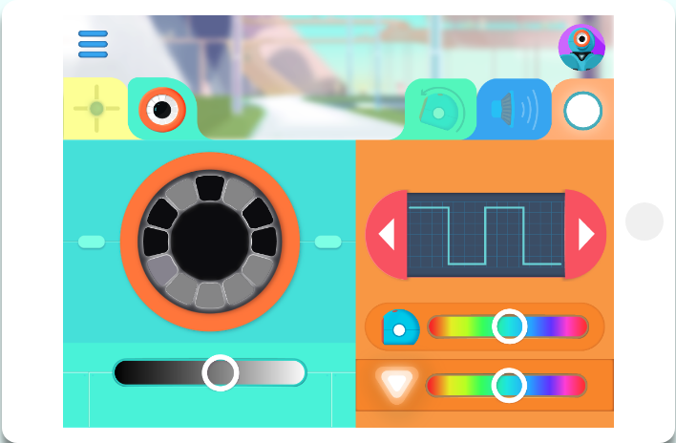
What happens when you click on this tab?
What happens when you move the sliders?

Slide 6
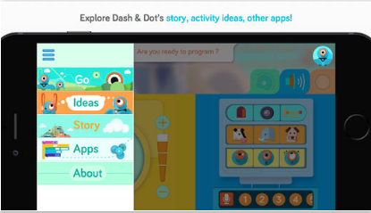
Click on three bars to see built-in Ideas and Story options.

Slide 7
Wonder app has a little bit of everything.
Lots of pre-populated items to try out.

Slide 8
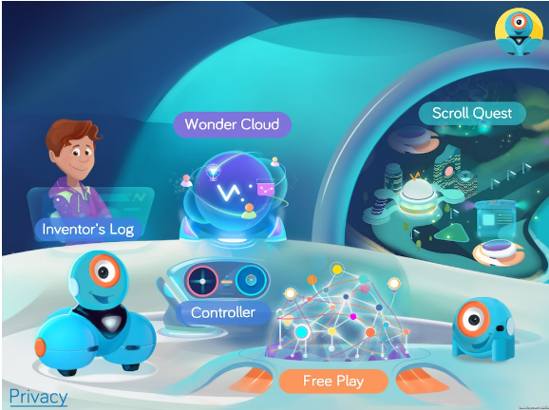

Slide 9
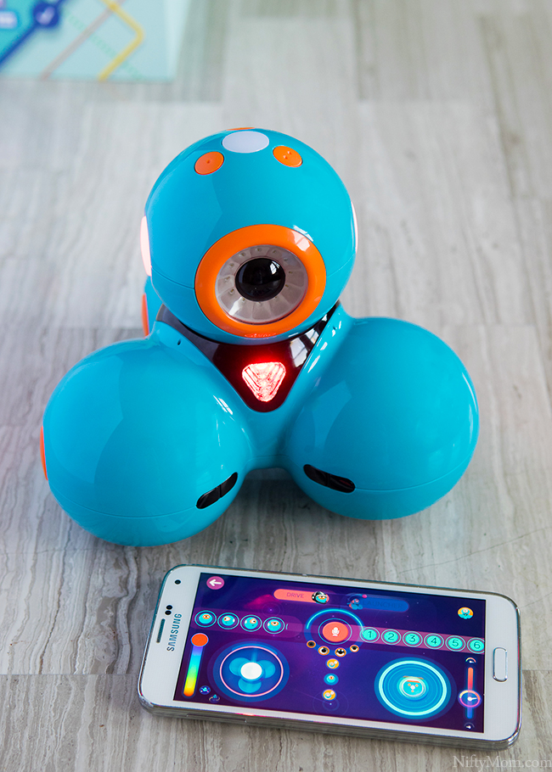
The Controller in Wonder app has more bells & whistles than
the Go app and is usually the one the students go back to time and time again.

Slide 10
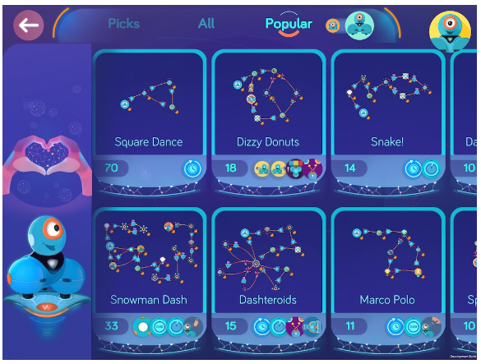
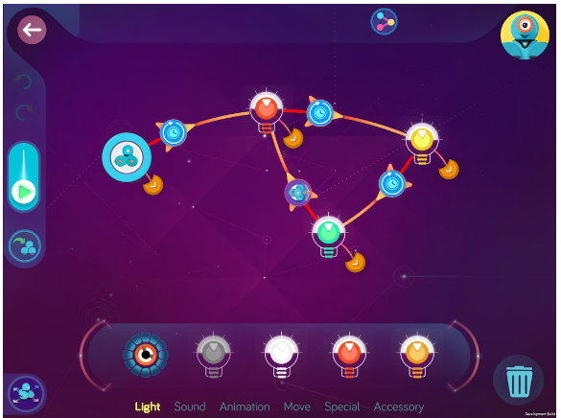

Slide 11
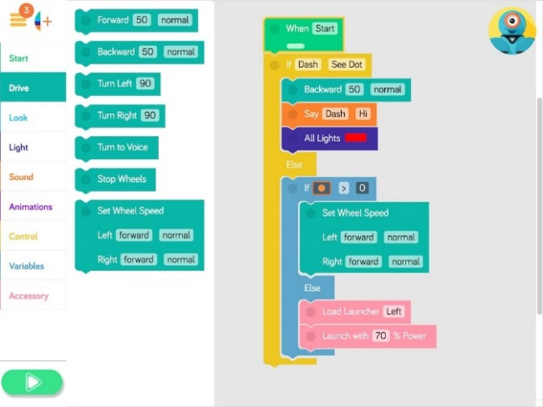
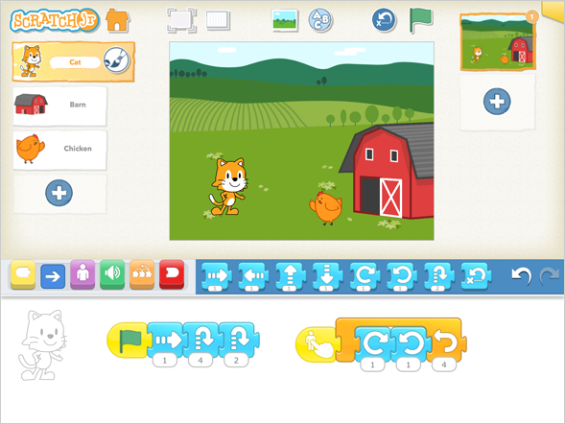
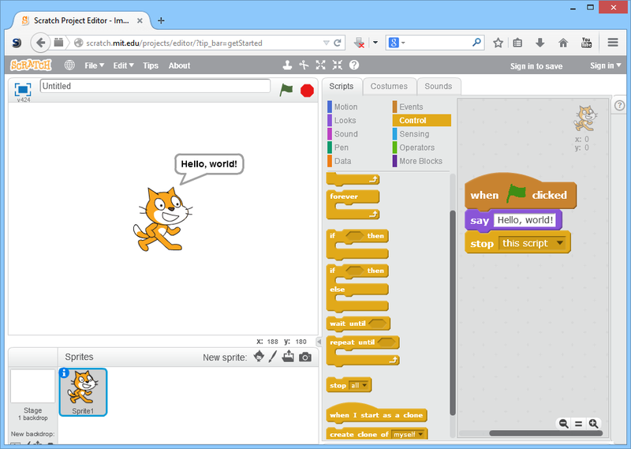
This app used Block-Based programming like you find in Hour of Code activities, ScratchJr, and Scratch.
If this is your students introduction to Block-Based coding it will be more difficult than the Go app, but once they understand how to use the different blocks and see DASH follow the commands. It is the high ceiling app of all the ones for DASH.

Slide 12
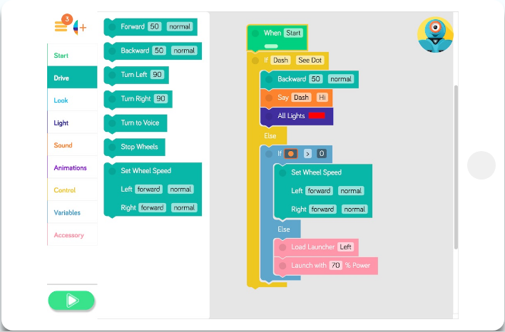
Each one
of these tabs is a section of blocks to drag and drop in the right hand side of the screen.

Slide 13
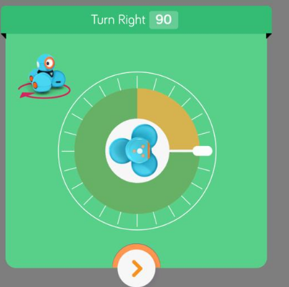
Students will need extra support to understand how to calibrate turns with DASH.

Slide 14
Suggestions to use DASH with Trade Books
● Students have already had “free exploration” with DASH
● Students have experienced coding DASH
(or other applications such as Hour of Code and ScratchJr)
● The activities follow reading a book and any literacy or
mathematics activities you select.
For example: Story Talk, creative writing, creating illustrations
Number Talk, problem solving with manipulatives, etc.
● Students work in pairs or groups of three – no larger
● Routines in place for robot handling (pick up by “legs” not “head”
stay away from stairs and people walking around)
● Routines in place for job sharing (Programmer, Manager)

Slide 15
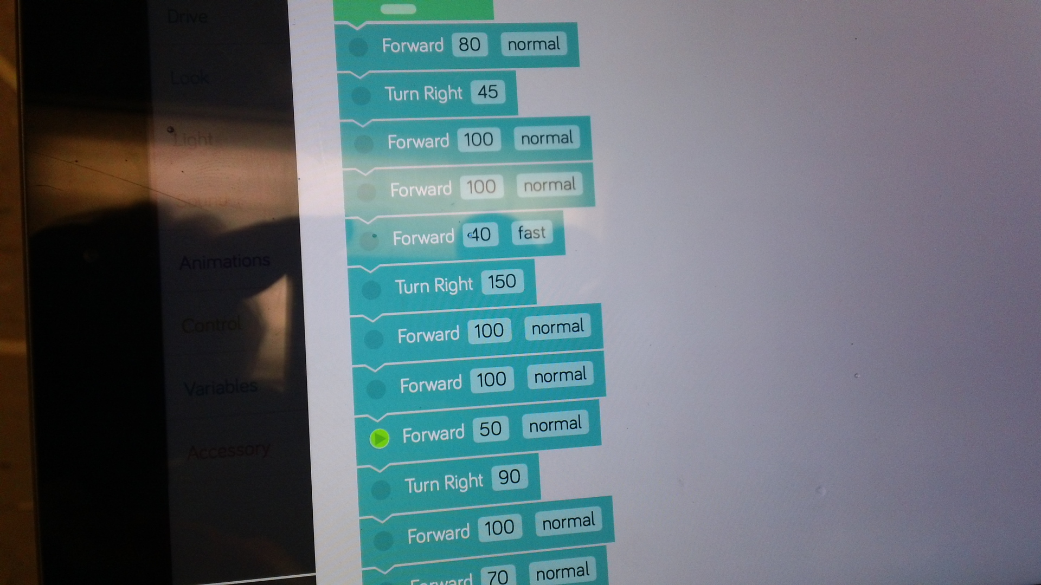
Example of Blocky coding – just to move DASH

Slide 16
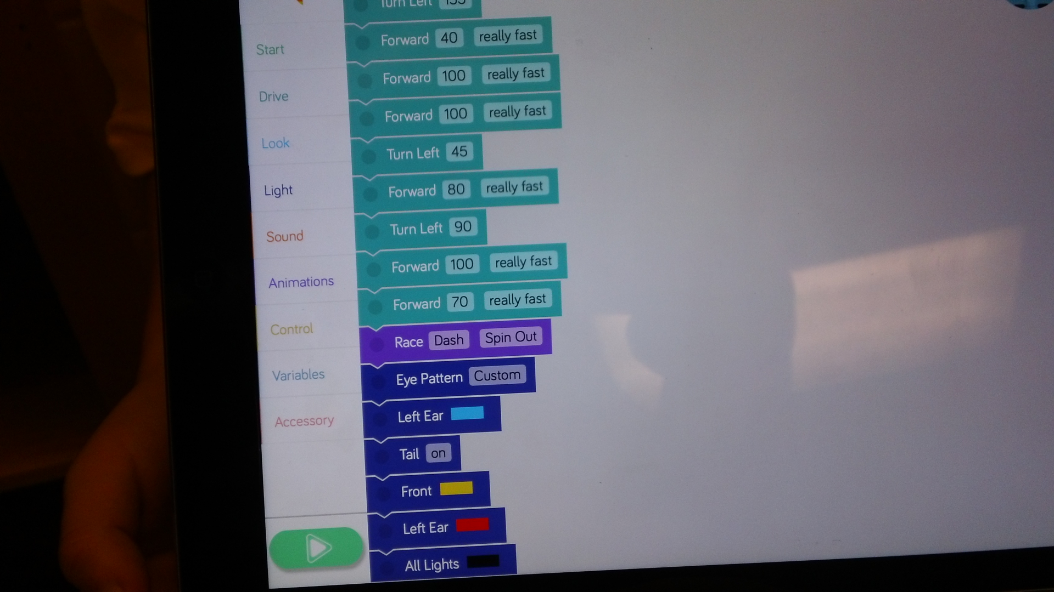
Blocks for DASH to do other things

Slide 17
What aspect of a
Trade Book text makes
it suitable to incorporate coding and robotics activities?

Slide 18
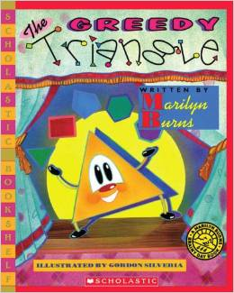
The polygons mentioned in this Marilyn Burns book can be created on the floor. Students can code robot to move around the perimeter.
Connections: geometry & measurement

Slide 19
The number of students loading on and off the bus in this Leslie Helakoski book can be translated in to movement forwards and backwards when coding the robot.
Connections: add & subtract, movement on a grid

Slide 20
The rearranging of bugs into rows to try and avoid a remainder of one in this Elinor Pinczes book can be created on the floor. The robot, as the Queen of the Parade character can be coded to go back & forth to “inspect” all the bugs.
Connections: multiplication and division

Slide 21
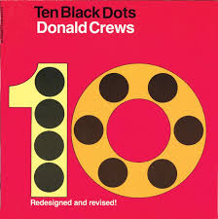
The illustrations in the book can be inspirations for students’ art work featuring black dots in this Donald Crews book. By laying the art work on the floor the robot can be coded to go to the dots in numerical order or find Ten Partner Numbers (i.e., 7 & 3).
Connections: numerical order, partner numbers

Slide 22
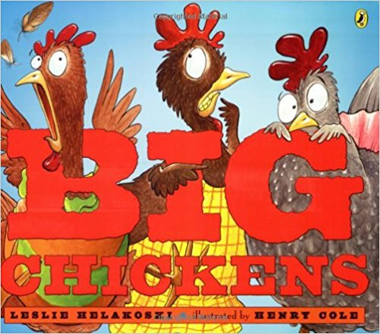
The places the Big Chickens visit in the setting of this Leslie Helakoski book are marvelous. Students create a story map to retell the story. Students code the robot to travel to all these places retelling the story at each stop.
Connections: retelling a story, creating a story map

Slide 23
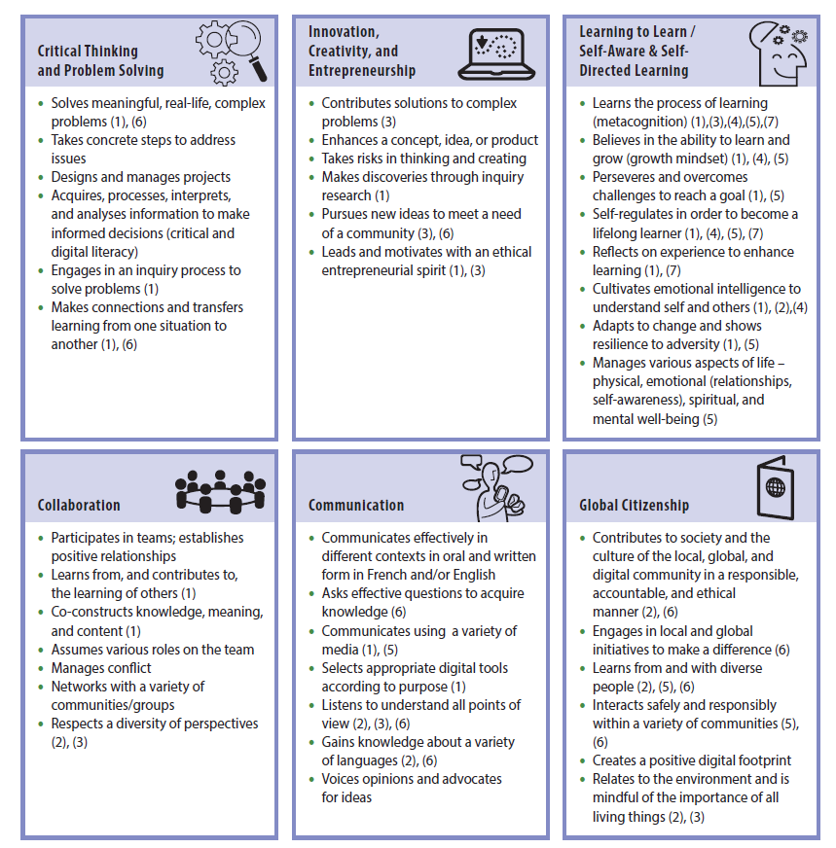
Coding & Robotics involves 21st Century Competencies

Slide 24
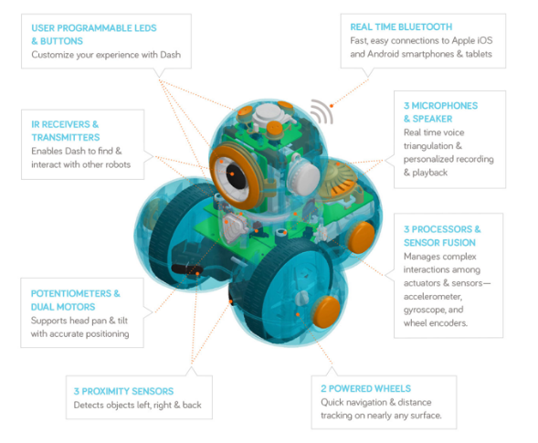
Information about DASH and apps?
https://www.makewonder.com

Slide 25
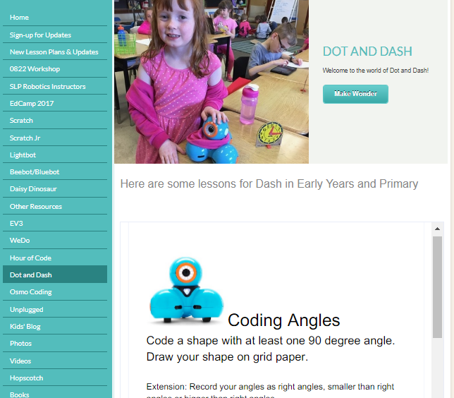
Our Kingsville Public School Weebly
http://kpscobracoders.weebly.com

Slide 26
Some resources for Trade Books and Mathematics

Slide 27
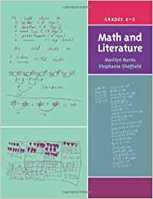
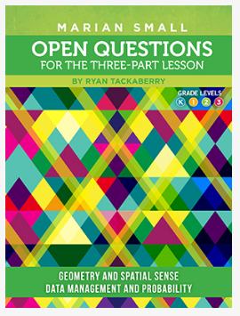
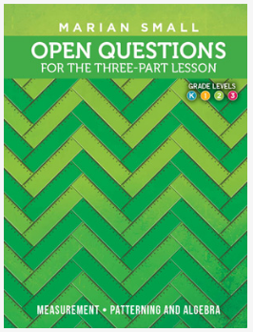
http://www.marilynburnsmathblog.com/
http://www.onetwoinfinity.ca/

Slide 28
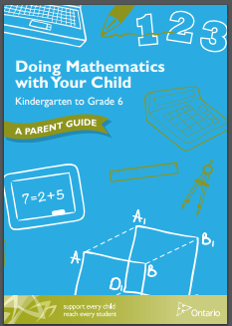
Doing Mathematics with your Child, Kindergarten to Grade 6: A Parent Guide (2014)
http://www.edu.gov.on.ca/eng/literacynumeracy/parentGuideNumEn.pdf

Slide 29
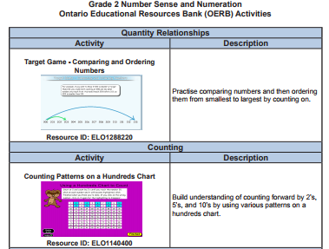
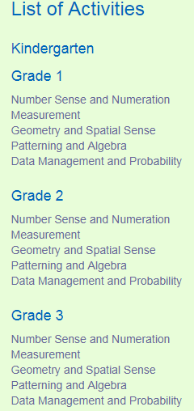
http://www.mathies.ca.activities.html

Slide 30
https://illuminations.nctm.org/Lessons-Activities.aspx

Slide 31
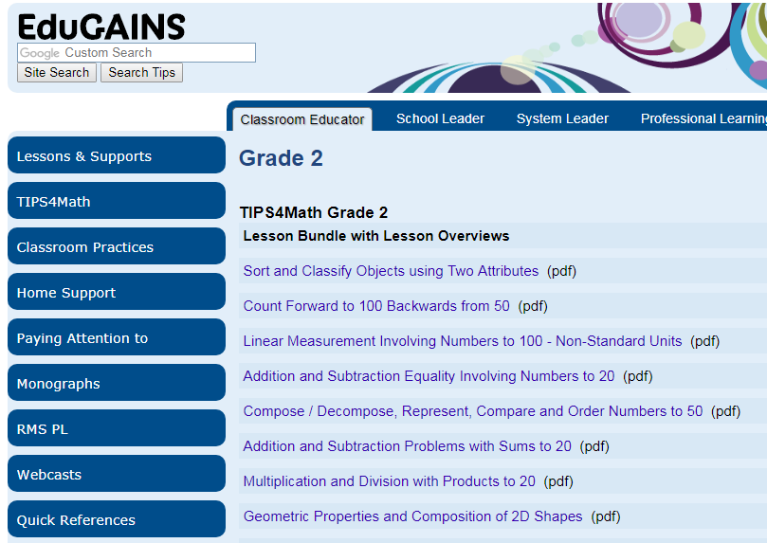
http://www.edugains.ca/newsite/math/tips4math/grade2.html

