Slide 1
CIESC Meeting November 20th 2017
Coding and Robotics Updates
www.kpscobracoders.weebly.com
Local Events

Slide 2
Local Events

Slide 3
Supervised in this area by:
Connecting Windsor-Essex

Slide 4
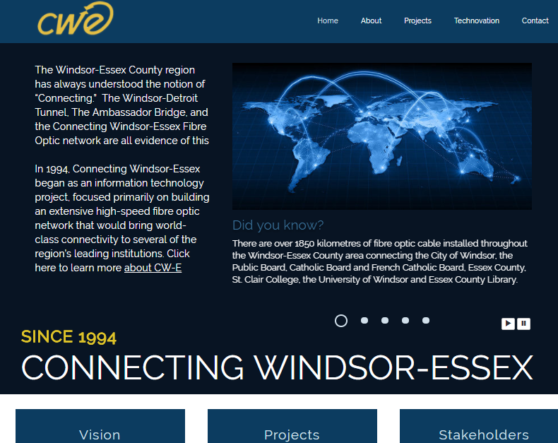
http://www.cw-e.com/home.html

Slide 5
Technovation began as a grass roots project in 2009 to inspire school aged girls to pursue technology course and careers. It has since become an International competition with over 15 000 girls across 100 countries.
Over 12 weeks, teams of up to 5 young women are paired with mentors from the University, College, or Industry and have meet-ups to:
● Identify a problem in their community
● Design an application to solve it
● Code the app
● Build a company and business plan
● Launch the app and pith the business to experts at a local event
Ages 10 to 18 with Junior competition for Grades 6 to 8, Senior Division Grades 9 to 12

Slide 6
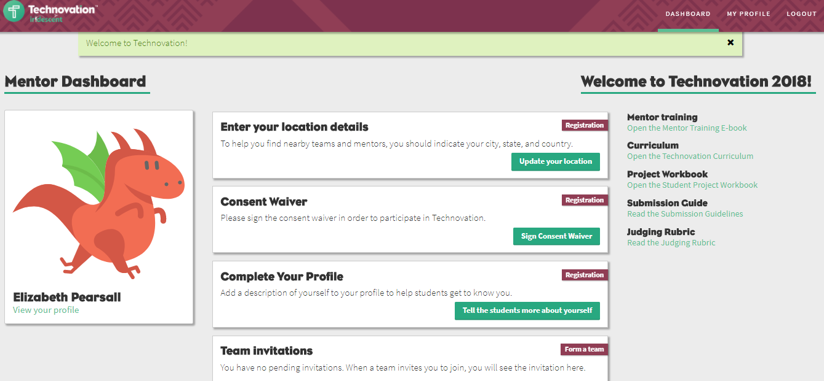

Slide 7
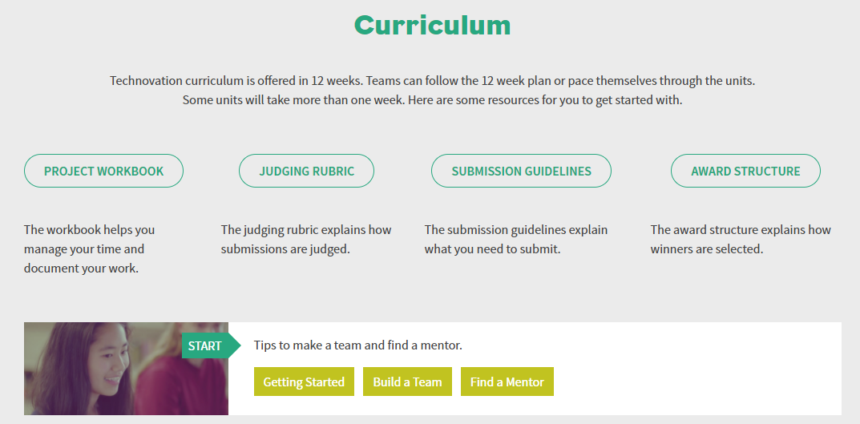

Slide 8
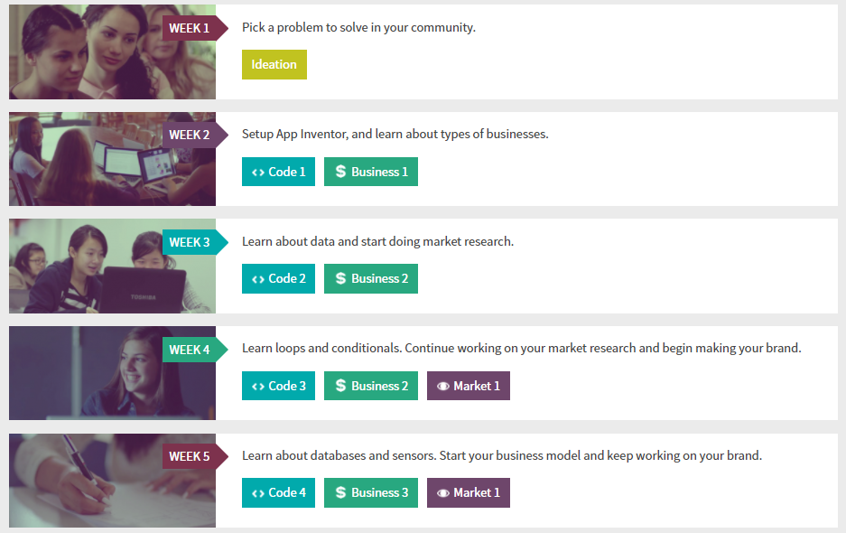

Slide 9
For additional information
Contact At CW-E:
Angela Demario
Angela.Demario@cw-e.com
226-674-3636
Technovation
http://technovationchallenge.org/about/

Slide 10
https://www.masseyhacks.ca/
Ron McKenzie @Massey

Slide 11
