Slide 1
CIESC Meeting November 20th 2017
Coding and Robotics Updates
www.kpscobracoders.weebly.com

Slide 2
GECDSB Resources:
● WeDo Construction
● WeDo 2.0 Bluetooth
● EV3 Mindstorms
● DASH Robot
@ www.Mediacentre.ca

Slide 4
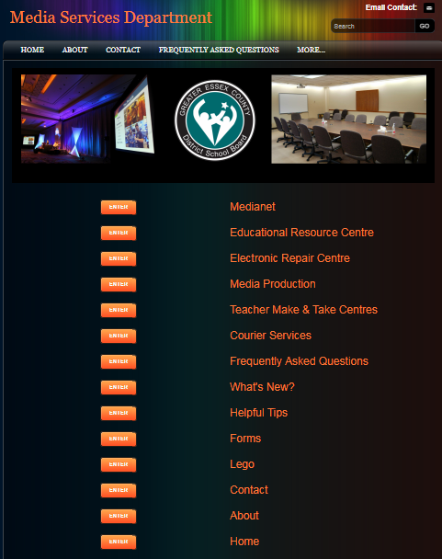
http://www.mediacentre.ca/main-menu.html
Resources for Lego WeDo Construction Kit #43005 (not Bluetooth)
and EV3 Kit #43006

Slide 5
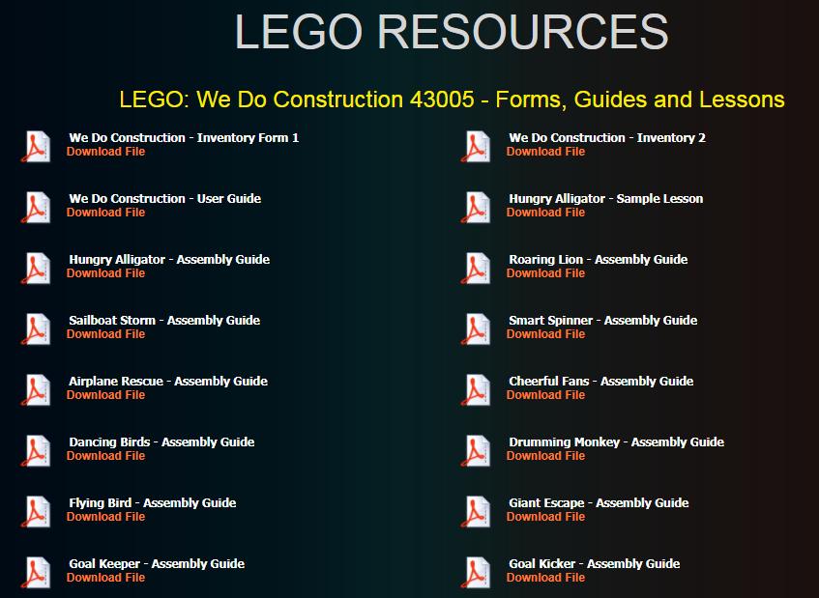

Slide 6
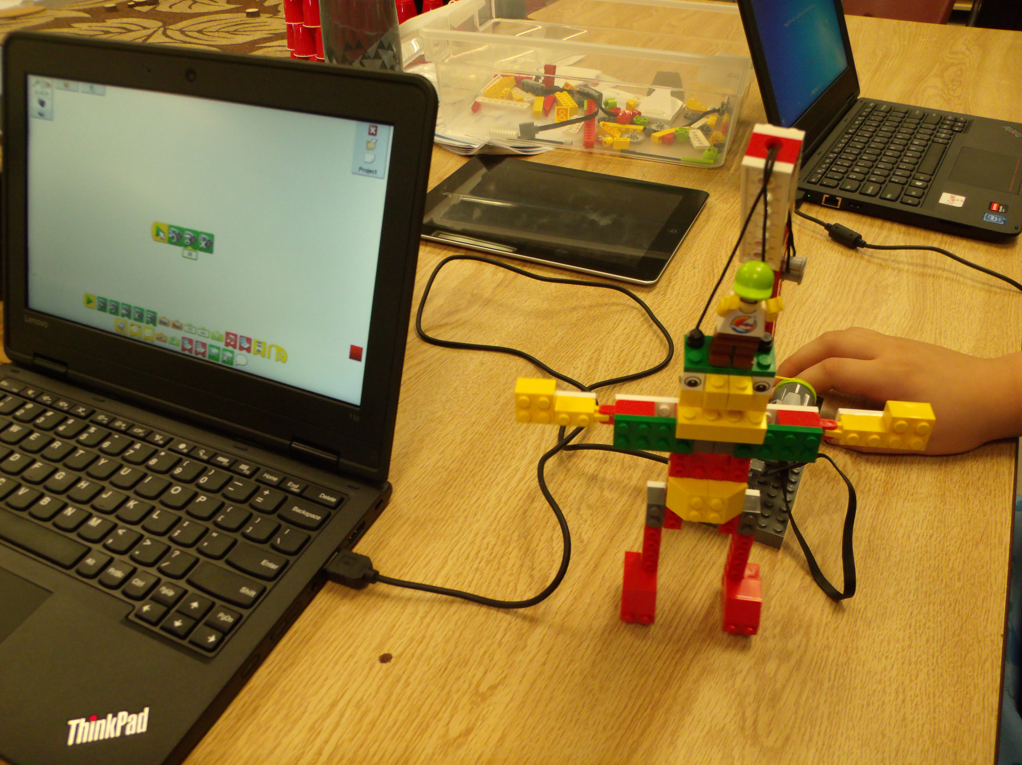
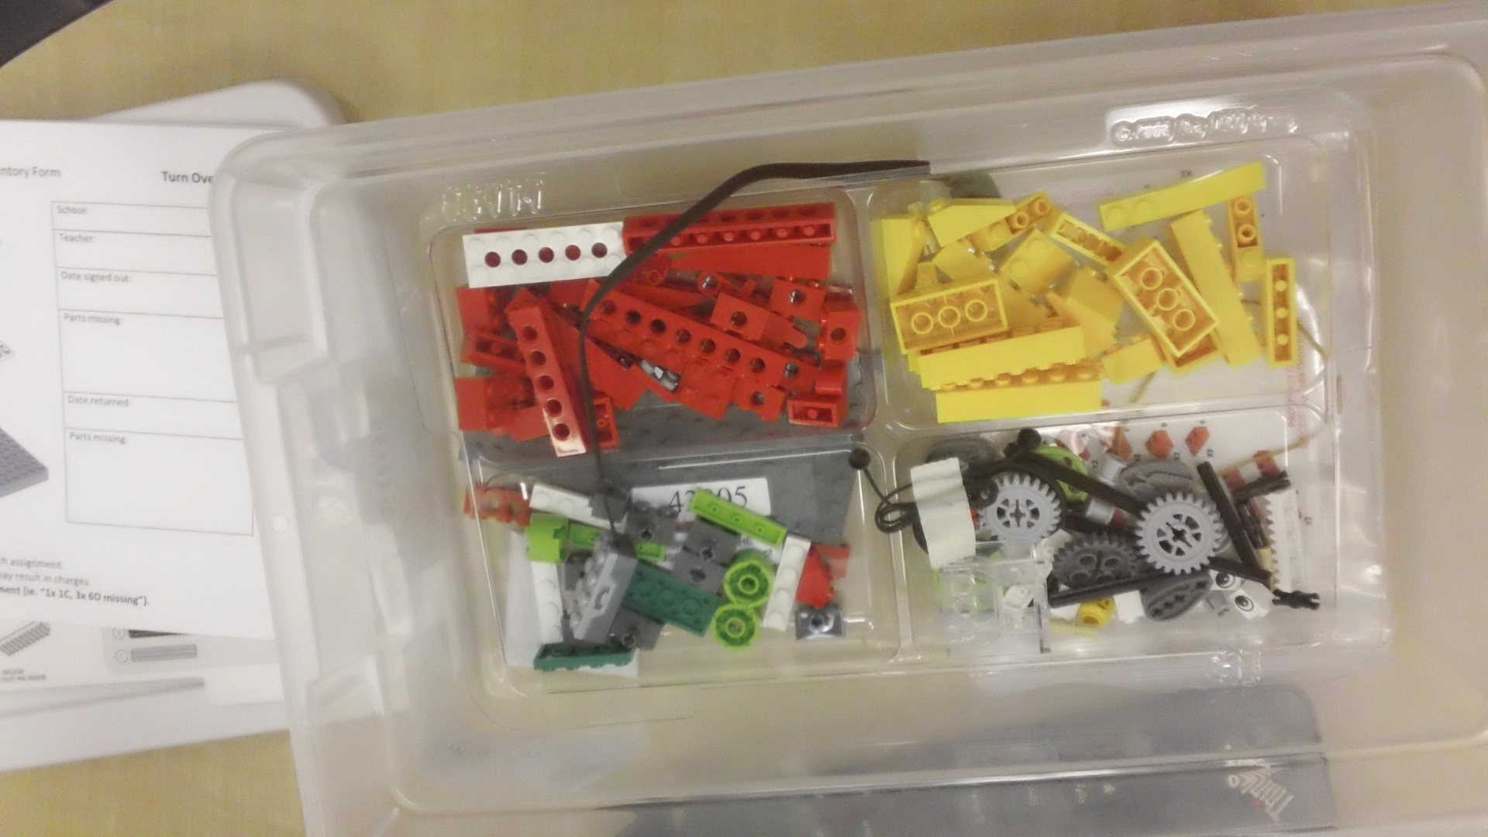
WeDo
Construction
ONE in every Elementary School

Slide 7
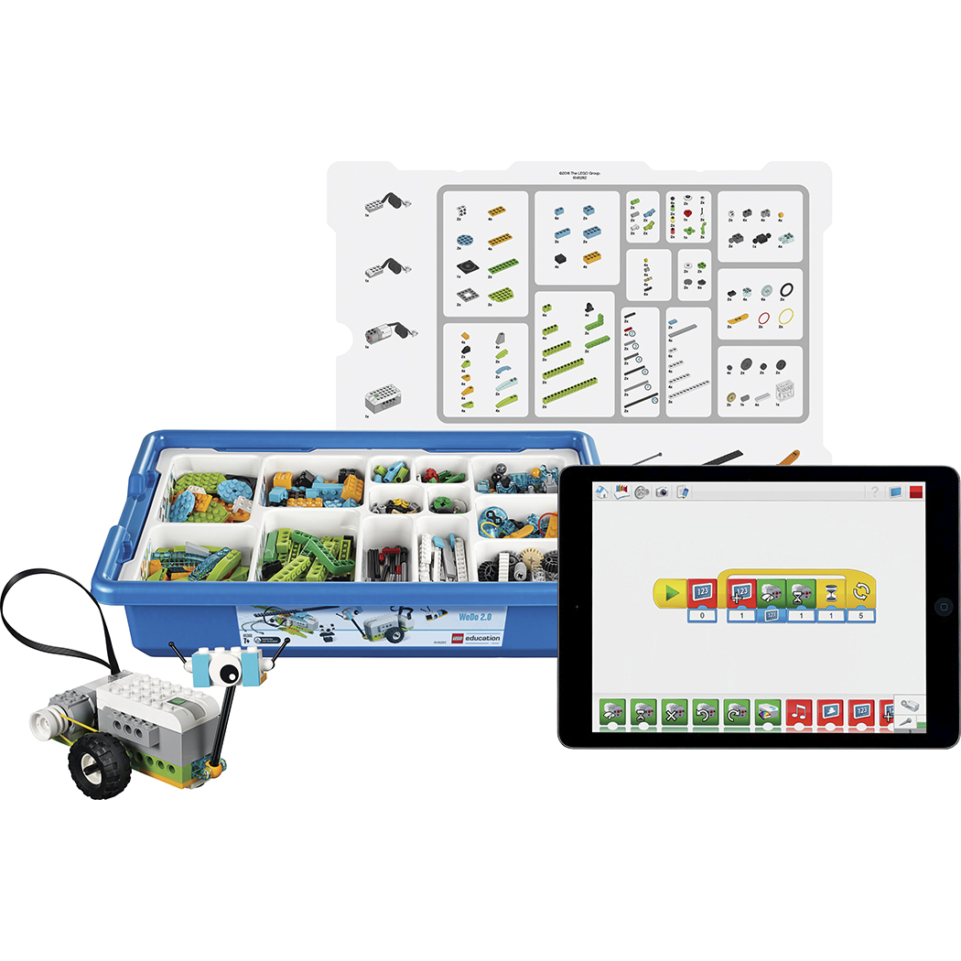
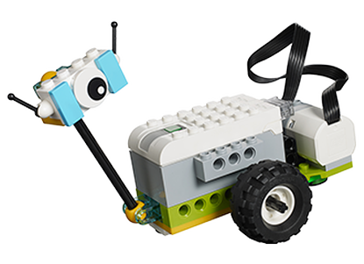
WeDo 2.0
Bluetooth
ORDER from Media Centre
https://education.lego.com/en-us/downloads/wedo-2

Slide 8
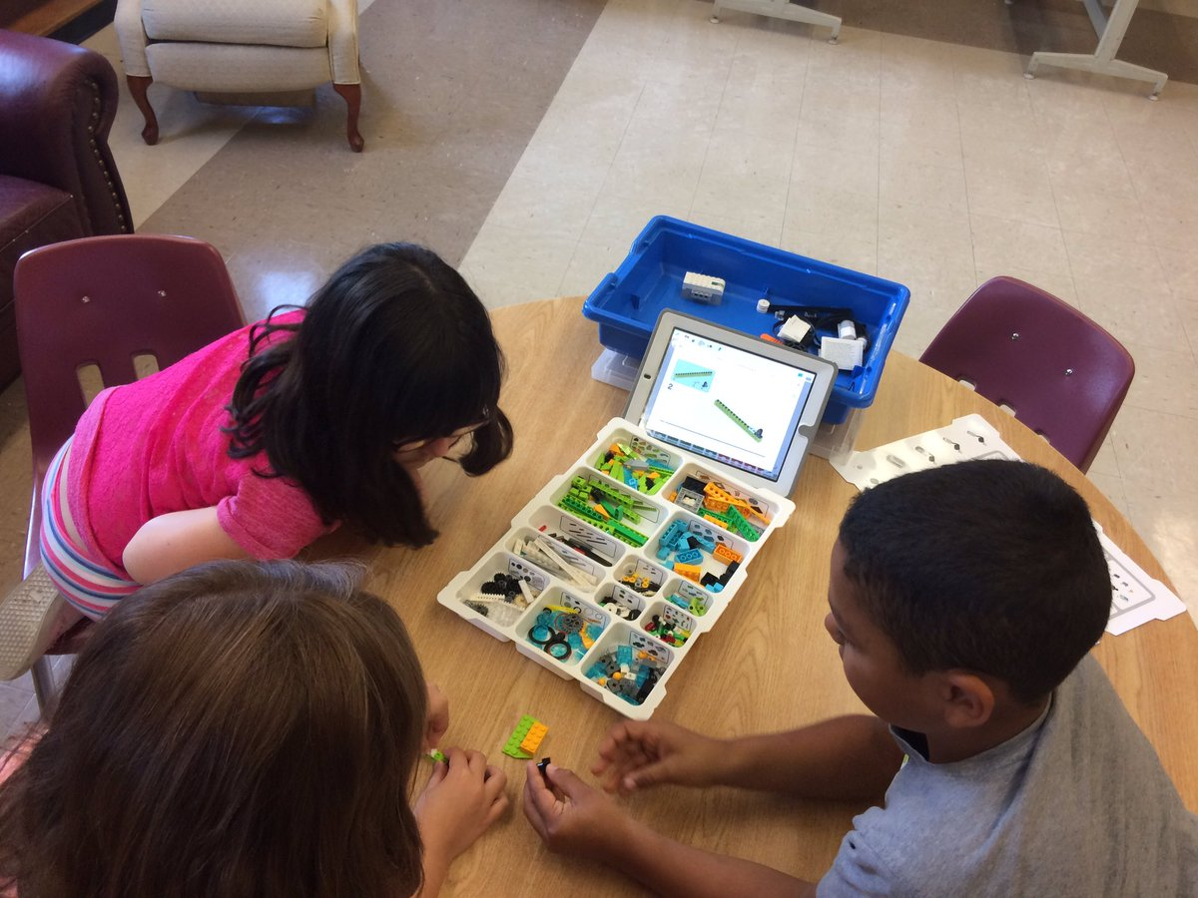
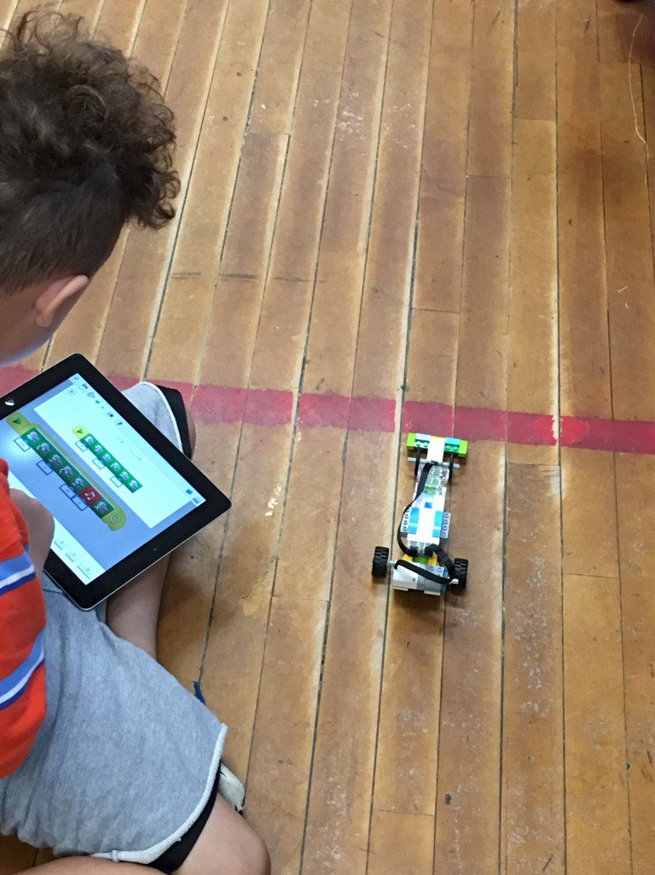

Slide 9
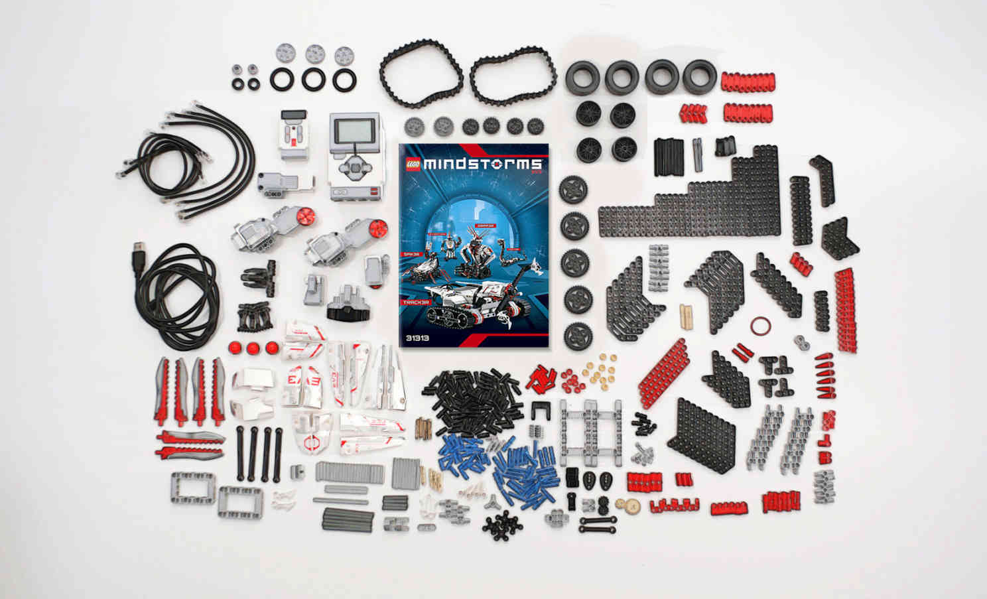
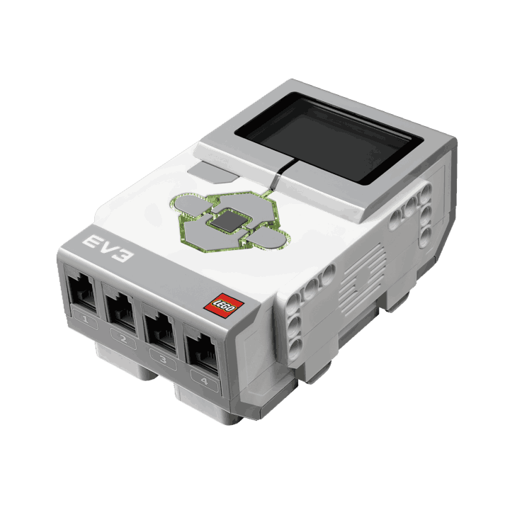
ONE in every elementary School
https://www.lego.com/en-us/mindstorms &
www.mediacentre.ca

