Slide 1
CIESC Meeting November 20th 2017
Coding and Robotics Updates
www.kpscobracoders.weebly.com
Global Events

Slide 2
Global Events

Slide 3
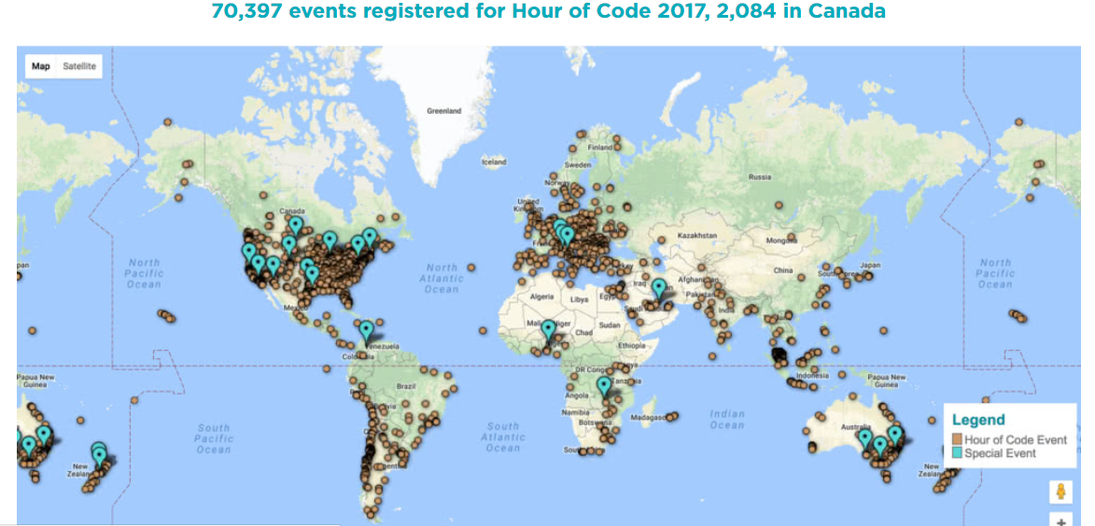
Hour of Code December 4th to 10th 2018

Slide 5
