Slide 1
CIESC Meeting November 20th 2017
Coding and Robotics Updates
www.kpscobracoders.weebly.com
Free Coding Apps

Slide 2
Apps
● LightBot
● ScratchJr
● Scratch

Slide 3
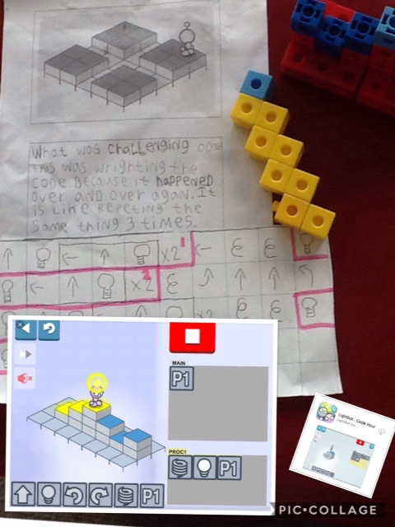
http://lightbot.com/hour-of-code.html

Slide 4
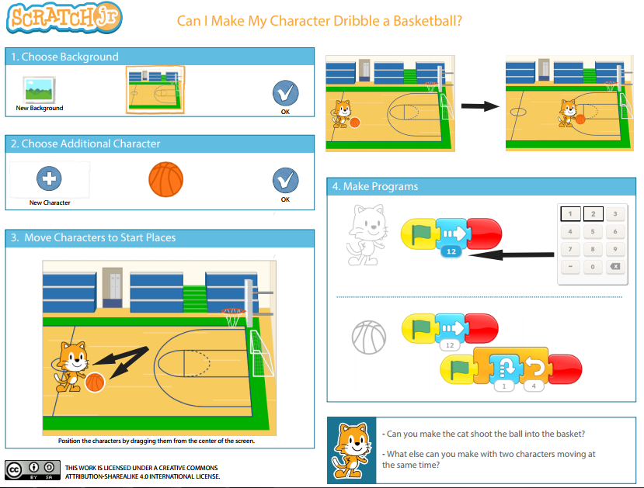
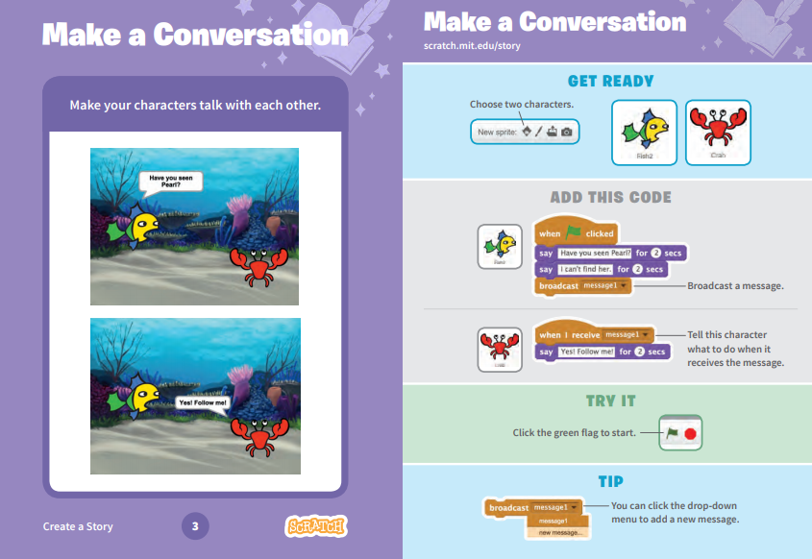
ScratchJr https://www.scratchjr.org/
Scratch https://scratch.mit.edu/

Slide 5
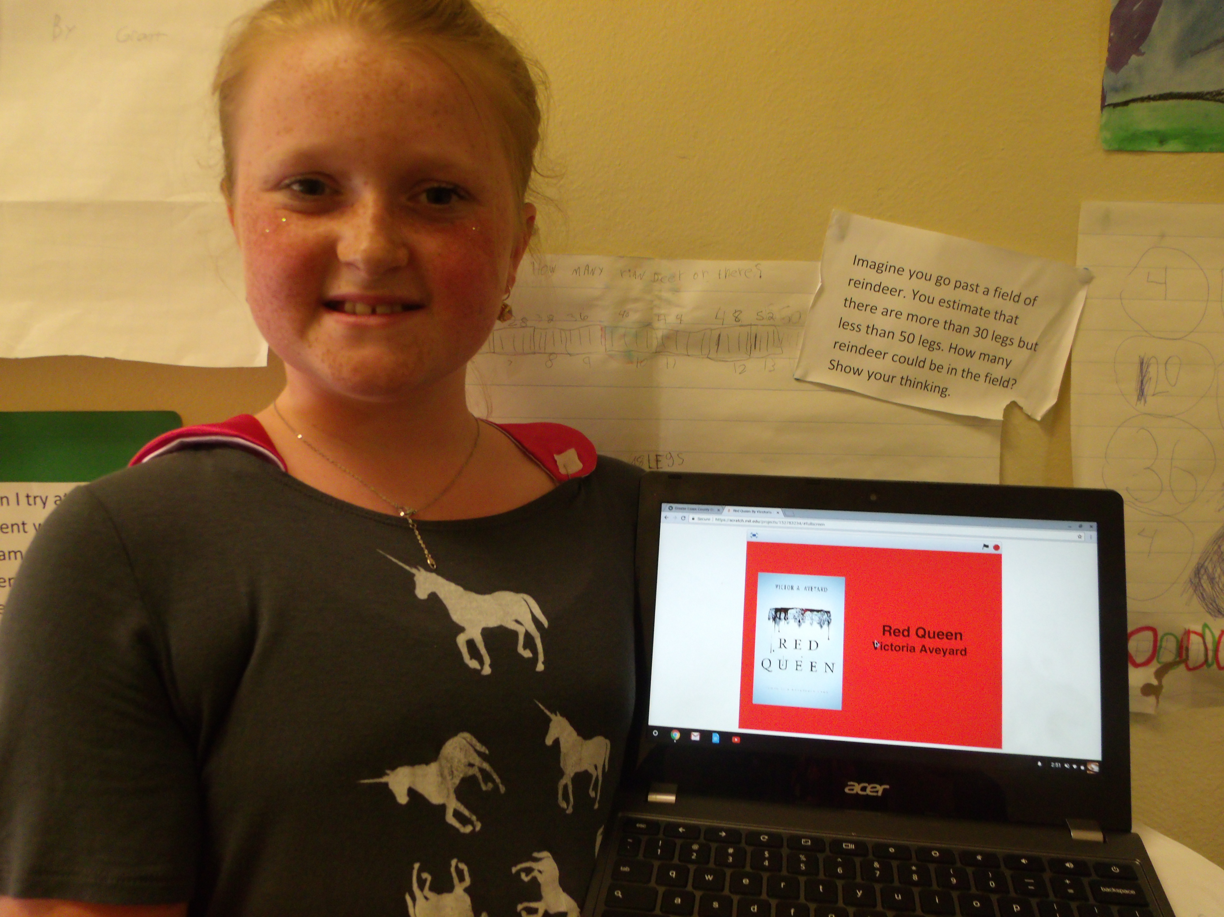
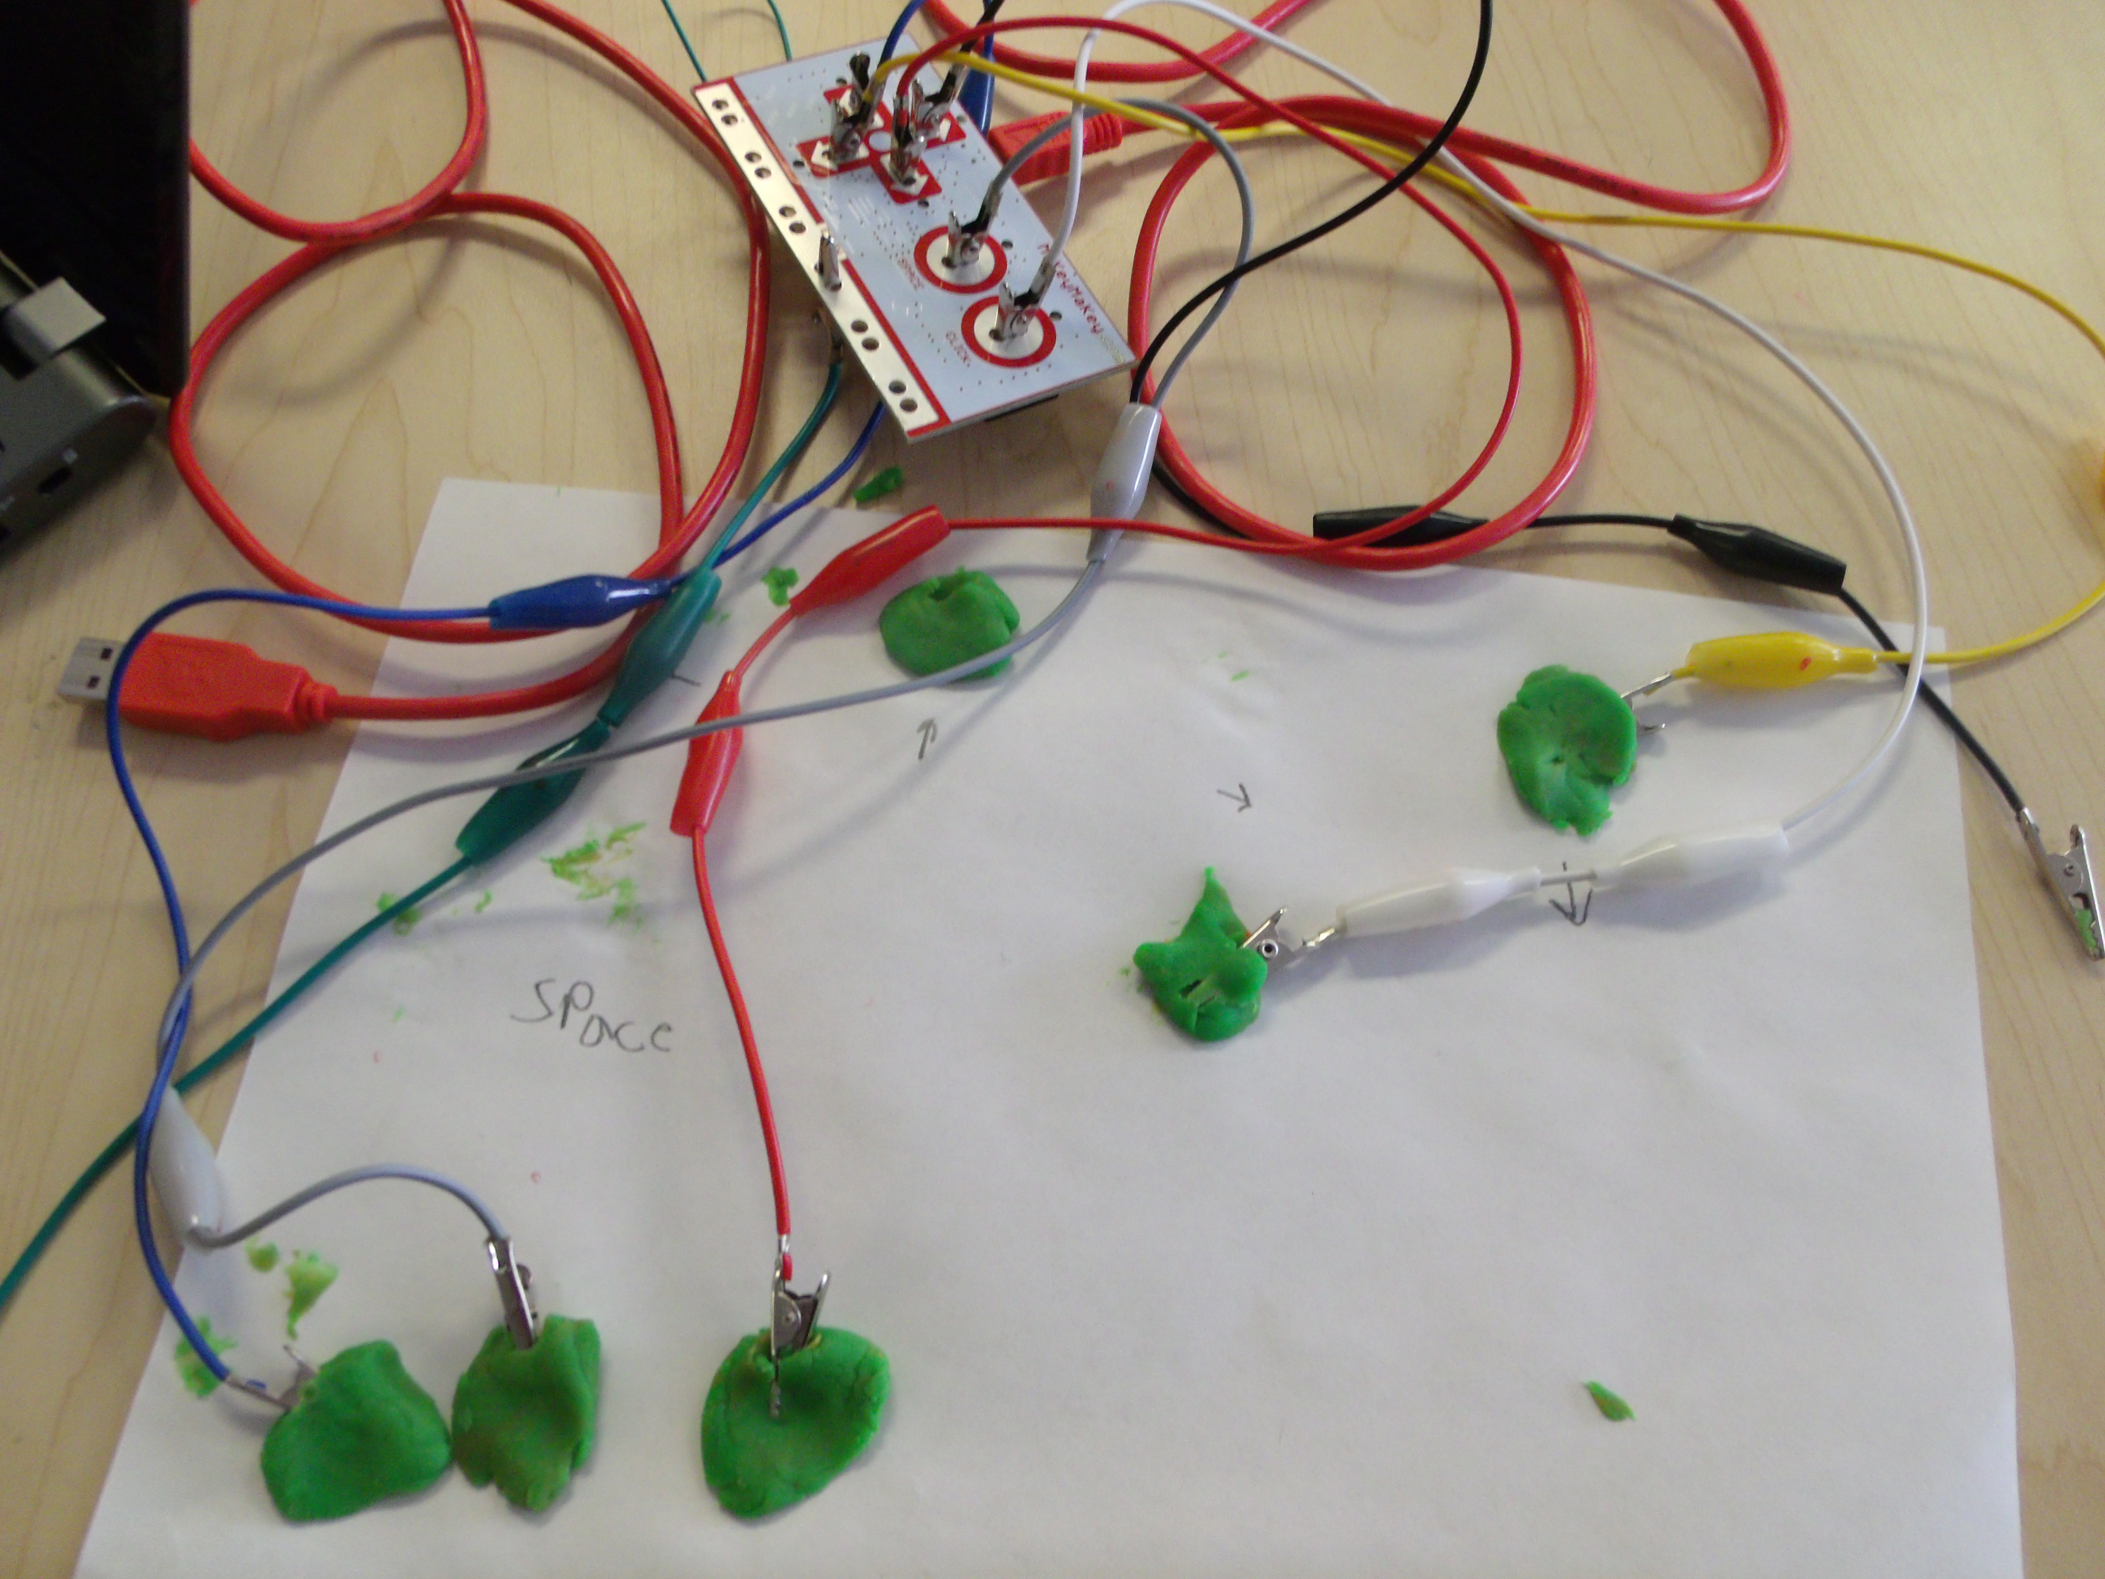
Book Reports
Makey Makey

