Slide 1
CIESC Meeting November 20th 2017
Coding and Robotics Updates
www.kpscobracoders.weebly.com

Slide 2
GECDSB Resources:
● DASH Robot
@ www.Mediacentre.ca

Slide 4
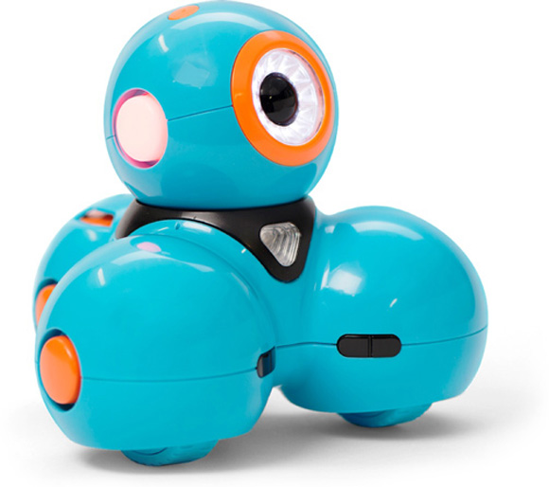
DASH has three apps with varying degrees of complexity.
Go,
Wonder, and
Blockly.
Order from Media Centre

Slide 5
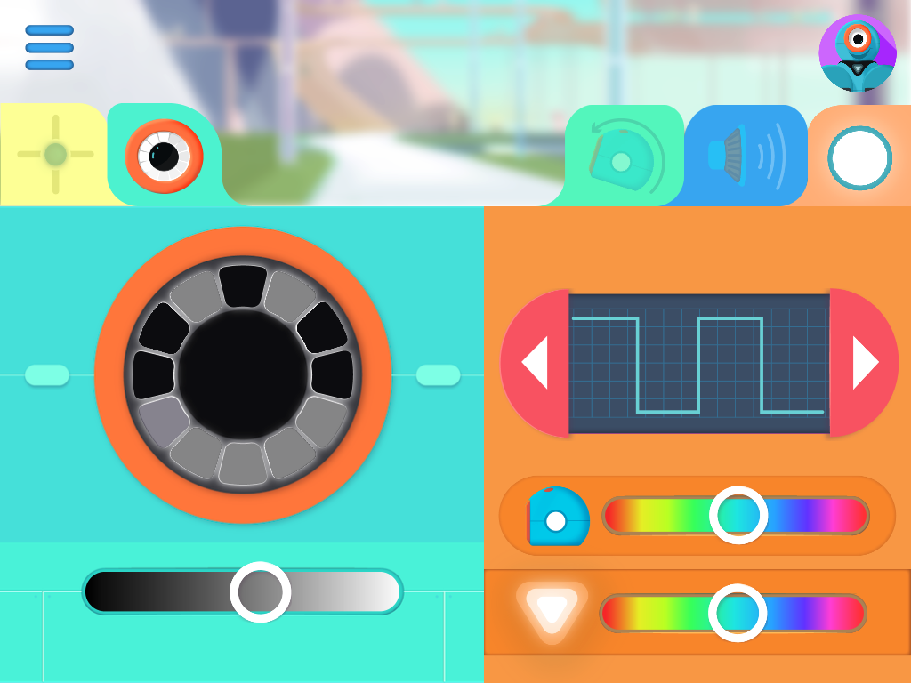
DASH Go app
● Easiest
● Instant ability to make DASH go and light up and speak (like a Remote-Control Car)

Slide 6
DASH Wonder app
● Contains
pre-populated challenges
● all the features in the GO app as well

Slide 7
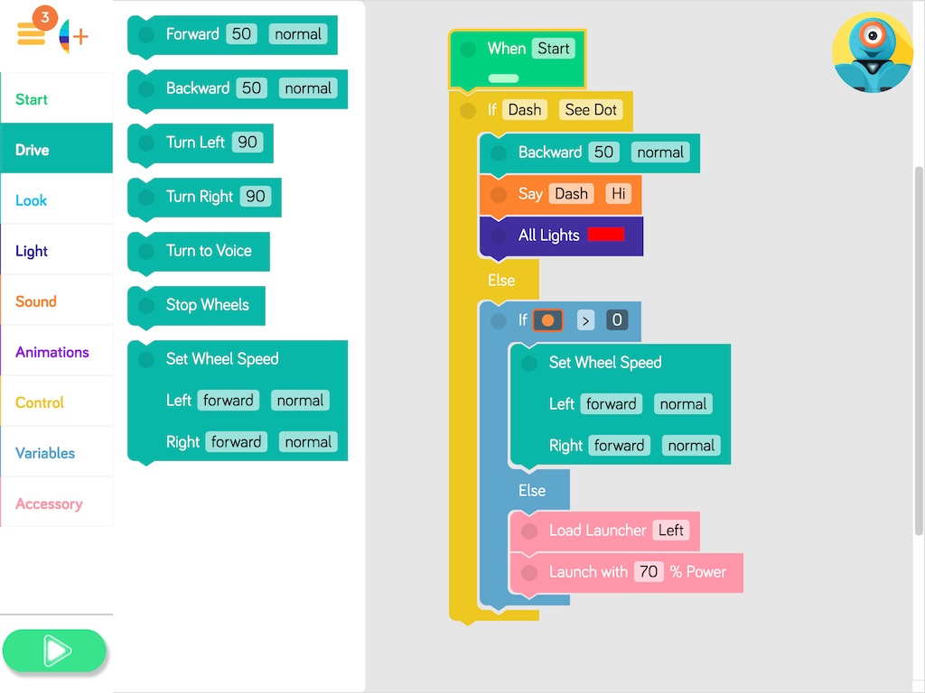
DASH Blockly app
●Drag-and-Drop block coding
● Students control robot by creating their own code
● Cross-over coding to ScratchJr and Scratch

Slide 8
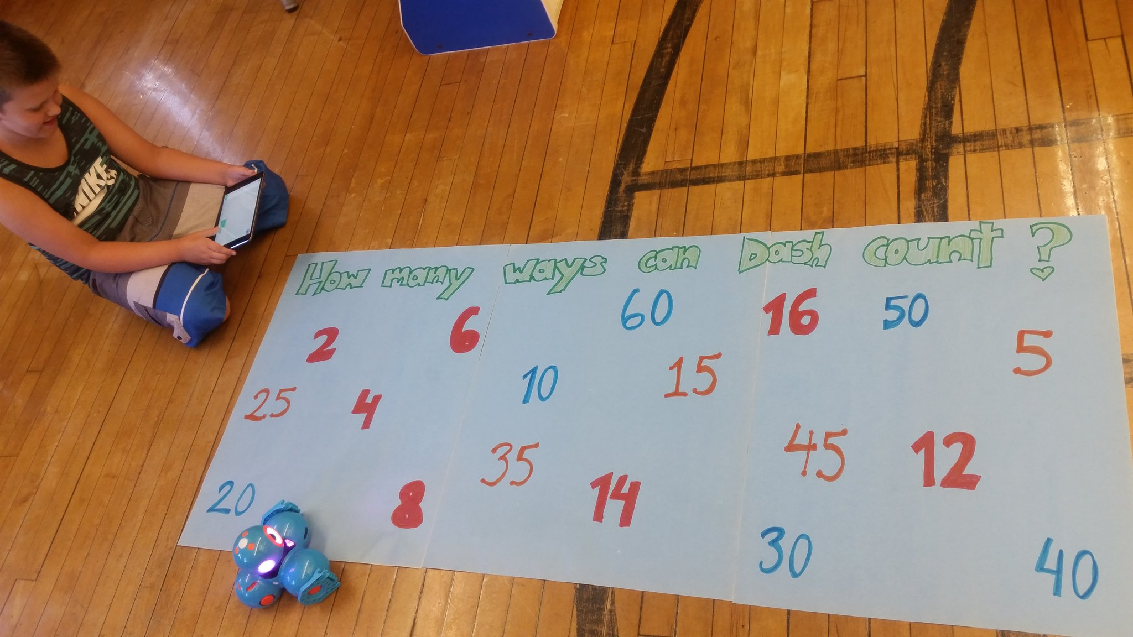
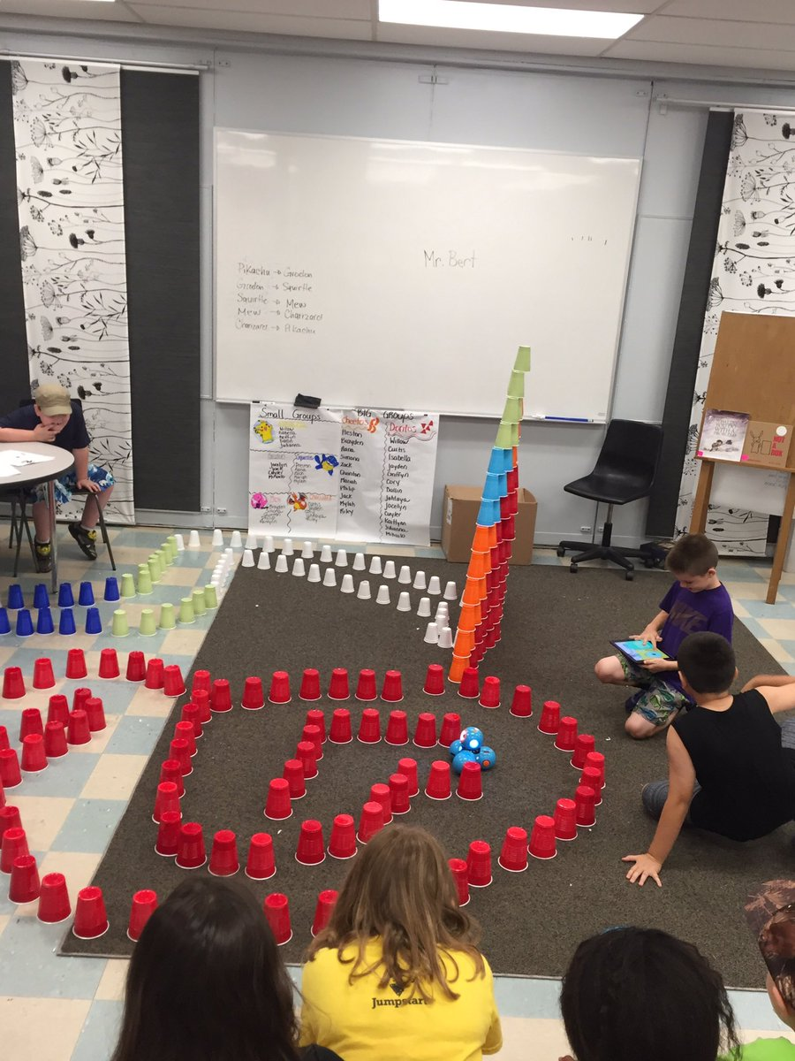
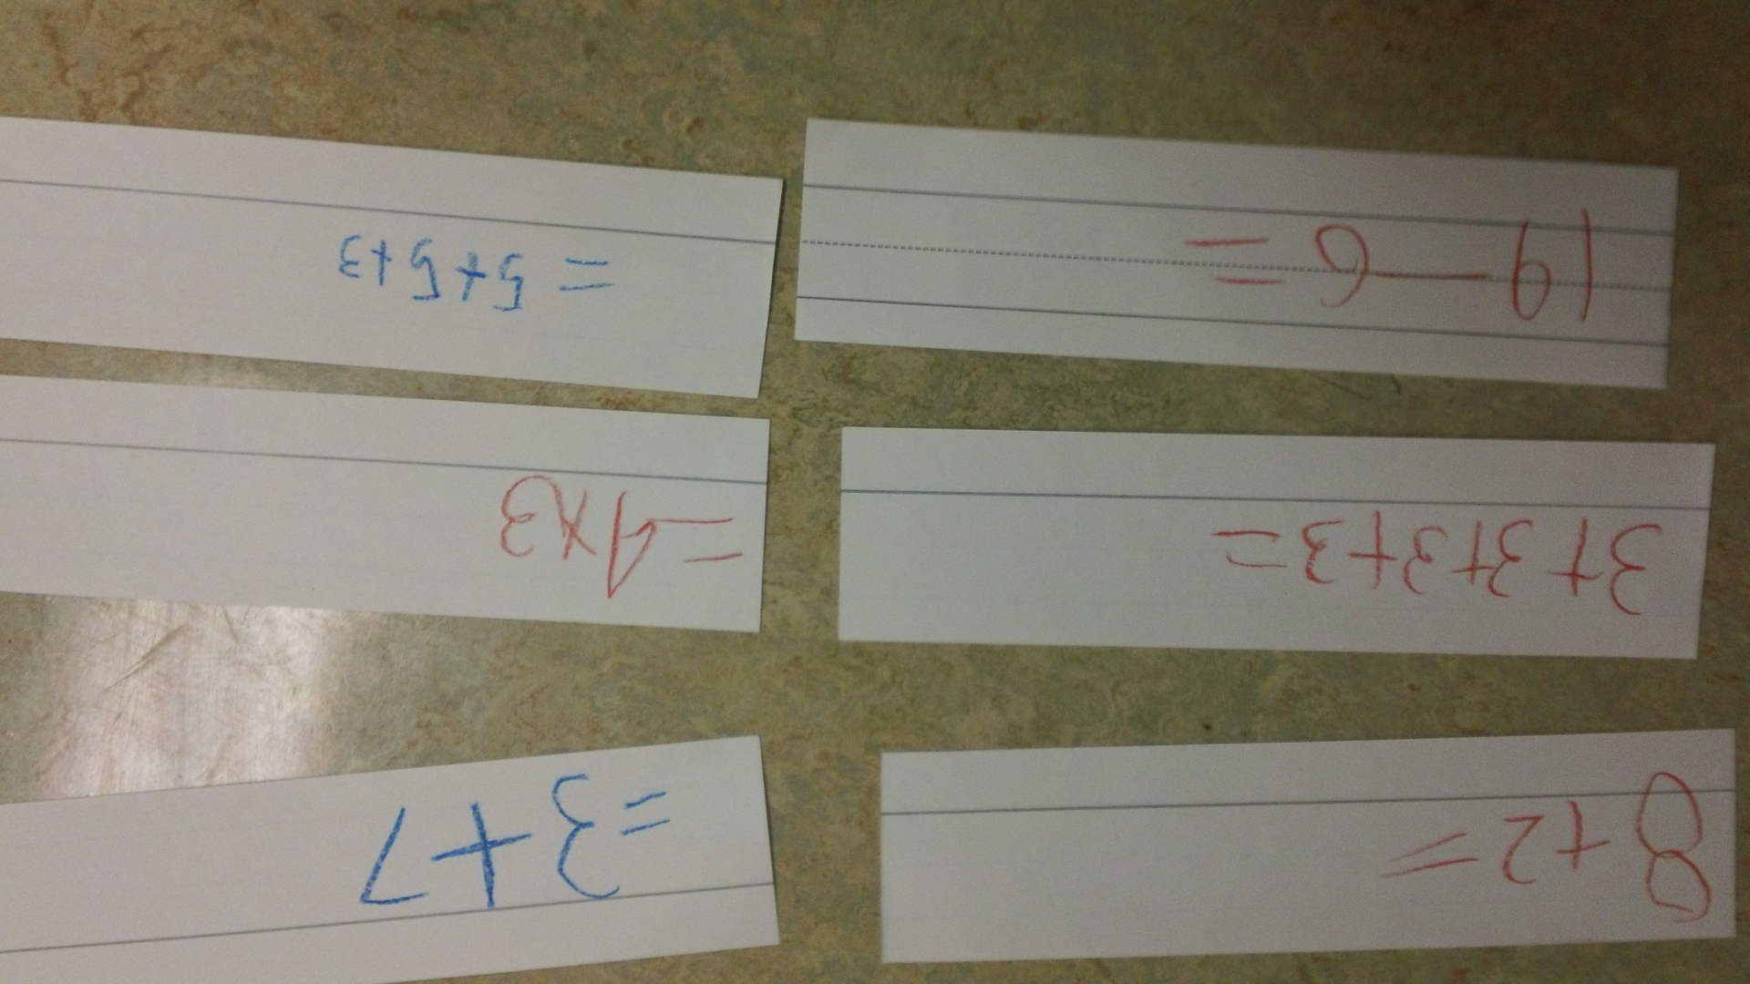

Slide 9
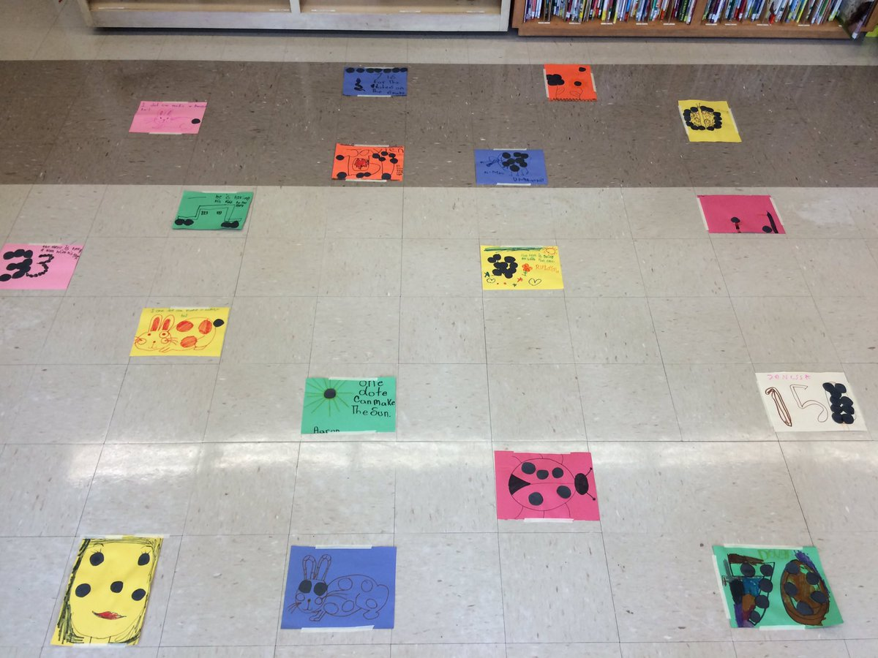

Slide 10
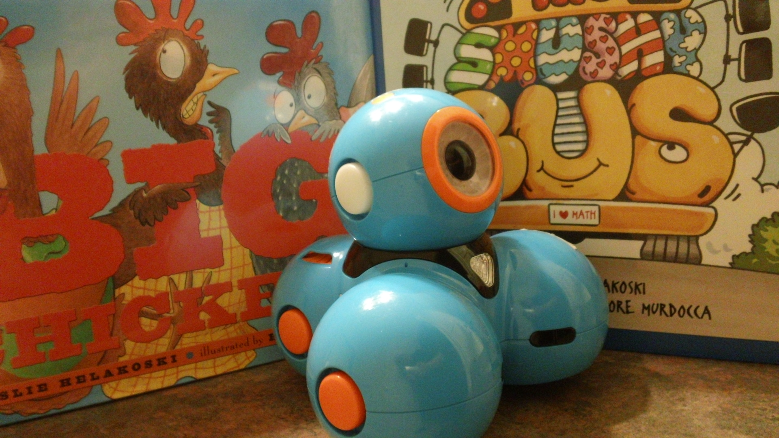
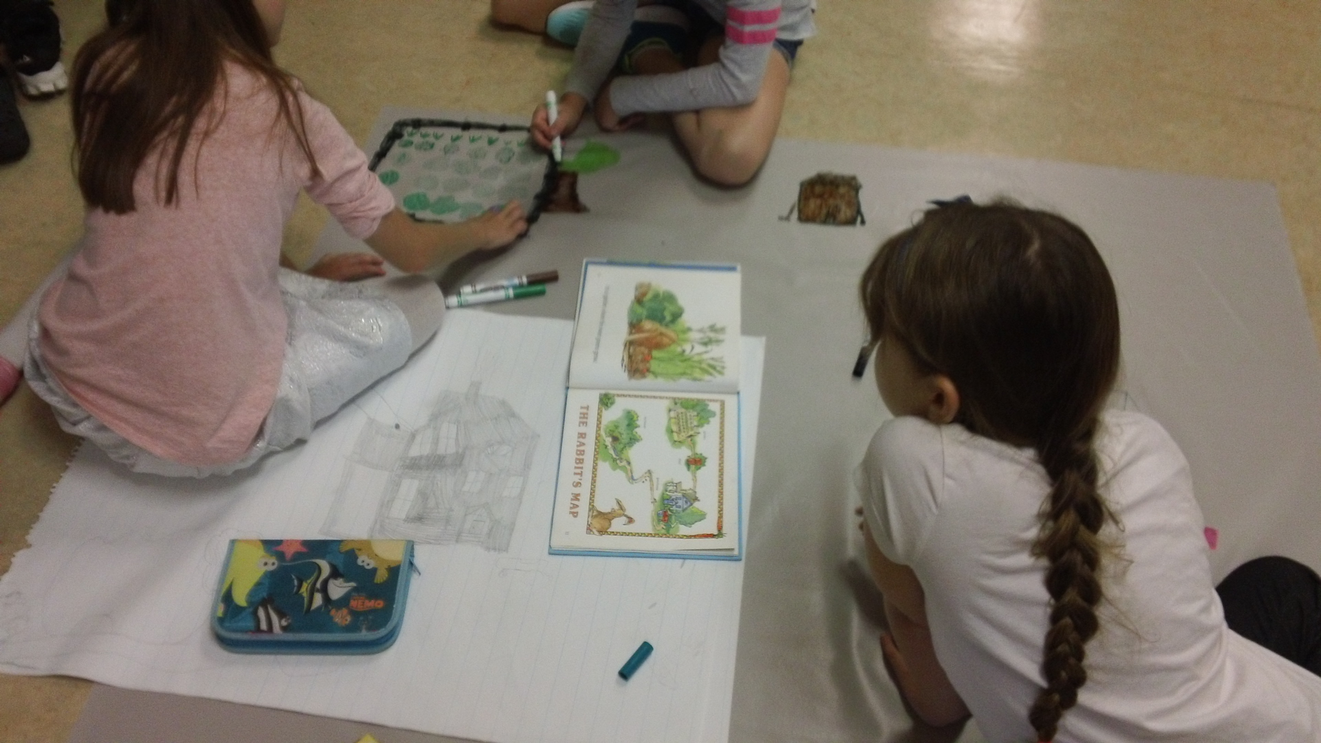

Slide 11
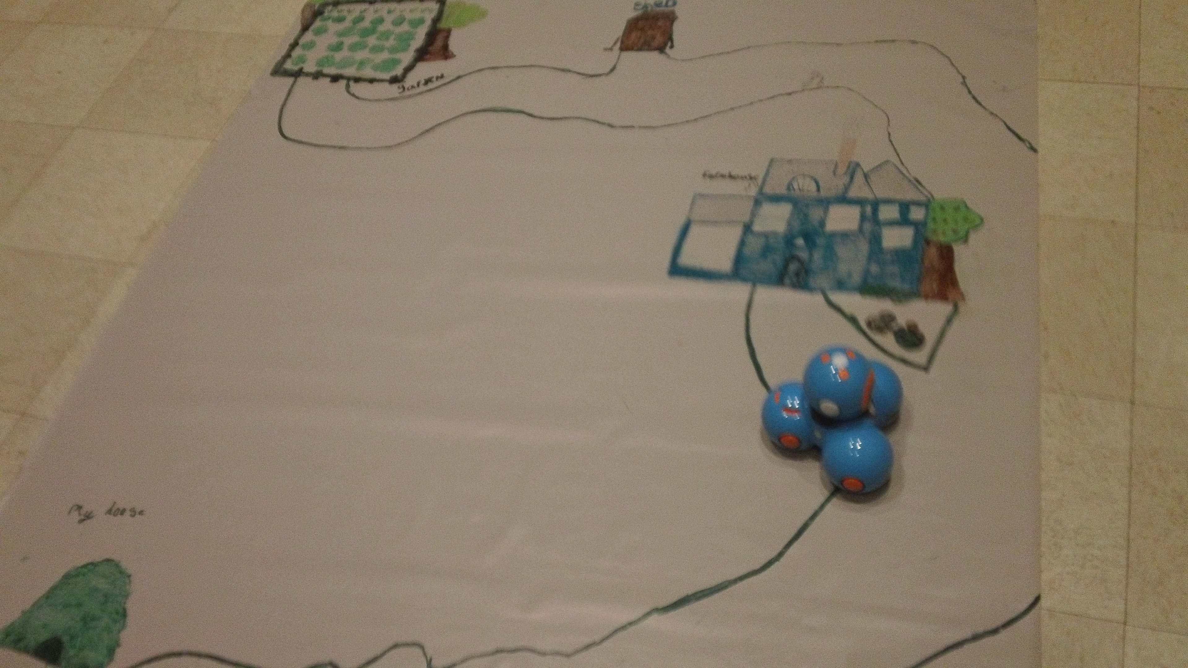
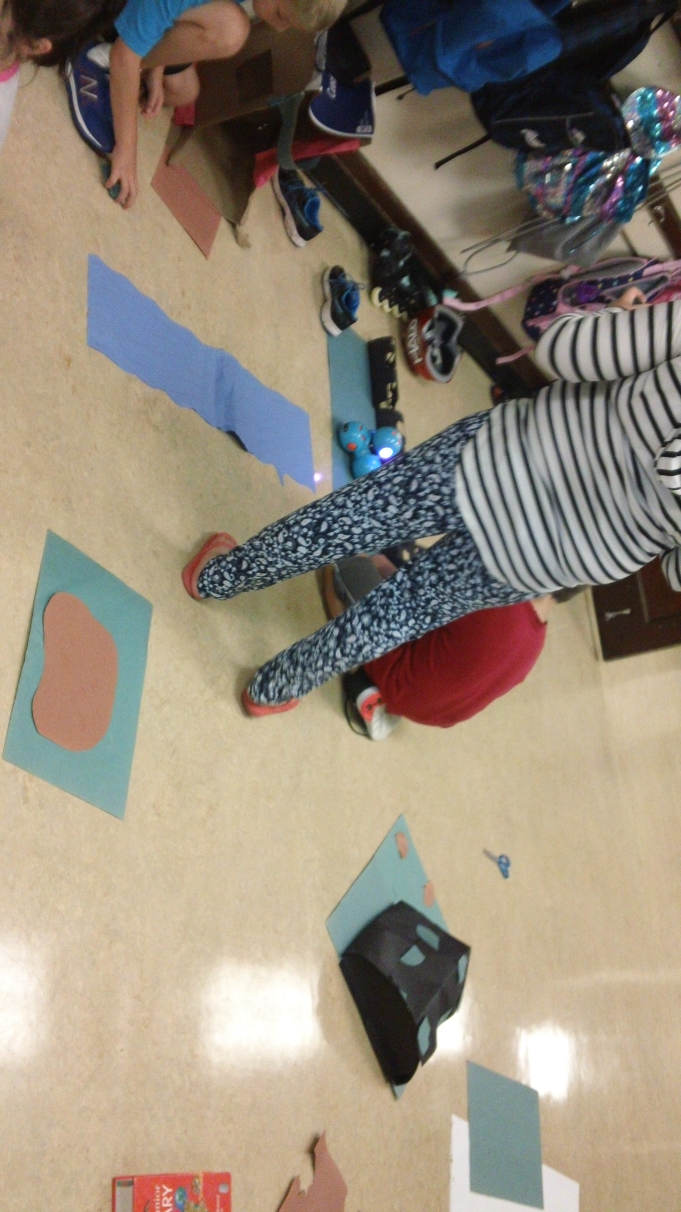

Slide 12
