Slide 1
Students can learn Scratch without you getting in their way
Let the Cat out of the bag,
Come learn Scratch – Part 2
Link to this presentation:
www.KPSCobraCoders.weebly.com
21st Century Learning
Inspire, Inquire, Innovate
August 22, 2017

Slide 2
By the end of the 9 cards students can …
find and code multiple sprites’ movements separately
code sprites to interact with conversations and movements
code the sprites to move to specific co-ordinates in a four quadrant grid
find multiple backdrops and code them to change on demand
code the sprites to change colour or size
find sound clips and include them in the code
record their own voices to become part of the project
code a button
With this information students can begin to put tasks
together to make a project.

Slide 3
How did I prepare?
made a class account for the students in my Teacher’s Account
completed the sign in process and gave them a simple password
WHY? So that when they went to the site they could begin immediately and I knew all the accounts & passwords worked!
Made a link in School Connect for computers
Made a log-in slip for each of them for agenda (to use at school & home)

Slide 4
How did I start?
Put set of cards between 2 students coaches (trainers)
WHY? To encourage them to discuss how to complete tasks
Showed them to look for Backdrop and Sprite icons at lower LH side of computer screen and look for blocks by colour in screen middle
Explained that these cards were the basic skills that everyone in the class would learn
Connected the cards to learning the alphabet and after they learned the alphabet they could make their own words i.e., “projects”
Explained they would coach others by following the card instructions
Circulated around and when a student completed a card had them “read” the blocks and show me how it worked

Slide 5
Then …
Once coaches has finished 9 cards they then trained 2 other students each with their own computer but … no computer for the coach
WHY? So the coach would give their full attention to peers
In all cases I had the students check in with me by “reading” the blocks and sharing how it worked
I sat back & listened to them guide each other and share their enthusiasm!

Slide 6
Why this worked …
Student coaches took their jobs to heart and made sure they understood how to complete all the tasks on the cards before they worked with their classmates
Any concerns they had about sharing were alleviated because they knew everything they needed was on the cards
Students saved each page’s work as a project to show their families and as references for future work
It was the start of building a Community of Practice

Slide 7
So let’s try one of the cards …

Slide 8
When the whole class finished the cards…
We came together & with the use of a projector I showed them all the button links on the main screen
Part of it was a review and part new information
WHY? I think they should be successful right away and have a basic understanding of how it works and then build from there
Mention how to extend the backdrops and sprites by designing their own, going out on the internet, and using photographs
Explain the Sharing process, the idea of Remixing, and Scratch Community Guidelines
End with TIPS and direct students to Projects to try

Slide 9
Reviewing the Scratch screen

Slide 10
Reviewing Scratch Main screen

Slide 12
Other items for each project
Star Icon
Love this Project
Total Views
View the Remix Tree

Slide 13
Comments and Remixes

Slide 14
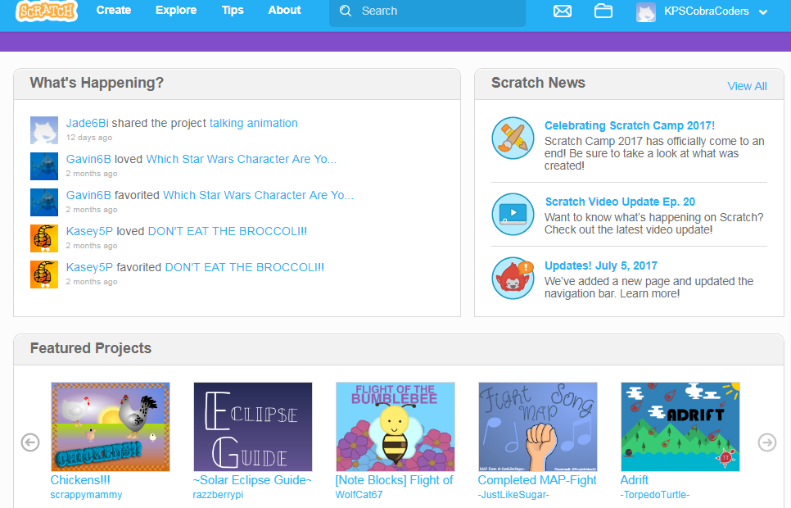
Main Screen in Teacher’s Account – Note updates on Student Activity

Slide 15
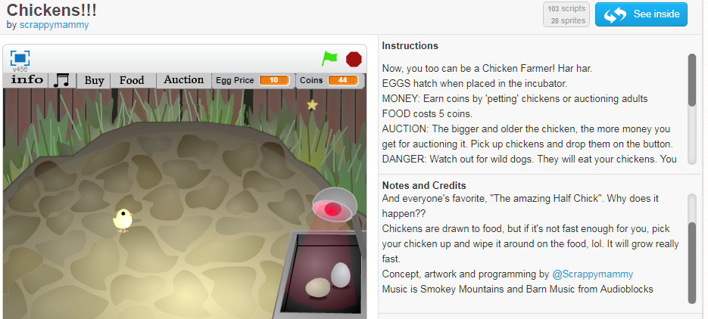

Slide 16
Review Community Guidelines
We need everyone’s help to keep Scratch a friendly and creative community where people with different backgrounds and interests feel welcome.
Be respectful.
When sharing projects or posting comments, remember that people of many different ages and backgrounds will see what you’ve shared.
Be constructive.
When commenting on others' projects, say something you like about it and offer suggestions.
Share.
You are free to remix projects, ideas, images, or anything else you find on Scratch – and anyone can use anything that you share. Be sure to give credit when you remix.

Slide 17
Keep personal info private.
For safety reasons, don't give out any information that could be used for private communication - such as real last names, phone numbers, addresses, email addresses, links to social media sites or websites with unmoderated chat.
Be honest.
Don’t try to impersonate other Scratchers, spread rumors, or otherwise try to trick the community.
Help keep the site friendly.
If you think a project or comment is mean, insulting, too violent, or otherwise inappropriate, click “Report” to let us know about it.
Scratch welcomes people of all ages, races, ethnicities, religions, sexual orientations, and gender identities.
Scratch is a project of the Lifelong Kindergarten group at the MIT Media lab. It is available free at http://sctach.mit.edu

Slide 18
After Cards What Next?
Click on Tips
Pick on of the Step-by-Step tutorials
These basic projects are just like the Cards except now they complete multiples pages to rather than just one page

Slide 19
After Tutorials, What Next?
Starter Projects!!!!
https://scratch.mit.edu/starter_projects/
Now, no more instructions
Students study the project’s code and REMIX their projects

Slide 20
After Cards, Tutorials, & Starter Projects, what’s next for teachers?
There are resources to use:
Follow a series of lesson plans in An Introductory Computing Curriculum Using Scratch http://scratched.gse.harvard.edu/guide/files/CreativeComputing20141015.pdf

Slide 21
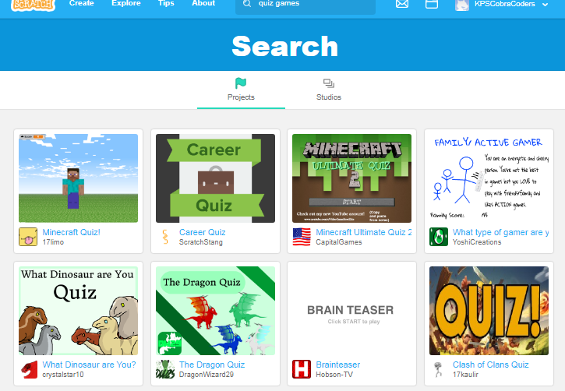
Search for project ideas in Scratch

Slide 22
Look for a particular type of project or subject area in ScratchEd.

Slide 23
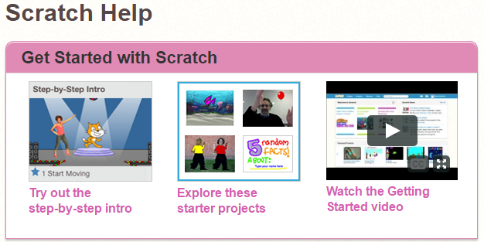
Where can teachers find out more? Scratch Help
https://scratch.mit.edu/help/

Slide 24
Scratch Guides

Slide 25
Searching the Scratch Community

Slide 26
Where can teachers get help? ScratchEd

Slide 27
Where can teachers get help? Scratch Wiki

Slide 28
Added this to workshop section: http://kpscobracoders.weebly.com/

Slide 29
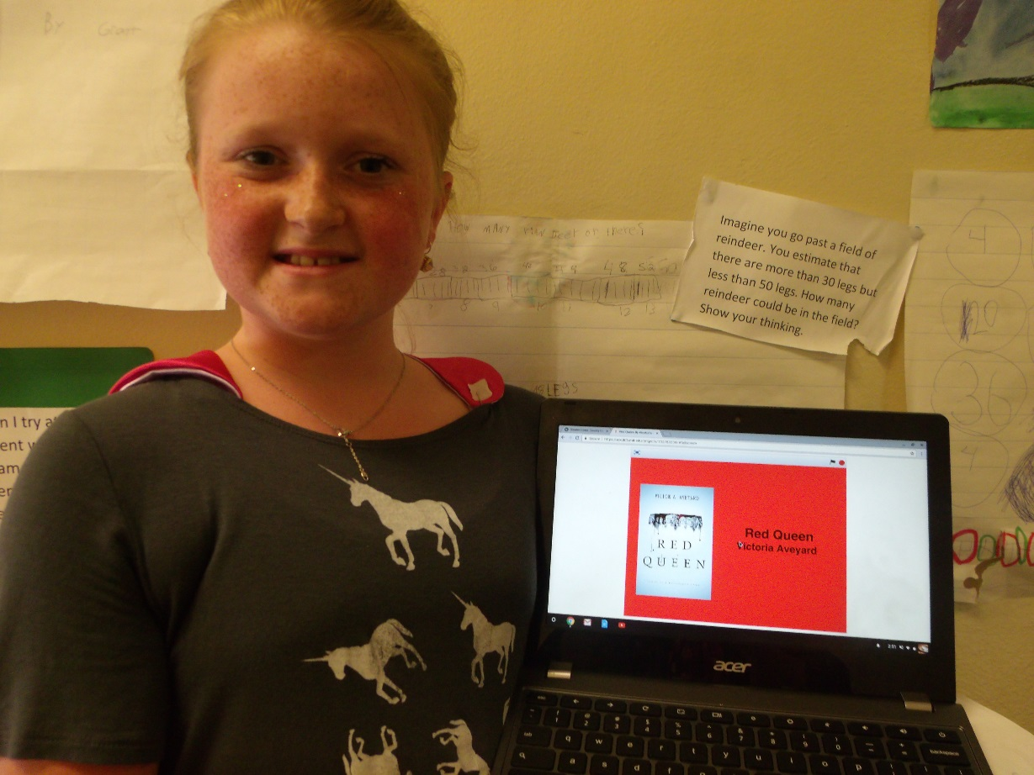
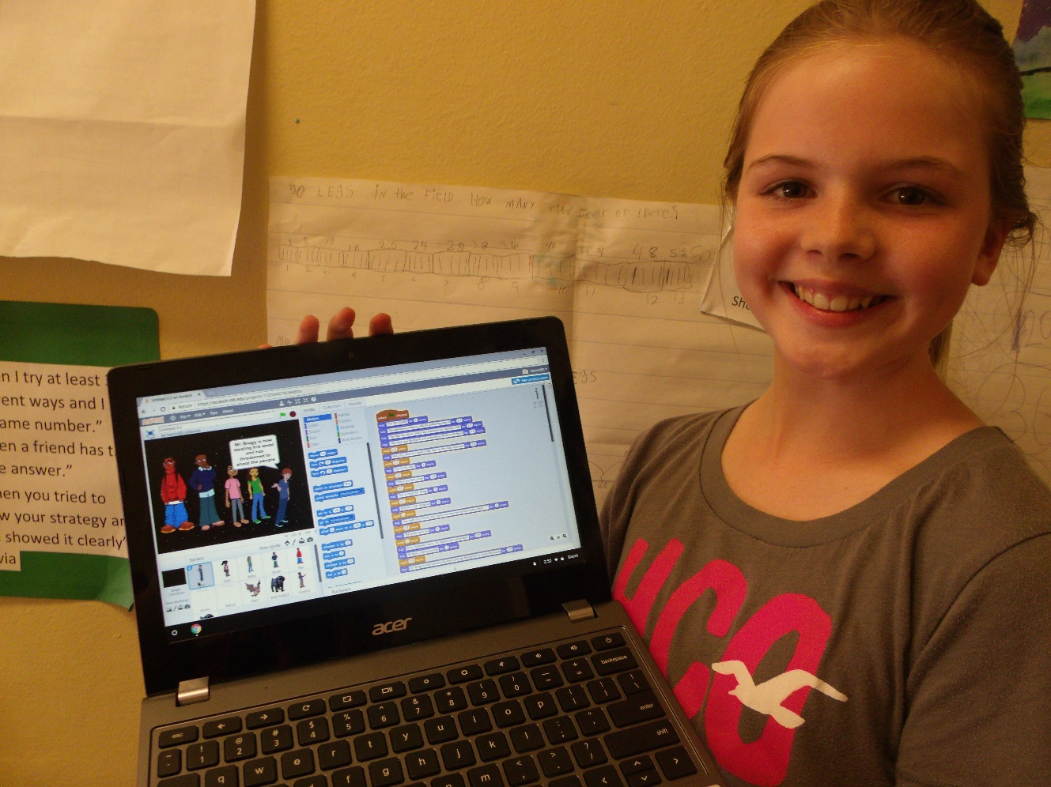
Book Reports using Scratch

Slide 30
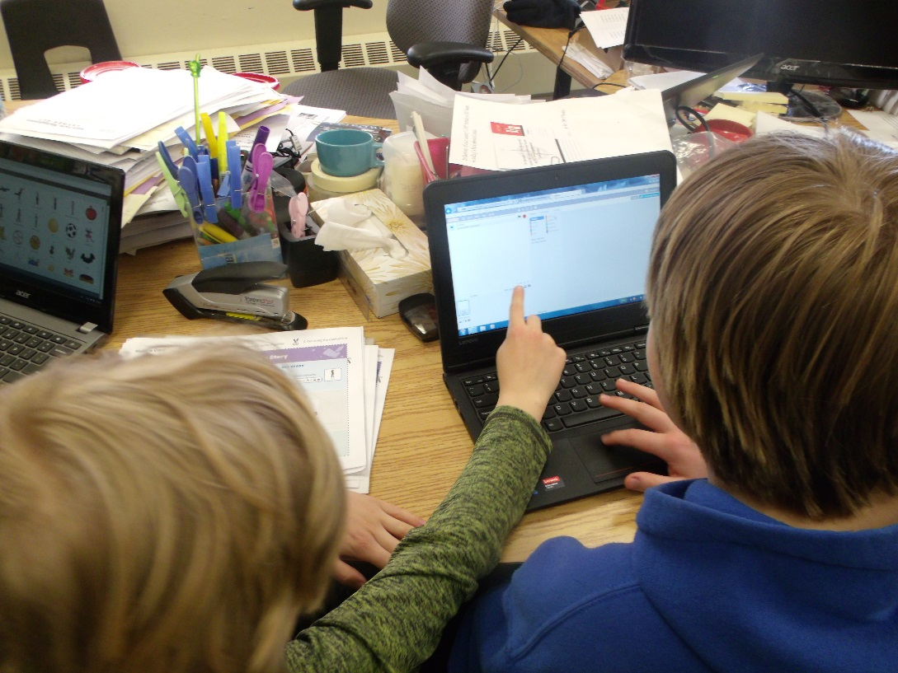
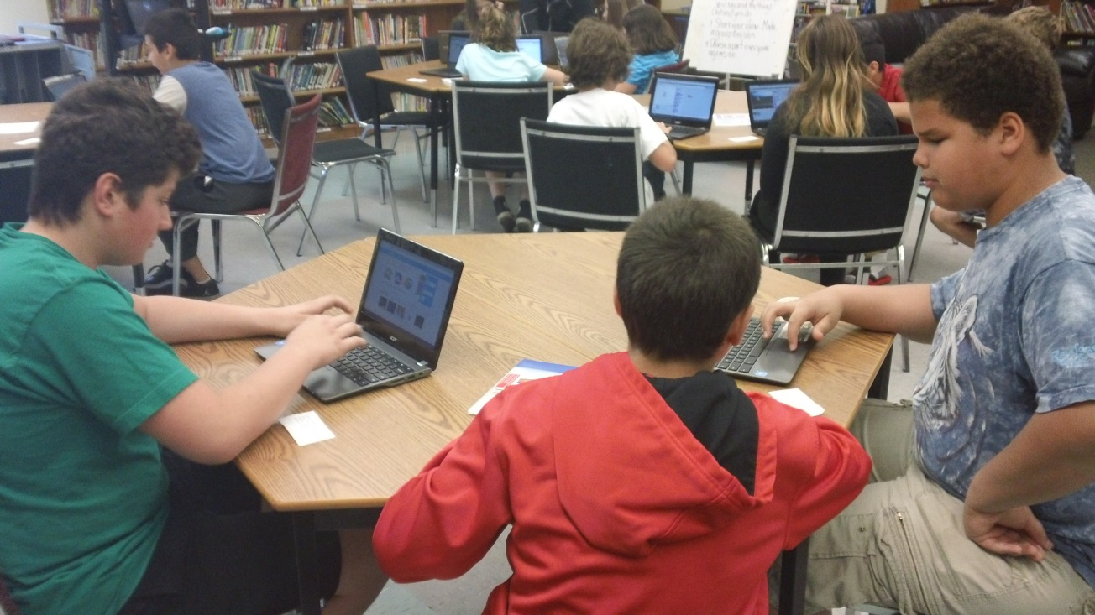
Student Coaches
Developing a
Community of Practice &
21st Century Competencies - Collaboration

Slide 31
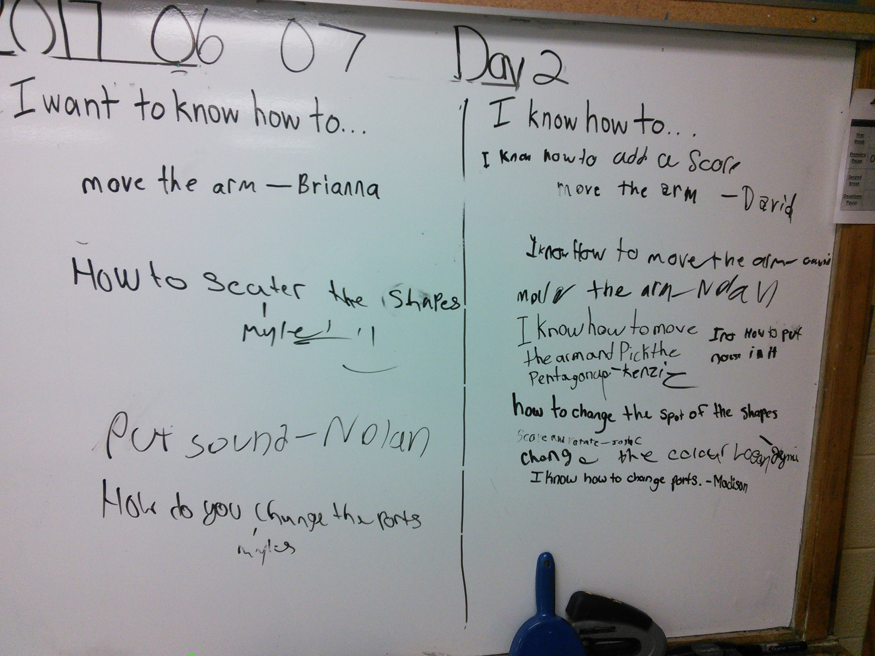

Slide 32
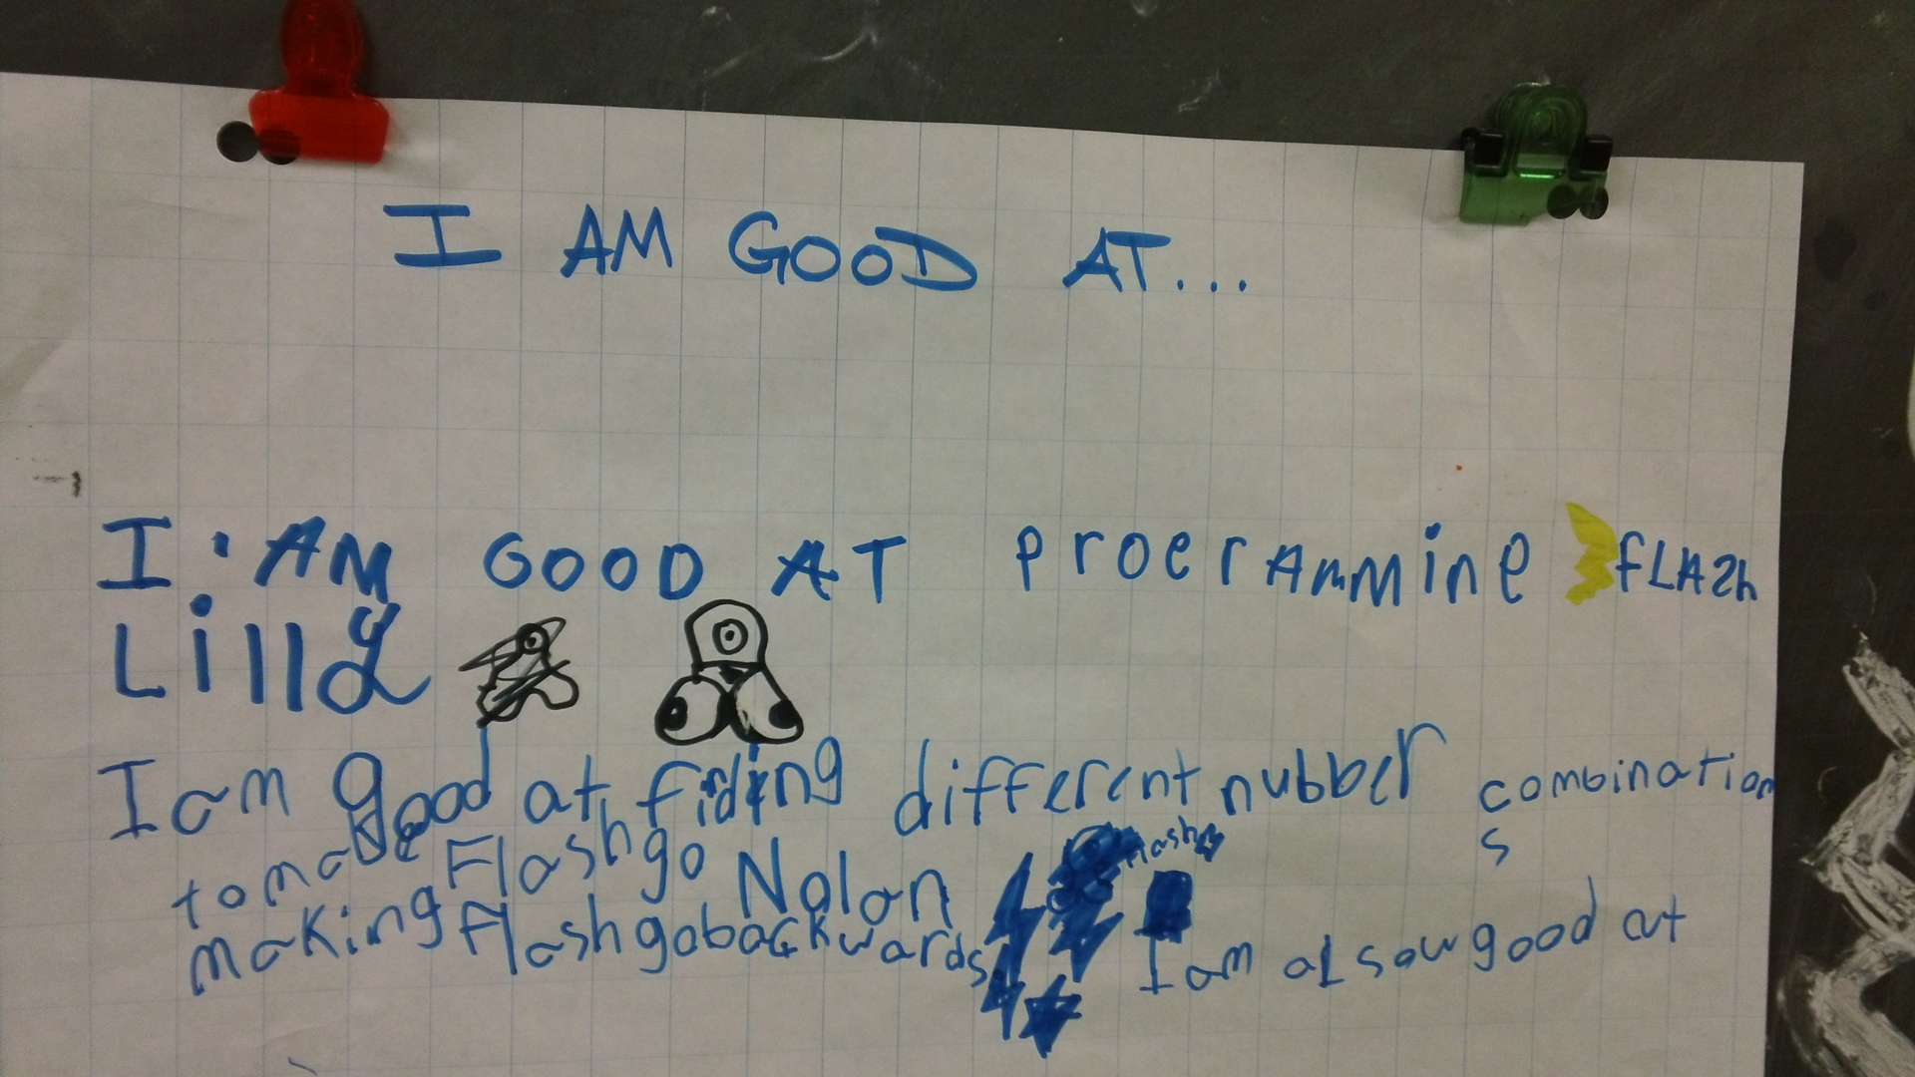

Slide 33
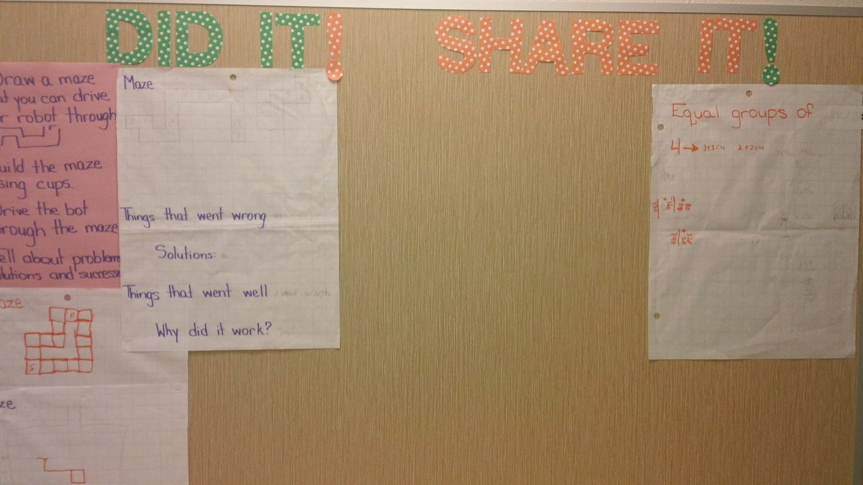

Slide 34
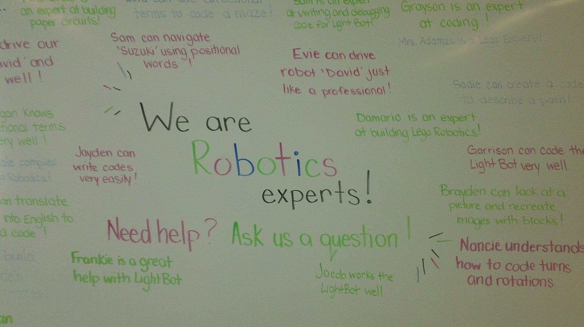

Slide 35
In the end coding isn’t about coding
It is about 21st Century Competencies

Slide 36
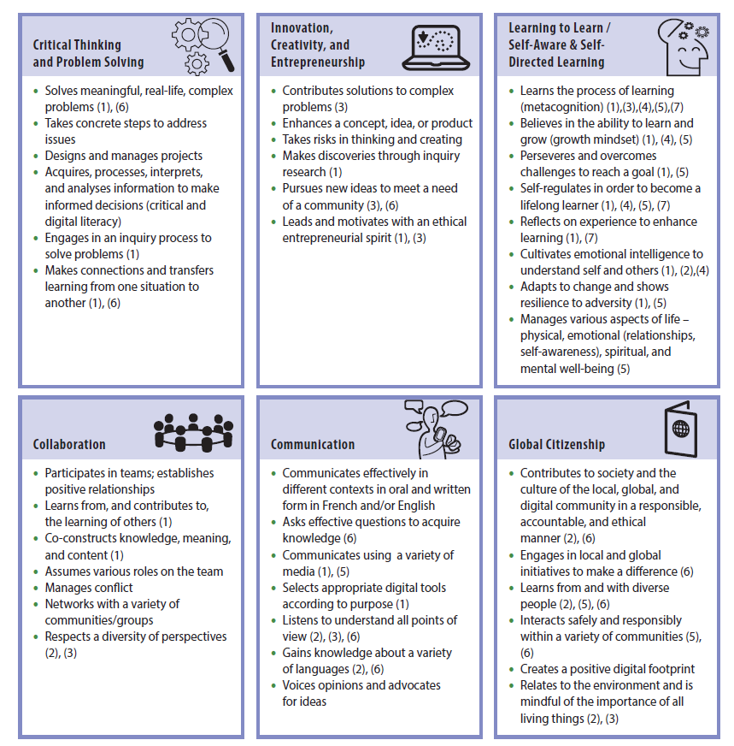

Slide 37
Where can teachers get help? KPSCobraCoders.Weebly.com

