Slide 1
Students can learn Scratch without you getting in their way
Let the Cat out of the bag,
Come learn Scratch
Link to this presentation:
www.KPSCobraCoders.weebly.com
21st Century Learning
Inspire, Inquire, Innovate
August 22, 2017

Slide 2
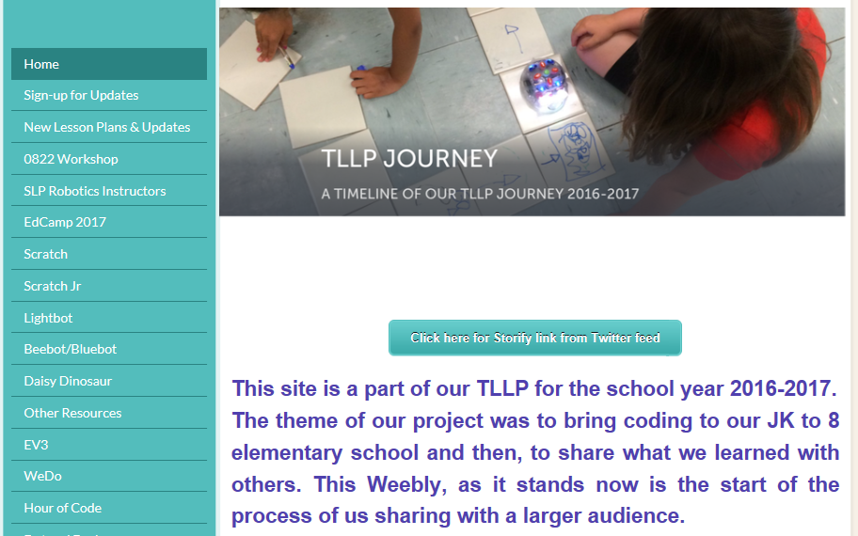
http://kpscobracoders.weebly.com/

Slide 4
The goals of this workshop are:
To provide a practical and informative session for educators who would like their students to code in Scratch but believe they don’t know enough about coding or Scratch to begin
To showcase useful resources for teachers so they know what they could do to start and what they could do to continue coding
To highlight specific student tasks that provide a common foundation for Scratch coding and are accessible for all
To introduce Hour of Code as a preliminary activity to start to understand Block-Based coding

Slide 5
Scratch: https://scratch.mit.edu

Slide 6
How to start your students coding?

Slide 7
All students in our project had experienced Hour of Code activities (https://code.org/learn ) Why? It is a great way to start coding!

Slide 8
Activities for Hour of Code use blocks to code and design coding using popular characters.

Slide 9
http://partners.disney.com/hour-of-code/wayfinding-with-code?cds The goals of the game and each step are clearly identified.

Slide 10
For Moana there are 19 steps, each with simple instructions and limited block choice.

Slide 11
When the blocks are in place the students click Run and watch what happens to the characters in the game.

Slide 12
The program directs the student to try again if the block choice is incorrect …

Slide 13
…or correct and then advances to the next step.

Slide 14
With Hour of Code …
it seemed students didn’t show any sizable connections when transferring block knowledge from one “game” to another and often tried varied combinations of blocks until one “worked”
it seemed students were interested in “beating” the level than learning to code
when students reached the final step (to develop a game) they became easily frustrated and it seemed that final step was too much of a leap from the previous steps
it seemed the gamification factor out-weighed the creativity factor

Slide 15
Hour or Code or Scratch? The answer is BOTH…
Hour of Code is a great way to get started coding
Students START to learn the basics of Block coding but …
With Scratch the creativity aspect dominates over the gaming aspect
Scratch enables students to continue to learn as they create
Scratch enables students to connect to a world-wide community
Scratch enables students to code in the virtual world and the real world (with devices such as Makey Makey and robots such as Mbots)

Slide 16
But before leaving Code.org there are three more activities to check out…

Slide 17
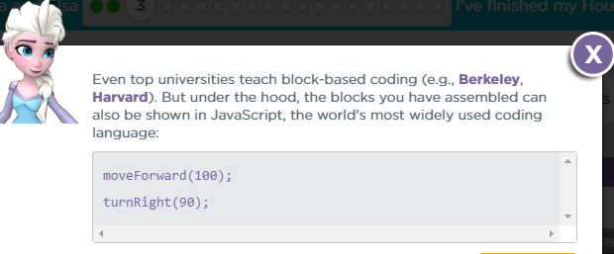
Anna & Elsa activity also shows the JavaScript behind the blocks.
https://studio.code.org/s/frozen/stage/1/puzzle/1

Slide 18
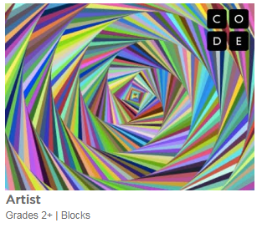
Artist activity is a low floor, high ceiling, & wide wall experience. Not as flashy as some of the others but gives students a chance to be very creative.
Consider it for older students as well.
https://studio.code.org/s/artist/stage/1/puzzle/1

Slide 19
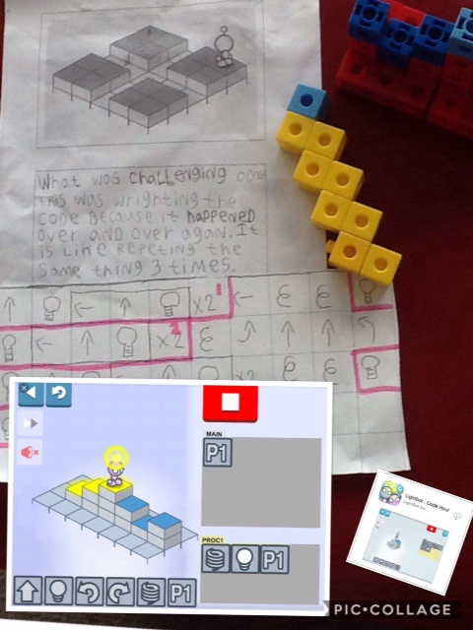
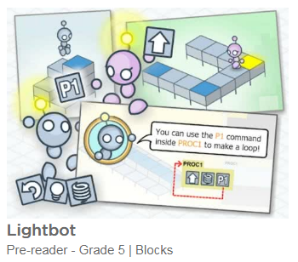
Lightbot is a great activity to build spatial reasoning. Check out the worksheets we have designed to go along with it (at our weebly blog)

Slide 20
What System Requirements and Devices do you need to get started?
Scratch On-line and an Off-line version
Off-line version 1.4
On-line version 2.0 (the file extension is .sb2)
Available on Windows, Mac, or Linux computers, Chrome Books NOT iPads BUT COMING SOON!
Adobe Flash Player (released on or after 06152016
Web Browsers
Internet Explorer 10+ for Windows only
Chrome for Mac, Windows, or Linux
Firefox for Mac or Windows only
Safari Mac or Windows only
Edge for Windows only

Slide 21
What accounts do you need to get started?
Students can create their own accounts before they start or even AFTER they start
Students can share or NOT share their work
But even without an account any Project (work) can be downloaded & saved & then uploaded back into Scratch with either On- or Off-line versions
Teachers can create class accounts
These accounts make it easy for students to see their classmates work
Students can share or NOT share their work

Slide 22
In the past I …
worked with individual students,
worked with students in my own class (small groups) learning to code during class time while the rest of the class were working on language and math activities
worked with students from other classes, training a small group of students & then supervising them as they coached their classmates over 5 or 6 days
worked with students from another school, training small groups of students while the homeroom teacher worked with the remaining 2/3 of the class in ONE day
worked with students from another school, training a small group of students and they coached/trained their classmates while the homeroom teacher worked with the remaining students in one day
Trained adult robotics instructors for GECDSB Camp Wonder
AND THEY ALL STARTED WITH
THE SAME SCRATCH CARD

Slide 23
What resources do you need to do to get started?
Teachers copy off the Create a Story cards in colour - WHY?
Colour print to help students find the correct block because there are 10 categories of blocks in SCRIPTS & several of the colours are close
Suggestion 1 copy for every 2 or 3 students

Slide 24
In all situations here is what I used to start…

Slide 25
Why Scratch Cards and Student Coaches?
In this set of cards (Create a Story Cards) there are 9 tasks students complete and this is a manageable number even if the students complete all in one day
We have found that all our students can complete the tasks either independently or with student coaches (The effectiveness of Student Coaches is one of the concepts we did not consider in our original proposal)
We believe the idea of Student Coaches is key for teachers who want to have their students code but don’t know how to accomplish it
Using these cards ensures that all students have the same basic knowledge and therefore form a learning community to develop tasks beyond the ones described in the cards

Slide 26
The instructions have minimal text making it easy for students to learn simple tasks. Each task is one page long.
Everything they need is on the screen but they must learn to look for it. Stress that the Story Cards were made to be helpful so the information is there – just look!

Slide 27
Students are directed to resources already in Scratch libraries – Backgrounds Sprites

Slide 28
Later they learn how to create their own Sprites and Backdrops:

Slide 29
FYI: Using the device’s camera and/or microphone requires two acceptances

Slide 30
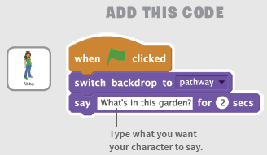
Coding instructions are clear and concise
HINT: At this point I ask students to “read” the blocks so they know what will happen with these blocks …
“When the green flag is clicked, the backdrop will be the pathway and the sprite Abby will have a speech bubble that says, “What’s in this garden?””

Slide 31
Here is the result
Having students talk their way through the coding is an important step
Often problem situations are “debugged” by talking them out to themselves or a peer
Debugging moves from a mistake, wrong, error to “it WILL be fixed
It builds a Community of Practice

